Slide 1
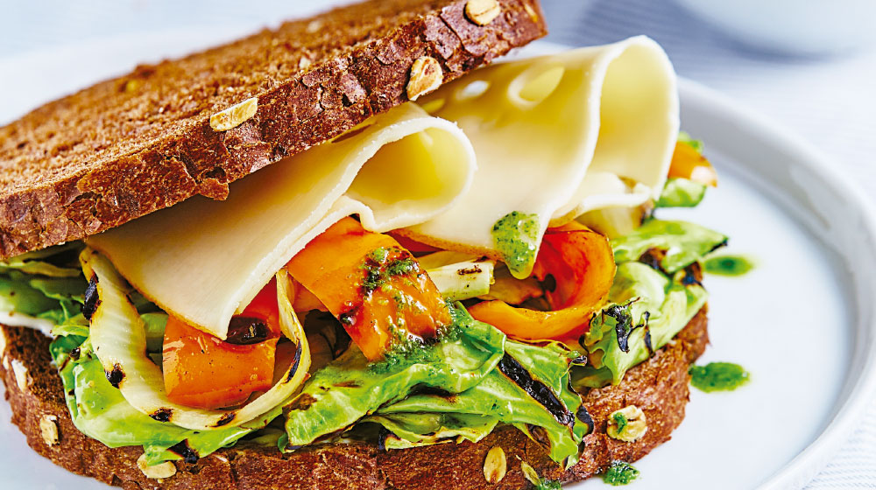
1
2
3
4
5
6
7
8
9
SANDWICH
Notes:
Click on a numbered square to make the square disappear.
Click on the image to reveal it. All the squares will disappear.

Slide 2
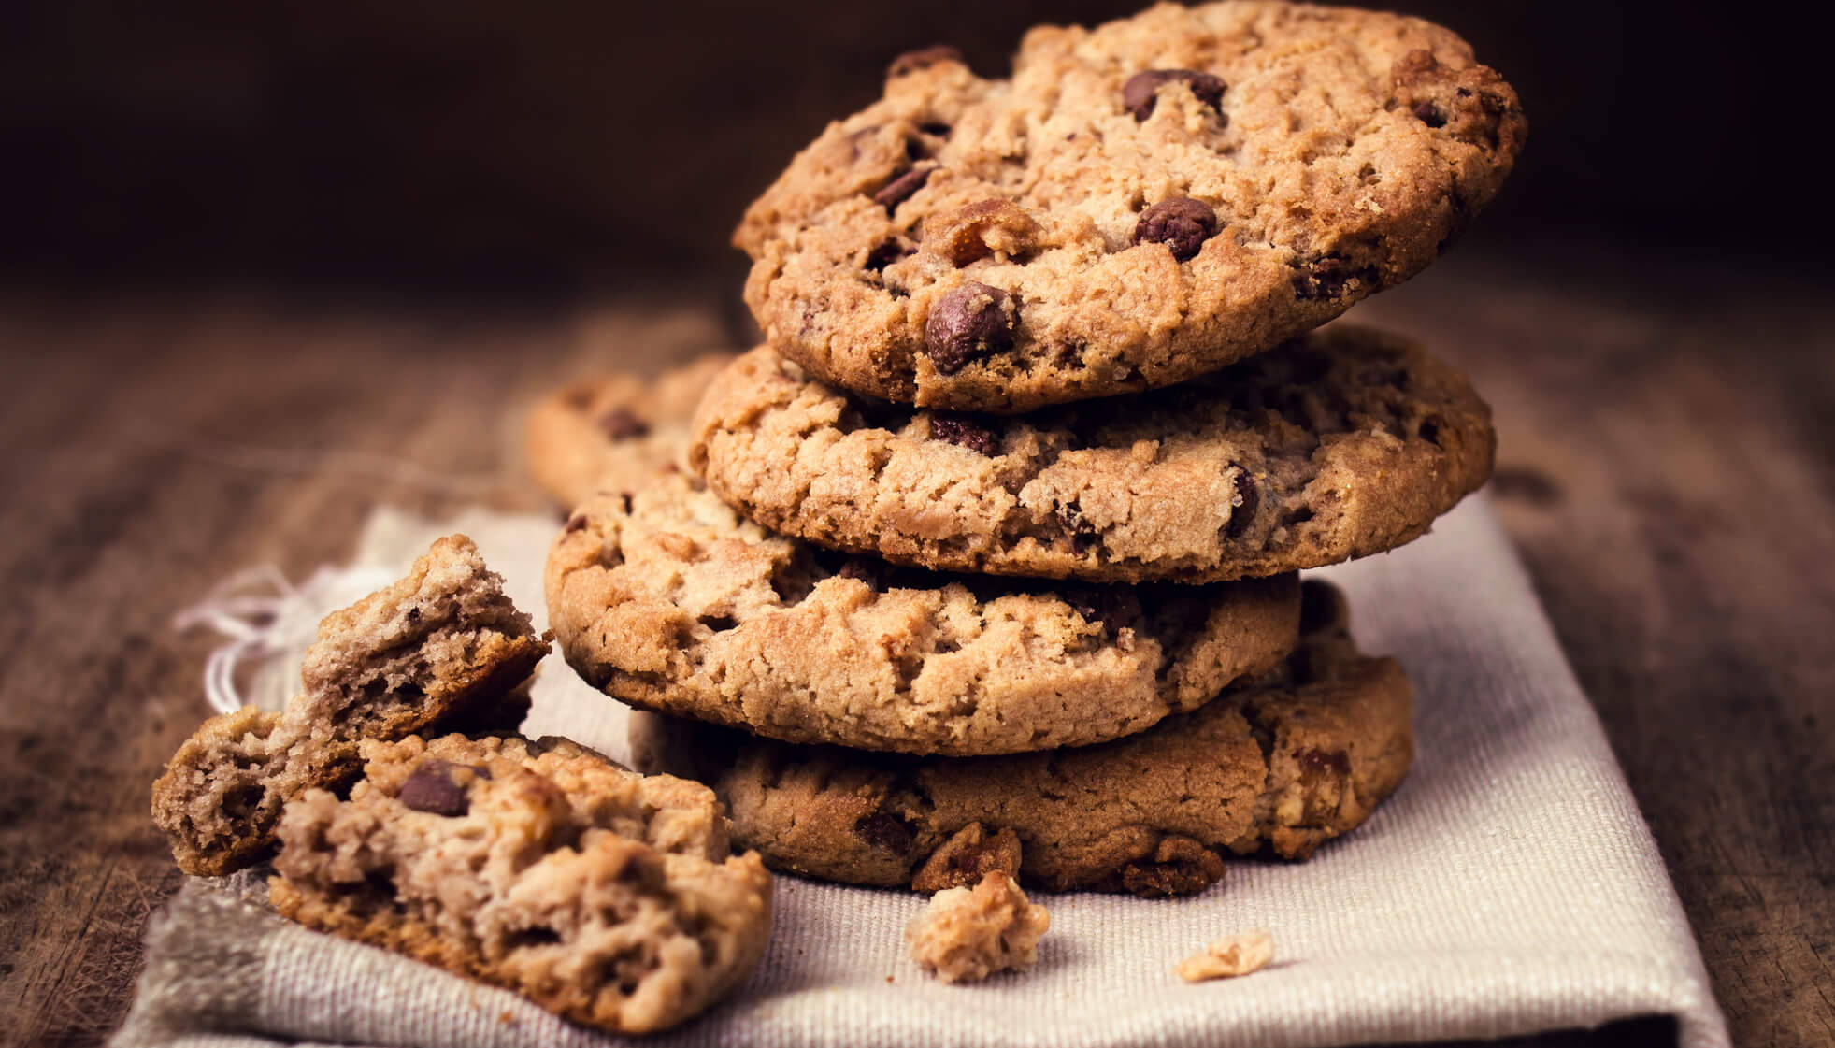
1
2
3
COOKIE
4
5
6
7
8
9
Notes:
Click on a numbered square to make the square disappear.
Click on the image to reveal it. All the squares will disappear.

Slide 3
1
2
3
JUICE
4
5
6
7
8
9
Notes:
Click on a numbered square to make the square disappear.
Click on the image to reveal it. All the squares will disappear.

Slide 4
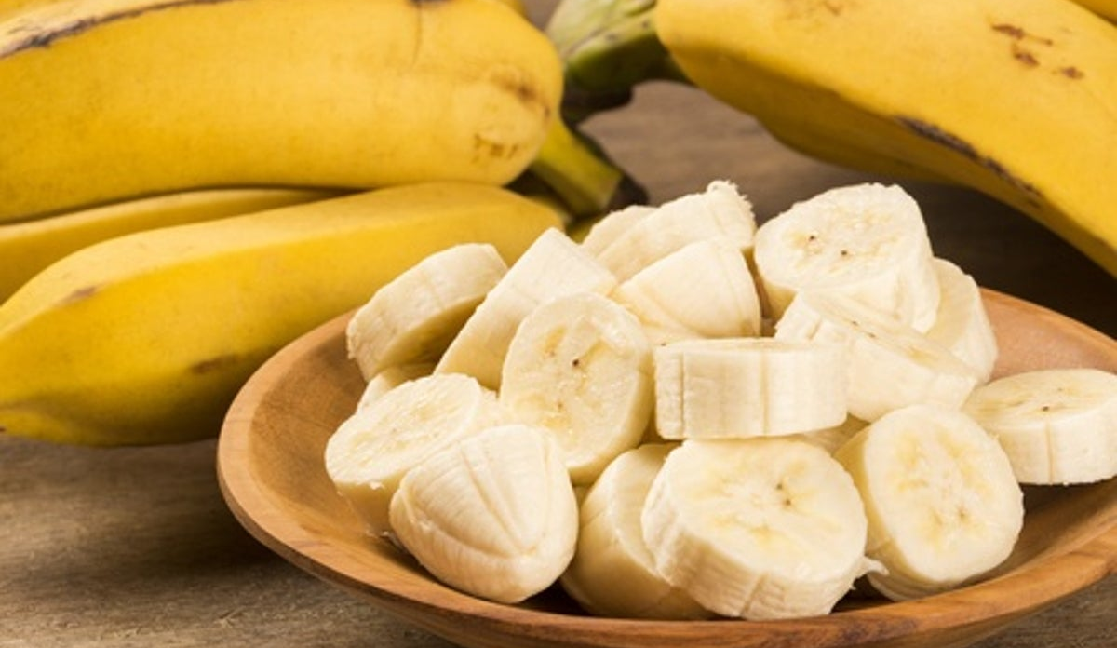
1
2
3
BANANA
4
5
6
7
8
9
Notes:
Click on a numbered square to make the square disappear.
Click on the image to reveal it. All the squares will disappear.

Slide 5
1
2
3
GRAPES
4
5
6
GRAPES
7
8
9
Notes:
Click on a numbered square to make the square disappear.
Click on the image to reveal it. All the squares will disappear.

Slide 6
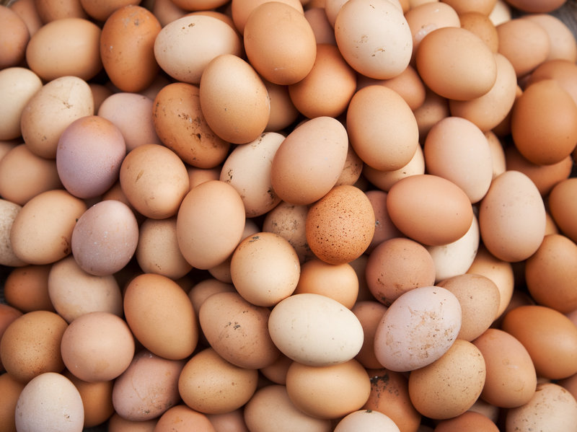
1
2
3
4
EGGS
5
6
7
8
9
Notes:
Click on a numbered square to make the square disappear.
Click on the image to reveal it. All the squares will disappear.

Slide 7
1
2
3
PIZZA
4
5
6
7
8
9
Notes:
Click on a numbered square to make the square disappear.
Click on the image to reveal it. All the squares will disappear.

Slide 8
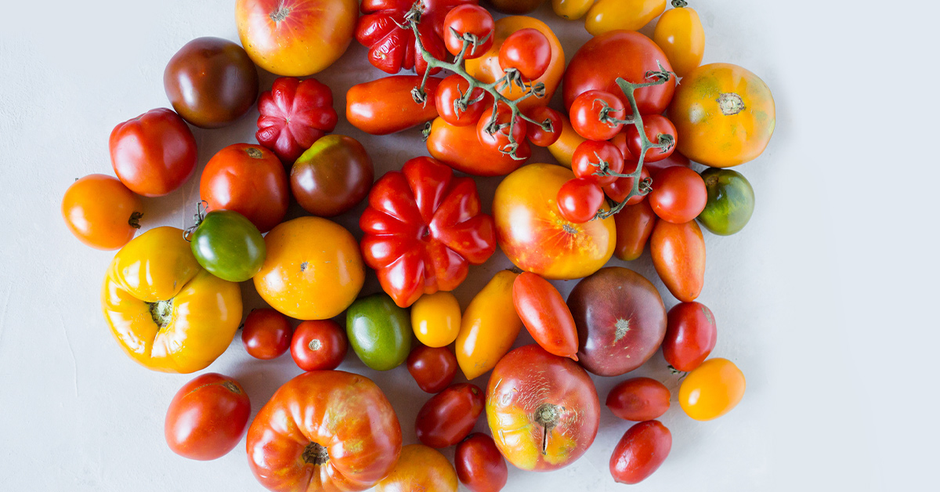
1
2
3
4
5
6
7
8
9
TOMATO
Notes:
Click on a numbered square to make the square disappear.
Click on the image to reveal it. All the squares will disappear.

Slide 9
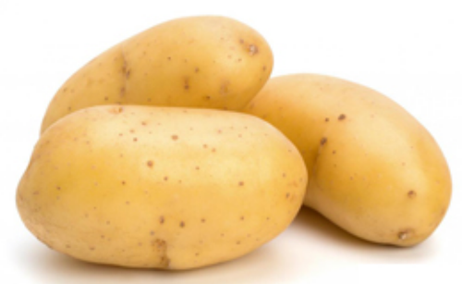
1
2
3
4
5
6
7
8
9
POTATO
Notes:
Click on a numbered square to make the square disappear.
Click on the image to reveal it. All the squares will disappear.

