Slide 1
UNIT 4: PLANTS
PRONUNCIATION
BY TEACHER MERCHE SALGADO

Slide 2
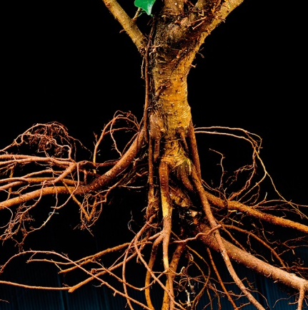
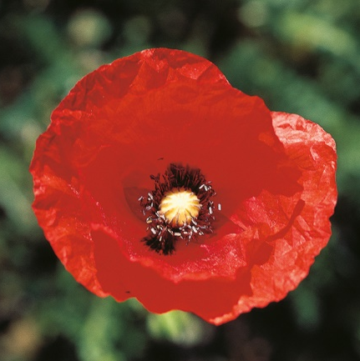
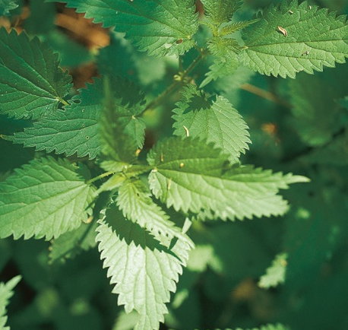
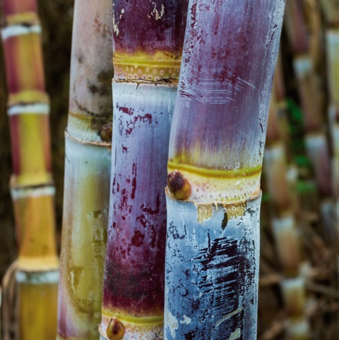
Parts of plants
leaves
stem
roots
flower
1st Listen 2nd Repeat
PRONUNCIATION

Slide 3
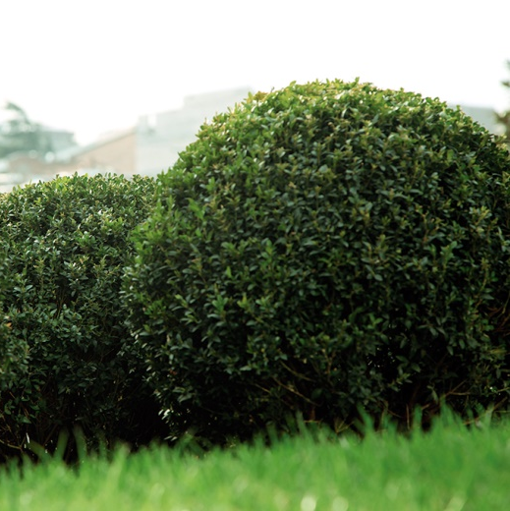
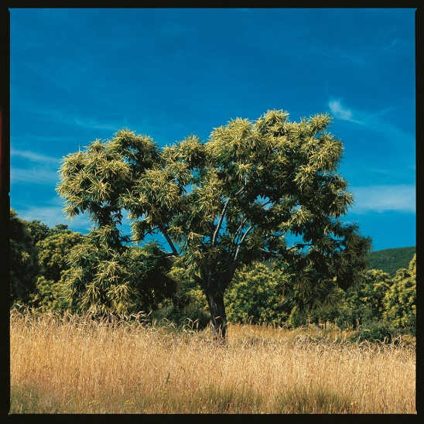
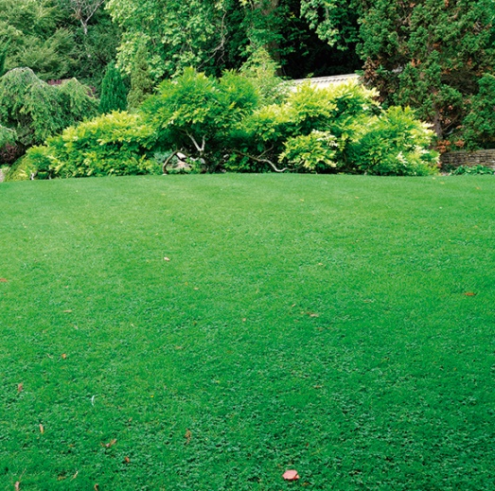
Types of plants
bush
grass
tree
1st Listen 2nd Repeat
PRONUNCIATION

Slide 4
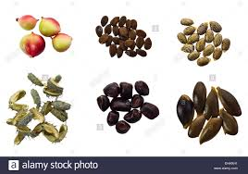
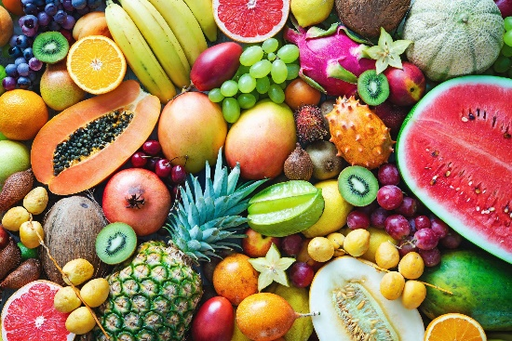
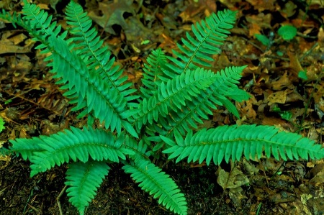
More words
fruits
Non flowering
seeds
1st Listen 2nd Repeat
PRONUNCIATION

Slide 5
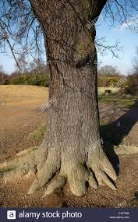
More words
TRUNK
1st Listen 2nd Repeat
PRONUNCIATION

Slide 6
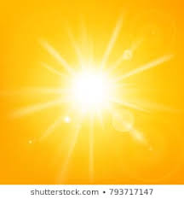
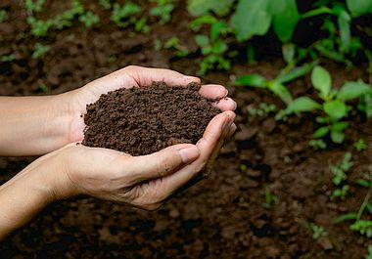
More words
sunlight
soil
air
1st Listen 2nd Repeat
PRONUNCIATION

Slide 7
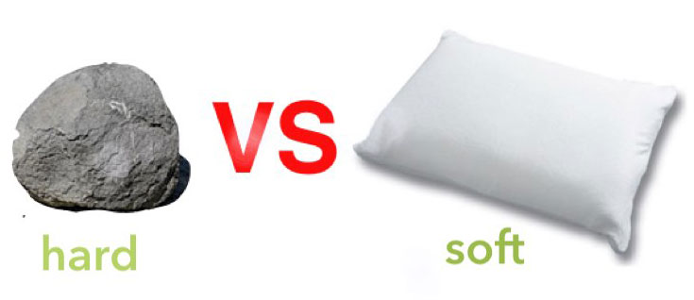
More words
colourful
hard
thick
thin
1st Listen 2nd Repeat
PRONUNCIATION

Slide 8
Other words
takes in
(toma)
Characteristics
(características)
produce
(producen)
Types
(tipos)
holds up
(sujeta)
1st Listen 2nd Repeat
PRONUNCIATION

Slide 9
END OF PART 1.
©MERCHESALGADO

