Slide 1
PERSONAL GROWTH PLAN
Isidro Hernanz Cabilla
Vancover July 2017

Slide 2
TARGET
TO IDENTIFY A COLLECTION OF INDICATORS TO EVALUATE THE PERFORMANCE OF THE LEARNING PROCESS

Slide 3
LEARNING PERFORMANCE INDICATORS
Pisa report
Early school leavers index
Education budget: comparison
CONCLUSION: A CHANGE IS NEEDED
WHY DO WE NEED INDICATORS?

Slide 4
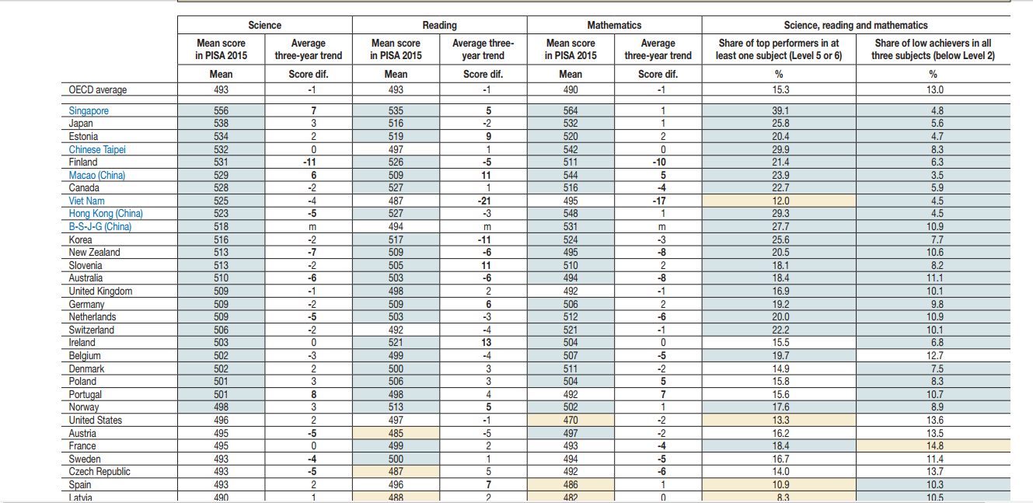
PISA RESULTS
SOURCE: PISA REPORT

Slide 5
Spain: 20% (*)
Canada: 12% (**)
EARLY SCHOOL LEAVERS INDEX
SOURCES:
(*) EUROSTAT
(**) BLUEWATER DISTRIC SCHOOL BOARD

Slide 6
Spain: 6% GDP(*)
Canada: 5.3% GDP(**)
PUBLIC SPENDING IN EDUCATION
SOURCES:
(*) OCDE
(**) WORLD BANK

Slide 7
Traditional approach: focus on contents
New approach: focus on competencies. Example: PBL
CHANGE IN METHODOLOGY
WHY DO WE NEED INDICATORS?

Slide 8
How do we kwow whether or not the change works?
We need achievement indicators
ACHIEVEMENT INDICATORS
WHY DO WE NEED INDICATORS?

Slide 9
Any concept that can be quantified and is meaningful into the learning process
WHAT IS AN ACHIEVEMENT INDICATOR?
SO WHAT?

Slide 10
Achievement indicators must be:
Complete
Quantifiable
Related to the developing competencies
Objective
Classifiable
ACHIEVEMENT INDICATORS FEATURES
SO WHAT?

Slide 11
Example
COMMUNITY BUILDING INDICATORS

Slide 12
COMMUNITY BUILDING INDICATORS
As a starting point, three groups of indicators:
1. STATISTICS
1.1. Statistics from students regarding other students:
Number of physical offenses reported
Number of physical offenses confirmed
Number of verbal offenses reported
Number of verbal offenses confirmed
Number of bullying cases reported
Number of bullying cases confirmed
As an important issue in the learning process, the social ambience of the school must be monitorized

Slide 13
COMMUNITY BUILDING INDICATORS
1.2. Statistics from students regarding teachers:
Number of disrespectful attitudes reported
Number of disrespectful attitudes confirmed
1.3. Statistic from teachers regarding students:
Number of disrespectful attitudes reported
As an important issue in the learning process, the social ambience of the school must be monitorized

Slide 14
COMMUNITY BUILDING INDICATORS
2. SURVEYS
2.1. Surveys on students about themselves
2.2. Surveys on students about classmates
2.3. Surveys on students about their own teachers
2.4. Surveys on students about other student teachers
As an important issue in the learning process, the social ambience of the school must be monitorized

Slide 15
COMMUNITY BUILDING INDICATORS
3. SYLABUS
3.1 Percentage of the final mark dependant on the attitude or behaviour
As an important issue in the learning process, the social ambience of the school must be monitorized

Slide 16
NEXT STEPS
Enlarge the number of indicators available. The more indicators, the better analysis
Analyse the indicators in a rational way to get conclusions on what must be reviewed
Create a report of general performance in the basis of these indicators, correcting the influence of each one on the basis of the experience
Explore the posibility of using achievent indicators as a new assesment criteria for students
This is only the starting point. Next steps would be…

Slide 17
Any questions?
THANKS!

Slide 18
By the way… My family

