Slide 1
Present Perfect 2nd part
UNIT 7
(PAGES 71, 73)

Slide 4
Present Perfect - Structure
ALREADY
JUST
(acabar de)
(ya)
+ yet. (todavía, aún)
?
?
+ yet
(todavía,
aún)

Slide 5
Present Perfect – Structure
Examples
I have already made the posters. (Yo ya he hecho los pósters.)
She has just made a cake. (Acabo de hacer una tarta.)
ALREADY
JUST
I haven´t served the drinks yet.
(Yo todavía no he servido las bebidas)
yet
?
Have you cleaned the forniture yet?
yet

Slide 7
yet
already
yet
yet
already
yet

Slide 9
No, I haven´t served the drinks yet.
Yes, I have already asked my mum.
No, I haven´t made the posters yet.
Yes, I have already sent the invitations.

Slide 11
found
finished
visited
seen
bought

Slide 12
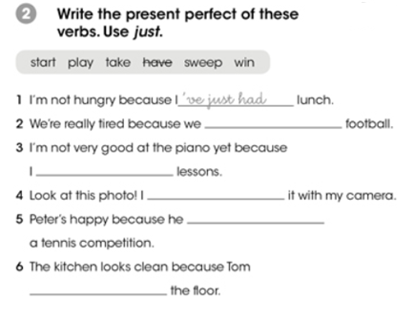

Slide 13
´ve just played football
´ve just started
´ve just taken a picture
has just won
has just swept

