Slide 1
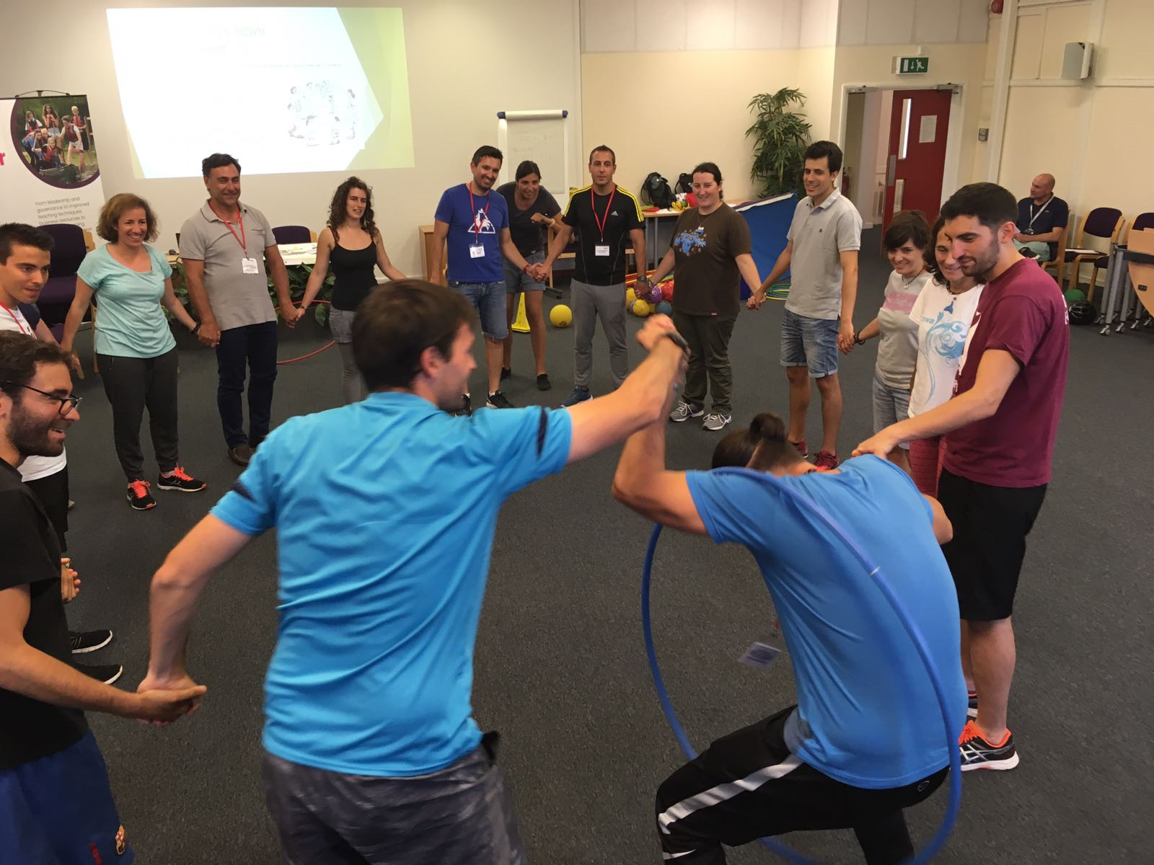
COOPERATIVE GAMES
Ana de la Cruz Ortiz
FINAL PROJECT
IN-30

Slide 2
WHY COOPERATIVE GAMES?
Have you heard about cooperative games? Cooperative games are games based on cooperation rather than competition. They are all based on the principle that it can be just as much fun—well, actually more fun—to play with each other than against each other!
Introducing cooperative games at the beginning of the course will be a fantastic way to create the perfect atmosphere in our P.E lessons.
The following cooperative games and initiative games are designed to require students to work and cooperate with one another, in order to solve a problem or succeed as a team

Slide 3
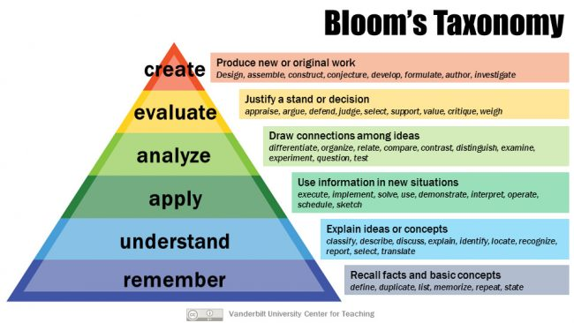
BLOOM´S TAXONOMY
This project is based on Bloom´s taxonomy.
You will find question related with CLIL methodology to help the learning progress of our pupils.

Slide 4
DIDACTIC UNIT
UNIT: 1
GRADE: YEAR 4
NUMBER OF SESSIONS: 5
SESSION: 3

Slide 5
OBJECTIVES
To create a positive and warm atmosphere in the P.E class
To comunicate with the group to come to an agreement.
To develop cooperative attitudes in team games.

Slide 6
CONTENTS
Team building games
Strategies to solve situation / Communication skills
P.E introductory activities

Slide 7
ASSESSMENT CRITERIA
To be able to contribute to the development of a positive atmosphere in the class.
To be able to cooperate in team games
To be able to known and respect the classroom rules materials and facilities.

Slide 8
SESSION
PARTS OF THE SESSION | TIME | MATERIALS
WARM UP Sardines in a can | 10 MIN | Whistle / Dice
MAIN PART Crossing the river Mat surfing | 15 MIN 15 MIN | 4 mats, 4 hula hoops,
COOL DOWN Pass the hula hoop Cartepillar race | 7 MIN 7 MIN | - 2 hula hoops - 25 balloons
CONCLUDING ACTIVITY | 4 MIN | - Digital board

Slide 9
KEY WORDS
WHISTLE
CAN OF SARDINES
MATS
SLIDE
HOLD HANDS
CARTEPILLAR
RACE
RELAY

Slide 10
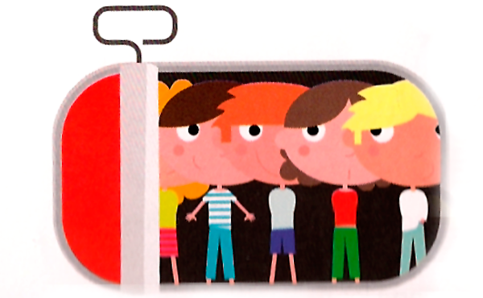
WARM UP
SARDINES IN A CAN:
- Students are running around the gym. When the whistle sounds you have to organize in groups of (2,5,7,3)….depending of the number that the teachers announces.
Variations: laying on the floor, standing in a balanced position, holding a member of the team (not allow to touch the floor)…
Mixed teams

Slide 11
CLIL QUESTIONS WARM UP
SARDINES IN A CAN
Did you find it difficult to run and join a group?
Could you tell me a variation for this game?
What could we do with the person that does not make it into a group?
Instead of using a whistle what else could we use to say the number?

Slide 12
MAIN PART
CROSSING THE RIVER
Working with your team trying to cross to the other side of the gym without touching the floor. You are going to have 2 mats per team.
4 teams playing
Rules:
- You CANNOT touch the floor with your FEET.
- If you touch the floor with your FEET everyone in the team must count to 10 as a penality before continuing.
- You have to get to the other side of the gym.
- The teams have to work together to get to the other side as quick as possible.

Slide 13
MAIN PART
MAT SURFING
- 4 of the mats used in the previous game are the only material needed.
Rules:
- Each team has a mat. The first team member in the line has to slide on the mat. So you have to jump on the mat so that it slides along the floor like you are surfing.
- Then you have to run back and tag your teammate like a relay.
- It goes on until you get the mat to the cone that is set on the midfield line

Slide 14
CLIL QUESTIONS MAIN PART OF THE SESSION
CROSSING THE RIVER
What kind of strategies have you used to solve the task?
What else could have you tried in order to be more efficient?
What kind of role do you think you played during the game?
Did you share your opinion with your group?
MAT SURFING
What kind of variation could we introduce?
What kind of jumping technique did you/ could you use to slide more each time ?

Slide 15
COOL DOWN
PASS THE HULA HOOP
2 teams of 12 students
Rules:
Holding hands in a circle. They have to pass through the hula hoop as quick as they can, in order to fininsh.
The first team who finishes gets a point.
- Variations:
We can also use two hula hoops at the same time.
Play in a big group.
Challenge: timing – They have 1 minute to finish.
-

Slide 16
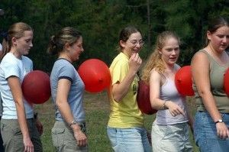
COOL DOWN
THE CARTEPILLAR RACE
4 teams
Rules:
- In between each player is a balloon and they must get to the finish line without dropping their balloon.

Slide 17
CLIL QUESTIONS COOL DOWN
PASS THE HOOP
Could you do the whole round in less than 1 minute?
CHALLENGE!!!
What will happen if we introduce two hula hoops?
Whay is the easiest way to pass through the hula hoop?
Could you show me?
THE CARTEPILLAR RACE
What do you think wwould be better? To run quick / slow?
How can you all manage to coordinate together?

Slide 18
CONCLUDING ACTIVITY
At the end of the lesson, we all go to the class room to watch a fun short film related to the games we have been playing.
https://www.youtube.com/watch?v=snqFX6NFeX8
Also we will introduce the IDIOM OF THE DAY:

Slide 19
BIBLIOGRAPHY
Physical Education in Bilingual Projects, Antonio Ortiz Calvo 2013
www.thepespecialist.com
http://corwin-connect.com
http://www.learningforlife.org/exploring/resources/99-720/x08.pdf

