Slide 1
HUMAN IMPACT IN THE ENVIRONMENT.
FORESTS

Slide 2
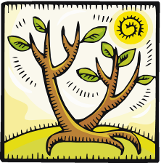
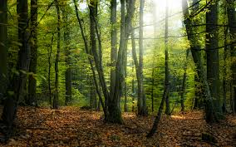
Forests
A forest is any area with a lot of trees. There are forests all over the world.
There are different types of forests
Notes:
There are different types of forests

Slide 3
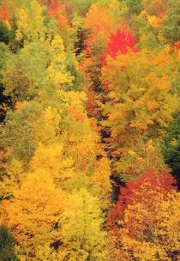
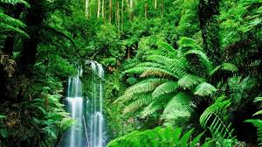
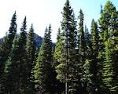
TYPES OF FORESTS
The type of forest varies depending on the location of the forest: for example, there are tropical rain forests, coniferous forests, and deciduous forests.
Notes:
TYPES OF FORESTS! DECIDUOUS They have warm, wet summers and cold winters. They have Maple and Oak trees. The large flat leaves that drop down each fall grow back each spring. The trees that lose and regrow leaves are called deciduous. They change colors when leaves drop. The species found in these forests include shrubs, mosses, ferns, insects, spiders, snakes, frogs, birds, rabbits, deer, and bears. TROPICAL RAIN They are found in Hawaii and Costa Rica. They are hot and wet all year. The leaves stay green all year. There are more living things that live here compared to any other forest. The animals and plants live from top to ground. The species include lizards, rodents, and frogs. COASTAL It is thick with tall trees. It is not too warm or cold. There is a lot of rain. The species include flying fox and Pemba Green pigeon. CONIFEROUS They have very cold winters and cool summers. Conifers have seeds in cones and needle-like leaves. A few examples include pines and spruces. They stay green all year which is why they are called Evergreen. They get less rain comparatively but the sharp needles prevent them from losing water. They are shaped like triangles which prevents snow from piling up on branches. They have lakes and streams. The species include squirrels, moose, wolves, insects, and flies.

Slide 4
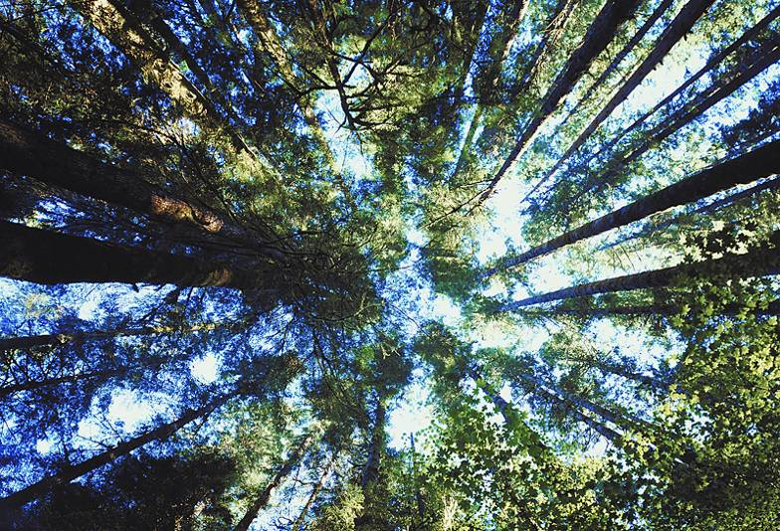
Forests
Forests occur naturally, but they can be affected positively and negatively by human behavior.

Slide 5
FORESTS
If a forest is carefully replanted and allowed to grow, it can exist in balance.

Slide 6
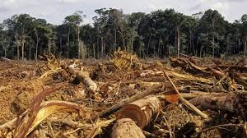
FORESTS
If the forest is cut down faster than it can grow back, then it will be used up quickly.
Notes:
<iframe width="560" height="315" src="https://www.youtube.com/embed/y1vQAWmduM4" frameborder="0" allow="autoplay; encrypted-media" allowfullscreen></iframe>

Slide 7
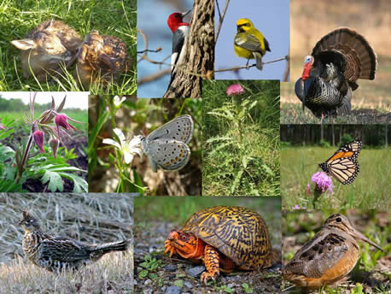
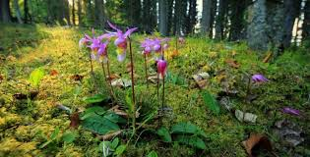
FORESTS
Forests serve as home to many of the organisms that live on the land.

Slide 8
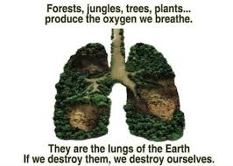
FORESTS
Forests are also very important because they are major contributors to recycling and cleaning the world supply of oxygen.

Slide 9
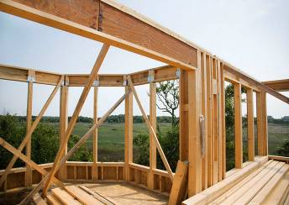
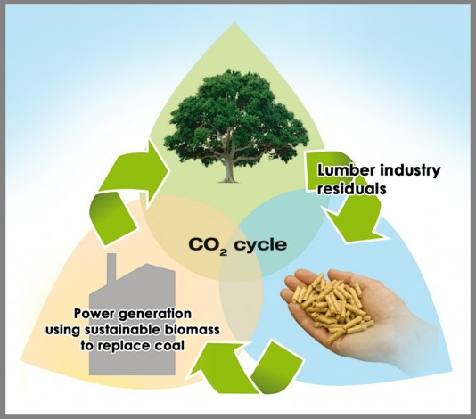
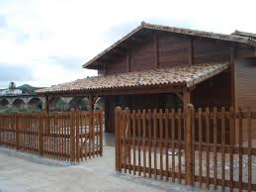
FORESTS
Forests also provide wood, which is useful both as a construction material and as a fuel source.

Slide 10
HUMAN IMPACT IN THE ENVIRONMENT
<a rel="license" href="http://creativecommons.org/licenses/by-sa/4.0/"><img alt="Licencia de Creative Commons" style="border-width:0" src="https://i.creativecommons.org/l/by-sa/4.0/88x31.png" /></a><br /><span xmlns:dct="http://purl.org/dc/terms/" href="http://purl.org/dc/dcmitype/MovingImage" property="dct:title" rel="dct:type">Human Impact in the Environment</span> is licensed under a <a rel="license" href="http://creativecommons.org/licenses/by-sa/4.0/">Creative Commons Reconocimiento-CompartirIgual 4.0 Internacional License</a>.
Notes:
<a rel="license" href="http://creativecommons.org/licenses/by-sa/4.0/"><img alt="Licencia de Creative Commons" style="border-width:0" src="https://i.creativecommons.org/l/by-sa/4.0/88x31.png" /></a><br /><span xmlns:dct="http://purl.org/dc/terms/" href="http://purl.org/dc/dcmitype/MovingImage" property="dct:title" rel="dct:type">Human Impact in the Environment</span> is licensed under a <a rel="license" href="http://creativecommons.org/licenses/by-sa/4.0/">Creative Commons Reconocimiento-CompartirIgual 4.0 Internacional License</a>.

