Slide 1
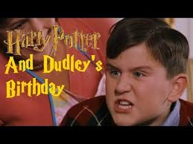
Written by: Ana, Nacho and Soco

Slide 2
Objectives
Level: 1st ESO
To learn new vocabulary and to recycle alredy known one.
To think about not being greedy.
To talk about personal experiences.
To learn to identify key words in a text.
To learn to express themselves and to communicate successfully with others not only through verbal language.
To talk about feelings.
To accurately describe a picture of family birthday party.
To write a birthday card to a friend.
Final: To role-play the video they have been working with and record it.

Slide 3
Pre-watching activities
1. Activating knowledge
Elicit several questions: What happens to you every year? What do you celebrate every year? Possible answers: Christmas, Birthdays, anniversaries, ... After someone mentioning Birthday we ask them to talk to their partner for 3 minutes about what they usually do to celebrate their birthday.
The teacher randomly chooses three students presenting their partner's birthday.

Slide 4
Two volunteers write on the board key words related to celebrating birthdays while their peers are giving their presentations:
-Birthday cards - Cake - Trips - Bands - Gifts/presents - invitations -Drinks - Food - Balloons - Streamers - Wrapping paper - Snacks -Party poppers - Fancy dress party -Swimming pool party - Going to the movies or a theme park

Slide 5
Pre-watching activities
2. Teaching visually vocabulary from script.
Matching images with the right words.
lightning-bolt shaped knocking raps Smacks giggle rags vast amount stares warning funny business

Slide 6
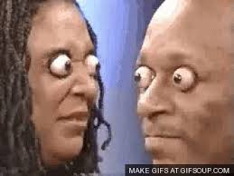
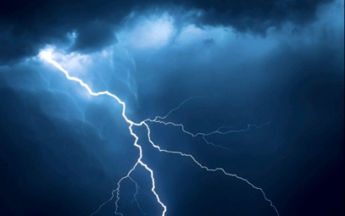
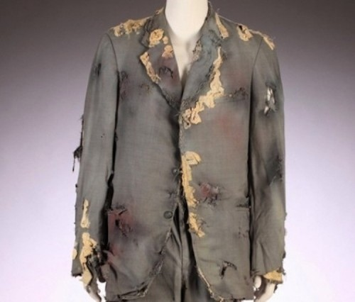
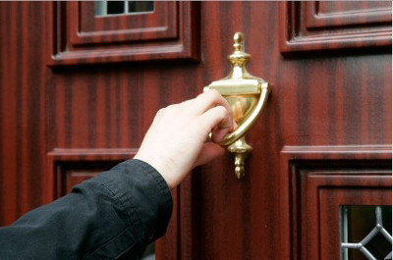
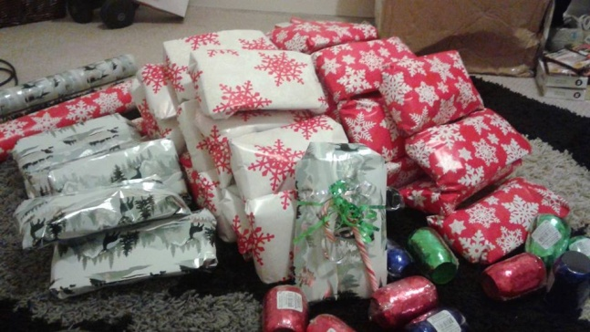
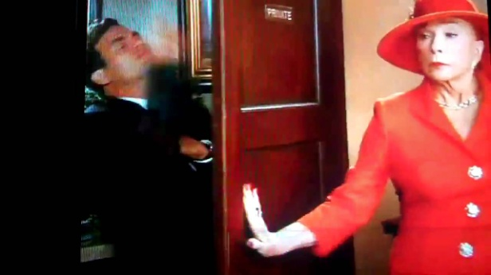
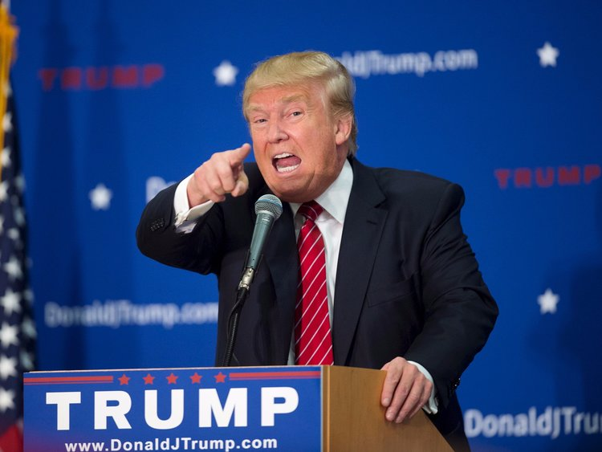
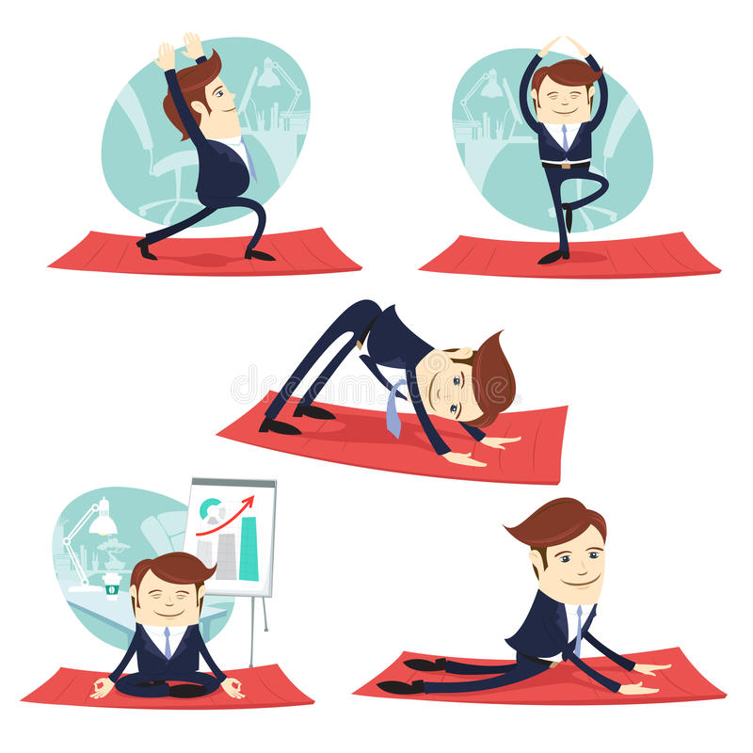
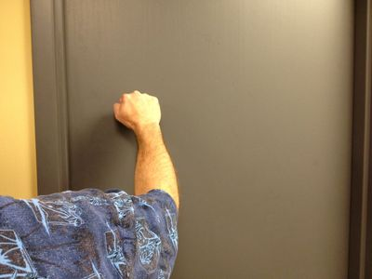

Slide 7
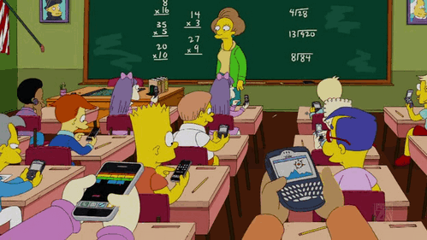
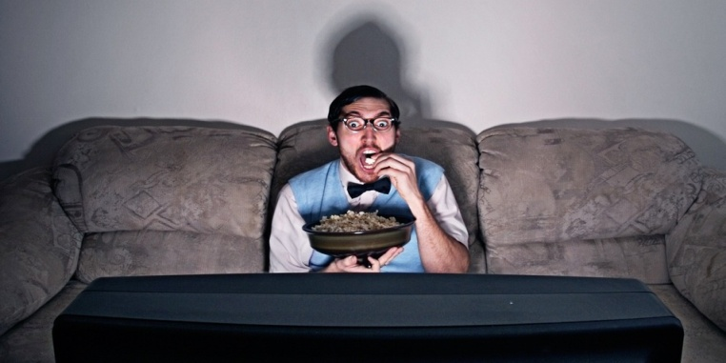
Watching: Watch both videos and decide which one contains all the words we have just learnt.
https://www.youtube.com/watch?v=GHXSvCMpCGM
https://www.youtube.com/watch?v=50N2eB0JI80

Slide 8
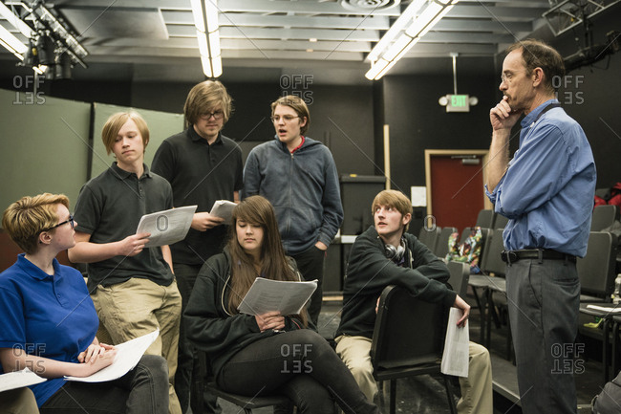
Reading the script
The students read the script and afterwards they watch and listen the video at the same time. They can listen to it a couple of times.

Slide 9
HARRY POTTER AND THE PHILOSOPHER'S STONE
Almost ten years after the: DURSLEY's home. The camera pans on a sleeping boy, almost eleven, with a lightning-bolt shaped scar on his forehead.
There is a click, and knocking. Outside, a tall woman, PETUNIA DURSLEY, raps the door.
Petunia: Up. Get up. {Knocks} {sighs} Now! {Smacks door of closet which is the boys bedroom}
A large, tubby boy, DUDLEY DURSLEY, suddenly comes running down the stairs above the closet. He stops half-way down and goes back, jumping on the staircase.
Dudley: Wake up, cousin! We're going to the zoo!
Dudley laughs, comes down the stairs and runs for the kitchen. The boy, HARRY POTTER, tries to come out of the closet, but is pushed back in by Dudley.
Petunia is in the kitchen, where Dudley has gone.
Petunia: Oh, here he comes, the birthday boy!
A larger man, VERNON DURSLEY, is sitting at the kitchen table.
Vernon: Happy birthday, son.
Petunia and Dudley giggle together. Harry comes into the kitchen, dressed in rags.
Petunia: Why don't you just cook the breakfast, and try not to burn anything.
Harry: Yes, Aunt Petunia.
He sets to work.
Petunia: I want everything to be perfect for my Dudley's special day.
Vernon: Hurry up! Bring my coffee, boy!
Harry: Yes, Uncle Vernon.
Petunia leads Dudley over to the family room, where there are a vast amount of presents. Dudley stares.
Dudley: How many are there?
Vernon: Thirty-six. Counted 'em myself.
Dudley: Thirty-six?! But last year last year I got thirty-seven!!
Vernon: Yes, well, some of them are quite a bit bigger than last year!
Dudley: I don't care how big they are!
Petunia: Oh, now, now, now. This is what we're going to do, is that when we go out we're going to buy you two new presents! How's that, Pumpkin?
Scene:
Outside, morning. The happy family is heading to the car. Harry goes to get in but is stopped by Vernon.
Petunia: This will be a lovely day at the zoo. I'm really looking forward to it.
Vernon: I'm warning you now, boy. Any funny business, any at all, and you won't have any meals for a week. Get in.

Slide 10
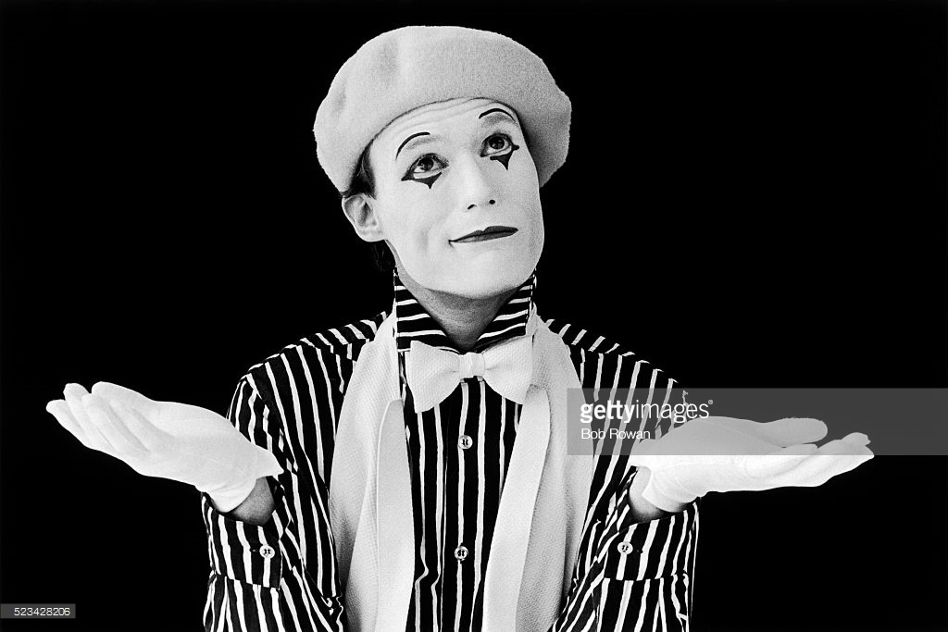
While reading:
While the teacher reads the script with the group he/she mimes key events.

Slide 11
HARRY POTTER AND THE PHILOSOPHER'S STONE
Almost ten years after the: DURSLEY's home. The camera pans on a sleeping boy, almost eleven, with a lightning-bolt shaped scar on his forehead.
There is a click, and knocking. Outside, a tall woman, PETUNIA DURSLEY, raps the door.
Petunia: Up. Get up. {Knocks} {sighs} Now! {Smacks door of closet which is the boys bedroom}
A large, tubby boy, DUDLEY DURSLEY, suddenly comes running down the stairs above the closet. He stops half-way down and goes back, jumping on the staircase.
Dudley: Wake up, cousin! We're going to the zoo!
Dudley laughs, comes down the stairs and runs for the kitchen. The boy, HARRY POTTER, tries to come out of the closet, but is pushed back in by Dudley.
Petunia is in the kitchen, where Dudley has gone.
Petunia: Oh, here he comes, the birthday boy!
A larger man, VERNON DURSLEY, is sitting at the kitchen table.
Vernon: Happy birthday, son.
Petunia and Dudley giggle together. Harry comes into the kitchen, dressed in rags.
Petunia: Why don't you just cook the breakfast, and try not to burn anything.
Harry: Yes, Aunt Petunia.
He sets to work.
Petunia: I want everything to be perfect for my Dudley's special day.
Vernon: Hurry up! Bring my coffee, boy!
Harry: Yes, Uncle Vernon.
Petunia leads Dudley over to the family room, where there are a vast amount of presents. Dudley stares.
Dudley: How many are there?
Vernon: Thirty-six. Counted 'em myself.
Dudley: Thirty-six?! But last year last year I got thirty-seven!!
Vernon: Yes, well, some of them are quite a bit bigger than last year!
Dudley: I don't care how big they are!
Petunia: Oh, now, now, now. This is what we're going to do, is that when we go out we're going to buy you two new presents! How's that, Pumpkin?
Scene:
Outside, morning. The happy family is heading to the car. Harry goes to get in but is stopped by Vernon.
Petunia: This will be a lovely day at the zoo. I'm really looking forward to it.
Vernon: I'm warning you now, boy. Any funny business, any at all, and you won't have any meals for a week. Get in.

Slide 12
After reading and watching:
Whose birthday is it?
Where are they going?
What’s the present Dudley likes the most?
What does Dudley complain about?
When do Dudley and his dad shout at each other?
What does Dudley’s mom promise him?

Slide 13
Explain why Dudley’s mum calls him Pumpkin.
Explain why Harry is warned.
What’s the effect of the expression “funny business”?
What’s the effect of the expression “happy family”?

Slide 14
How would you feel if you were Harry Potter/Dudley?

Slide 15
Speaking
Activity 1: Picture dictation
Students were told to bring a picture of one of their birthday parties with their families.
In pairs, they have to describe the picture they brought to their partner for him to draw it.
Afterwards, they swap roles.

Slide 17
Roleplay
Activity 2: Let’s go into acting: In groups of four choose a character among Harry, Dudley, Petunia and Vernon and play this scene. Students will record the role-play at home and then will share it with the teacher. A lesson could be devoted to watch and comment all the different role-plays.

Slide 18
Writing
BIRTHDAY CARD
My dear Harry, (heading)
After so many years of our close friendship, I would like you to have the best birthday ever. (wish)
You are great fun and you are always by my side. We will be friends forever. Do not forget you can rely on me!!! (body)
No much more to say on your day. Enjoy life today and keep sharing time with me. (closing)
Happy Bithday!!!
Your best friend (signature)

Slide 19
WRITING TASK:
Students write, following the model given, a birthday card to one of their friends.

