Slide 1
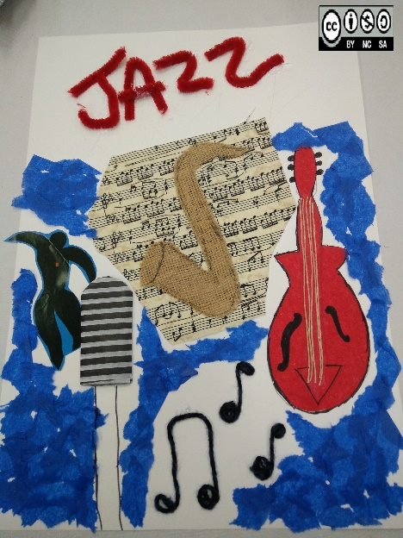
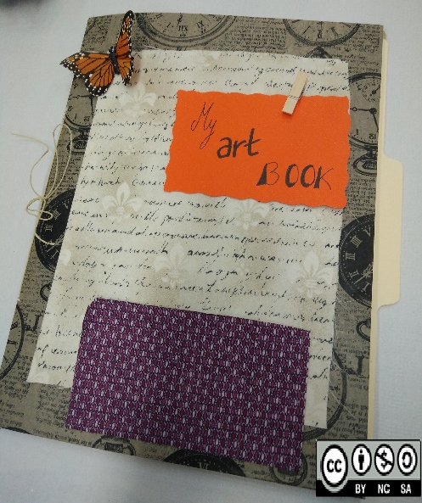
MUSIC AND VISUAL ARTS IN THE PRIMARY CLASSROOM
FINAL PROJECT:
“Route to the 50´s”

Slide 2
Final project
TITTLE: “Route to the 50´s”
SUBJECT AREA: My lesson plan is focused in the English area, but it also covers Geography, Music and Arts.
STAGE: Primary Education
GRADE: 4th -5th Grade
Objectives:
Get to know a famous 1950s song and the Singer.
Motivate the students with already known characters.
Learn about culture and geography of EEUU.
Let the students express themselves in an artistic way.
Promote English speaking activities
CONTENTS:
Song “Route 66” by Chuck Berry
Cities in Route 66 in EEUU
Adjectives
Past tense

Slide 3
ACTIVITIES
Session | ACTIVITY NUMBER | WHERE? | TIMING | DESCRIPTION | RESOURCES
0 | 1 | At home | 1h 30 min. | Students will be asked to watch the film “CARS” | DVD
1st (45 min) | 1 | School | 10 min | SPEAKING: Talk about the film, focusing on the route 66. I will ask some questions to encourage speaking
 | 2 | School | 10 min | Introduce Chuck Berry briefly And a playlist of 1950s | PRESENTATION Playlist (Page 5)
 | 3 | School | 15 min | ENGLISH LISTENING: Song “Route 66” Chuck Berry Students will listen to the song three times. They will fill in the gaps to complete the lyrics with the names of the cities. (I will write down the name of the cities on the board) | Youtube video https://youtu.be/tg2EbJy-9dc Song Lyrics worksheet (Page 6)
 | 4 | school | 10 min | Check themselves | Youtube video: https://youtu.be/508dn0u75JQ

Slide 4
Session | ACTIVITY NUMBER | WHERE? | TIMING | DESCRIPTION | RESOURCES
2nd (45 min) | 1 | School | 5 min | Review song from previous day to remind them about the cities in EEUU
 | 2 | School | 10 min | GEOGRAPHY: Present a map on the board with the route 66. (Page 7) | Images from Internet/pinterest
 | 3 | school | 25 min. | ARTS PROJECT: students will make a booklet about the cities that are connected through the route 66. (Page 8) | Different art materials: scissors, papers, tissue paper, feathers, glue, celo tape, …
3rd (45 min) | 1 | School | 10 min. | Students will be asked to talk about their booklets, describing what they did the previous day using the past and some adjectives.
 | 2 | School | 10 min. | WRITING: Students will form groups and they will invent a poem choosing 4 of the cities | Paper and pens
 | 3 | School | 20 min. | ARTS: Students will make a collage related to the poem from the previous activity. | Different materials and magazines.

Slide 5
CHUCK BERRY AND THE 50´S MUSIC
Charles Edward Anderson "Chuck" Berry born Oct 18, 1926 is an American guitarist, singer and songwriter, one of the pioneers of rock and roll music. His lyrics are focused on teen life.
50´s Playlist
Great Balls of Fire (Jerry Lee Lewis)
Route 66 (Chuck Berry)
In the Mood (Glenn Miller)
Teddy Bear (Elvis Presley)
The Twist (Chubby Checker)
La Bamba (Richie Valens)
Be my baby (The Ronettes)
Never on Sunday (The Chordettes)
California Dreaming (The mamas and The Papas)
Pinterest picture

Slide 6
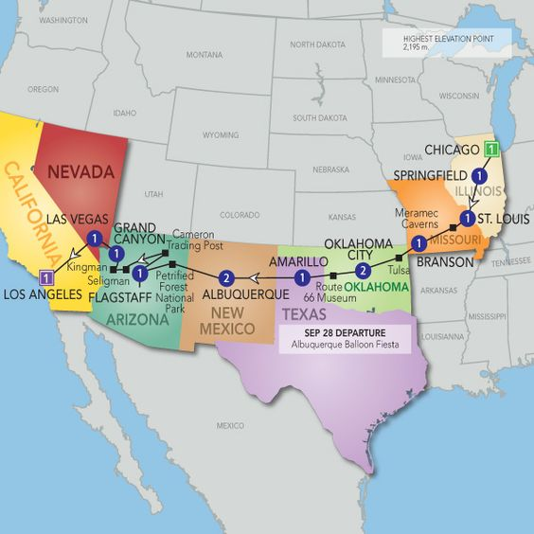
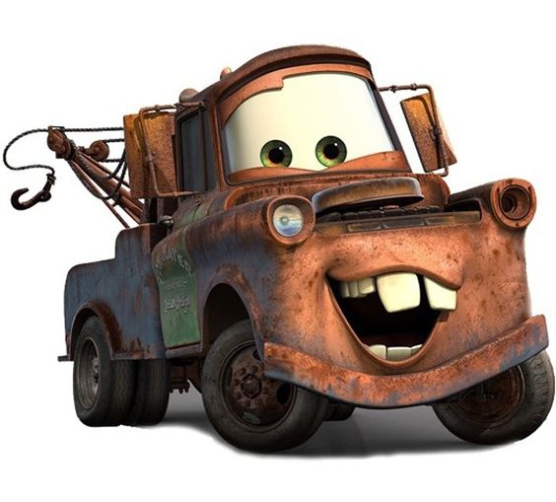
“Route 66 “ lyrics
Well if you ever plan to motor west
Just take my way it's the highway that's the best
Get your kicks on Route 66
Well it winds from Chicago to L.A.
More than 2000 miles all the way
Get your kicks on Route 66
Well it goes from St Louis, down to Missouri
Oklahoma city looks oh so pretty
You'll see Amarillo and Gallup, New Mexico
Flagstaff, Arizona don't forget Winona
Kingsman, Barstaw, San Bernadino
Would you get hip to this kindly trip
And take that California trip
Get your kick on Route 66
It goes from St. Louis, down to Missouri
Oklahoma city looks oh so pretty
You'll see Amarillo and Gallup, New Mexico
Flagstaff, Arizona don't forget Winona
Kingsman, Barstaw, San Bernadino
Would you get hip to this kindly trip
Take that California trip
Get your kicks on Route 66
Get your kicks on Route 66
And I'll meet you on Route 62
Get your kicks on Route 66
Pinterest picture
Pinterest picture

Slide 7
ROUTE 66 MAP

Slide 8
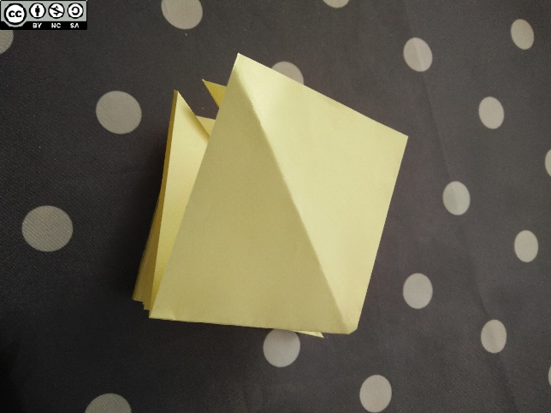
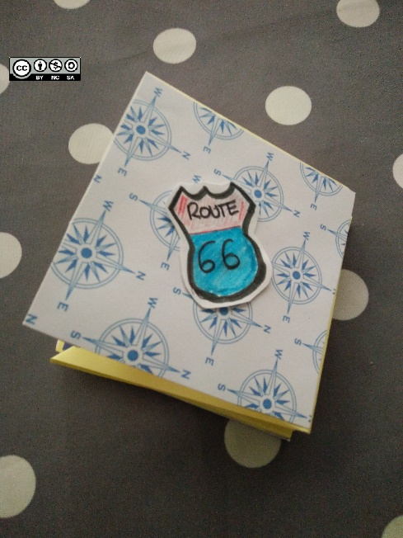
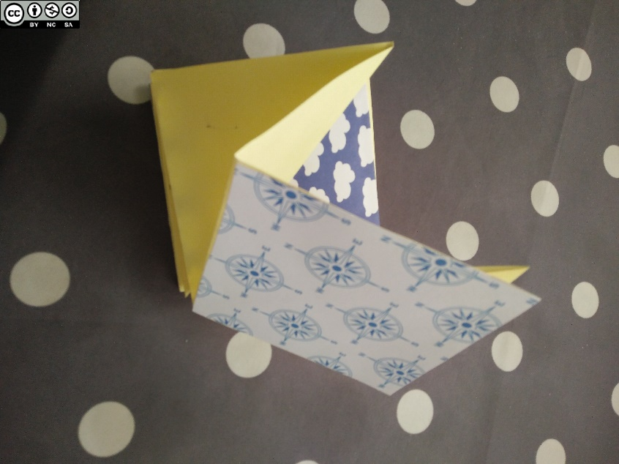
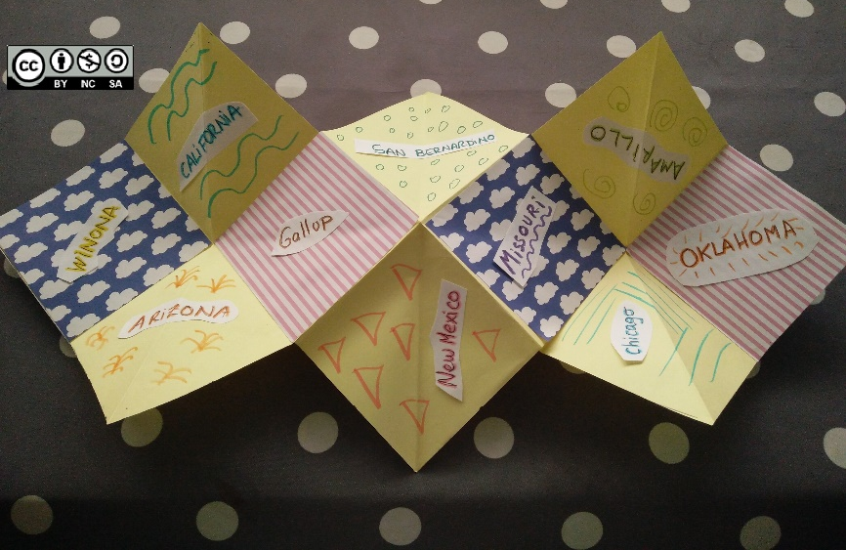
ARTS PROJECT

Slide 9
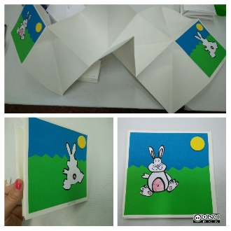
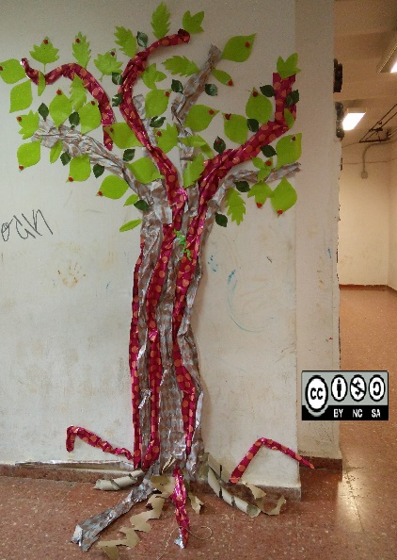
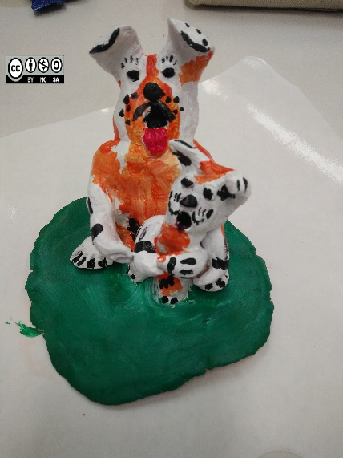
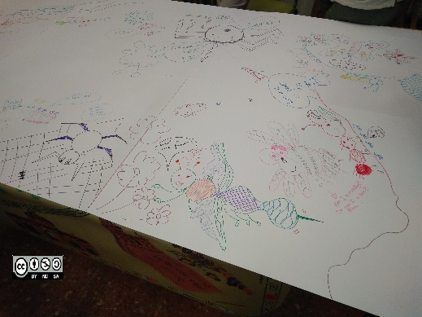
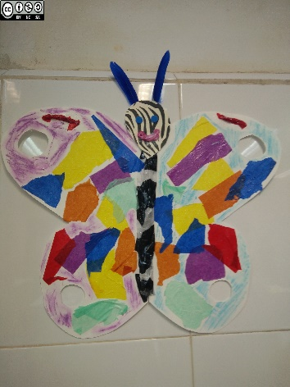
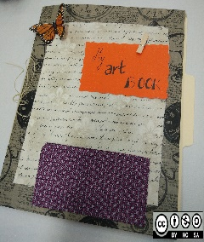
MEETING MY EXPECTATIONS
This course has been very interesting. It has given us lots of tools to integrate music and visual arts in the English classroom.
He have learnt about jazz, blues and other types of music and it has been very motivating. Regarding to arts, we have learnt how to use the arts session in order to improve the students speaking skills.
These are some of the thing we have done during the course:

Slide 10
Most of the pictures from this Project are taken from Pinterest and google , some are personal.

