Slide 1
Conditionals
“If you win the lottery, what is the first thing you would buy? “

Slide 2
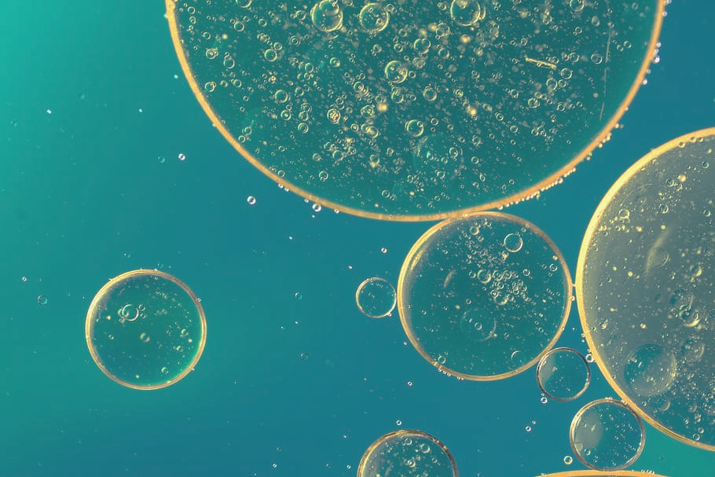
Sentences with “if” possibilities
Something that is always true or was always true in the past.
Zero conditional
If you pour oil on water, it floats.
Example:
*** Present simple in both parts of the sentence ***

Slide 3
2. (First Conditional)
Probable
It might happen in the future:
If I win €100, I will take you to Paris.
If I pass the exam, Ill go to medical school.
Present tense after “if”, future tense in main clause.

Slide 4
3. Second conditional
Improbable
It is unlikely to happen in the future:
If I won €100, I would take you to Paris.
If I passed the exam, I would go to medical school.
Past simple after if, conditional tense in the main clause.

Slide 5
Review & Examples
Zero conditional
Always true (past or present)
2. First conditional
Probable (future)
3. Second conditional
Improbable (future)

Slide 6
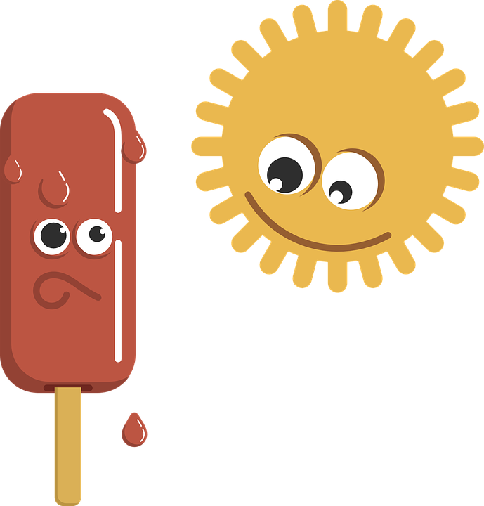
Examples:
Zero conditional:
If you heat ice, it melts.
If it rains,the grass gets wet.
If people eat too much, they get fat.

Slide 7
Examples:
First conditional:
If I have enough money, I’ll buy some new shoes.
If I study today, I’ll go to the party tonight.
She’ll miss the bus if she doesn’t leave soon.

Slide 8
Examples:
Second conditional: examples:
I would tell you the answer, if I knew what it was.
If I had enough money, I would buy a castle.
If I were you, I’d quit smoking.

