Slide 1
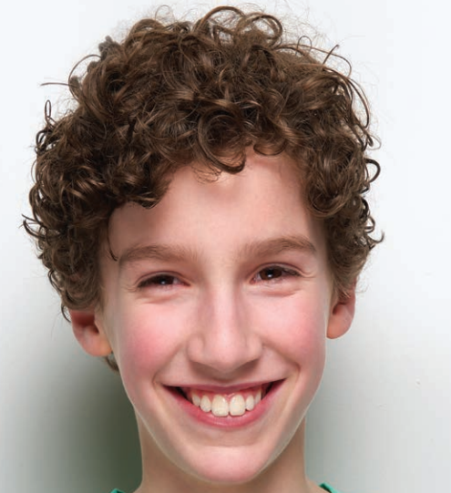
What does he look like?
He has got curly hair.

Slide 2
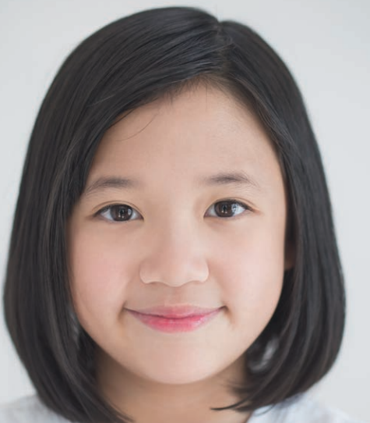
What does she look like?
She has got short straight hair.

Slide 3
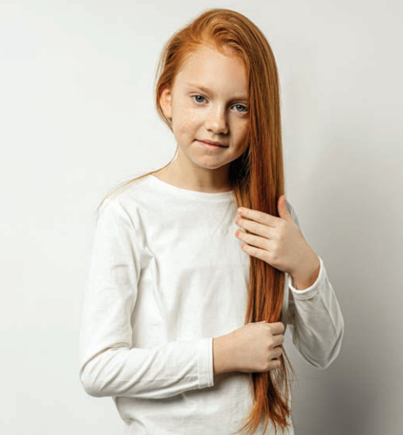
What does she look like?
She has got long red hair.

Slide 4
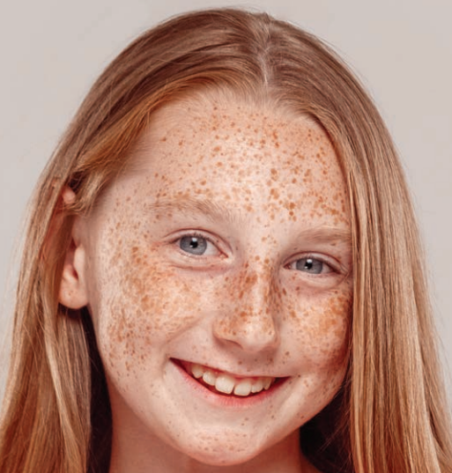
What does she look like?
She has got freckles.

Slide 5
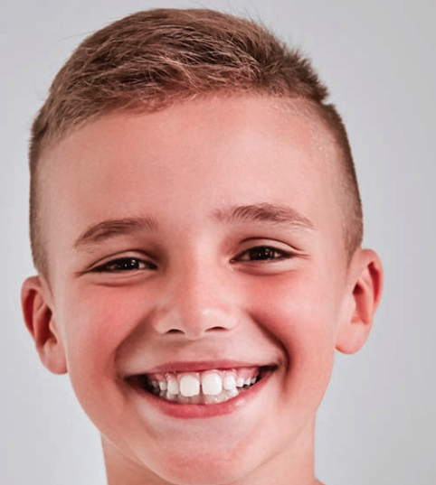
What does he look like?
He has got short hair.

Slide 6
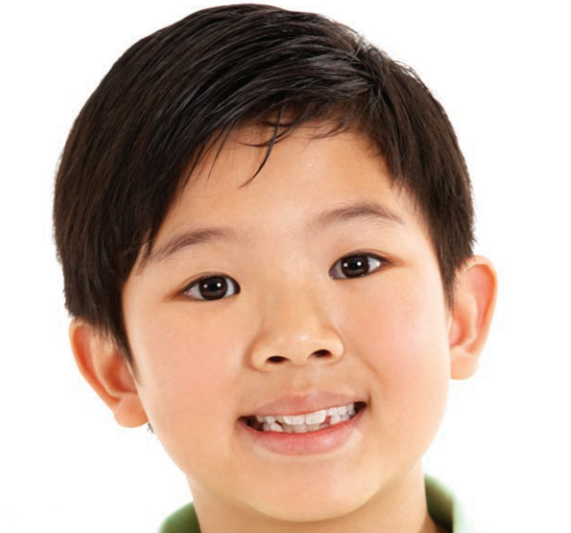
What does he look like?
He has got short dark hair.

Slide 7
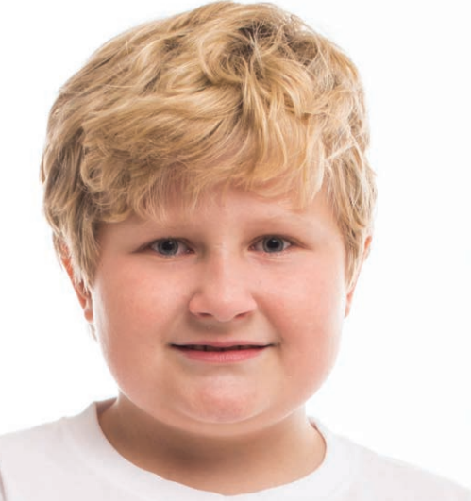
What does he look like?
He has got short fair hair.

Slide 8
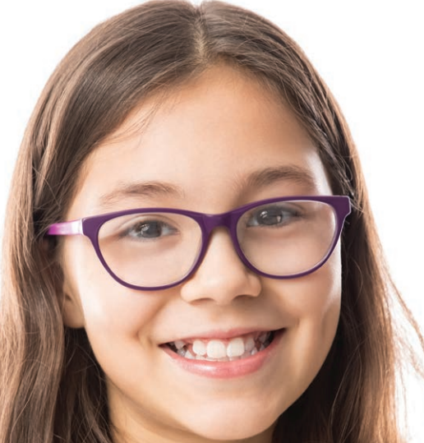
What does she look like?
She has got/ wears glasses.

