Slide 1
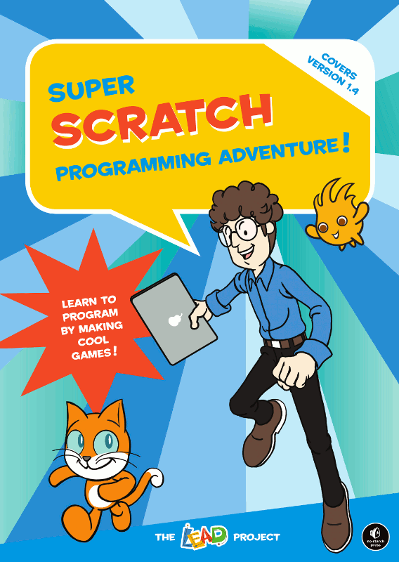
Mission: design a Virtual interactive tour guide with scratch
Ester Torices Serrano

Slide 2
The lesson plan is in the following link

Slide 3
Play while students are settling in.
Video: Classic Sesame Street animation-Bus Stop Sign Tour
https://www.youtube.com/watch?v=pVX1ZXFPqyk&ab_channel=MonsterpieceTheatre

Slide 4
Play while students are settling in.
Video: Top 5 Scratch Games
https://www.youtube.com/watch?v=9drwiPhf1Vw&ab_channel=CodeTeacher

Slide 5
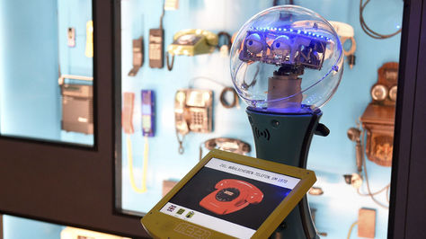
Let’s Begin . . .
Students will work in teams of 2 or 3 people

Slide 6
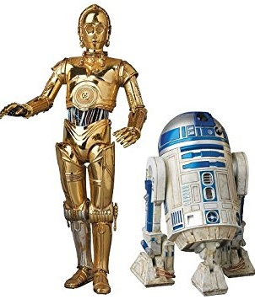
Plan for the month. . . .
Mission 1 | Look for 6 images about Madrid. They have to be exclusive. So the fastest team will get their images. Prepare the images for the Scratch scree size.
Mission 2 | Make the collage with GIMP. The tour should start with the collage as the main backdrop.
Mission 3 | The character should be able to interact with the user via speech bubbles, and the user has to be able to enter responses.
Mission 4 | The user should choose where they want to start the tour and the way to select the places.
Mission 5 | When the user selects a place, the picture associated with it should become the backdrop and some information, which you are going to find, will be presented on the screen.
Notes:
Background music to engage

Slide 7
Plan for the month. . . .
Mission 6 | Create a counter to make sure that the ‘tourist’ visits all the ‘places’ and if they repeat one the counter shouldn´t increase the account number.
Mission 7 | When the user has finished the tour, a quiz will start.
Mission 8 | Design the quiz. Be creative and original.
Mission 9 | The tour guide should let the user know if the answer is right or wrong. Show the quiz score.
Mission 10 | Present the Interface to other teams.
Notes:
Background music to engage

Slide 8
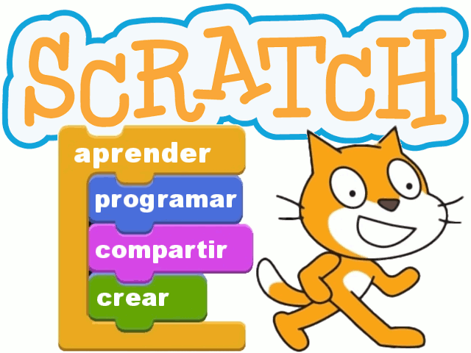
Materials
Computer
Scratch
online
offline
Internet
GIMP

Slide 9
Key Terms
Programme
Flowchart
Algorithm
Sprite
Backdrop
Stage
Script
Block
Costume
Category
Upload
Download
Run
Motion
Control
Looks
Sound
Operators
Data
Events
Sensing
Pen
Scale up and down
Collage

Slide 10
The high school Francisco de Goya-La Elipa has a problem!
The school has organised an exchange with a school from Boston, the students were coming next month but because of some problems they are coming next week and the welcome day everybody is busy with the open door´s day tasks.

Slide 11
You have been hired to help! Technology to the rescue!
Since the technology department has some interesting robots, the Information and tourism department have hired you to design a virtual interactive tour guide to take them into a virtual tour around Madrid.

Slide 12
Virtual interactive tour guide challenge
Goal: Programme a virtual interactive tour guide around 6 interesting places in Madrid.
Criteria:
Use Scratch
Use 6 pictures about Madrid
Use GIMP to make a collage with the 6 photos.
Use the Engineering Design Process for the challenge
Present to the class
Constraints:
Images are exclusive. The fastest team will get the images.
The computer won´t be switched on until the design plan is delivered.
Every group member must work in the computer everyday
Deadline: 10 days

Slide 13
Virtual interactive tour guide challenge
Constraints when presenting to the class:
Must use at least 5 of the vocabulary terms from above.
Every group member must speak.
Presentation should take 5 minutes.

Slide 14
You have a limited amount of time to do this. . .
So you must be resourceful.
And you must work fast.
Can your team save the Francisco de Goya-La Elipa reputation?

Slide 15
Warm up activities
How many different ways can we make a tour?
How have tour guides evolved?

Slide 16
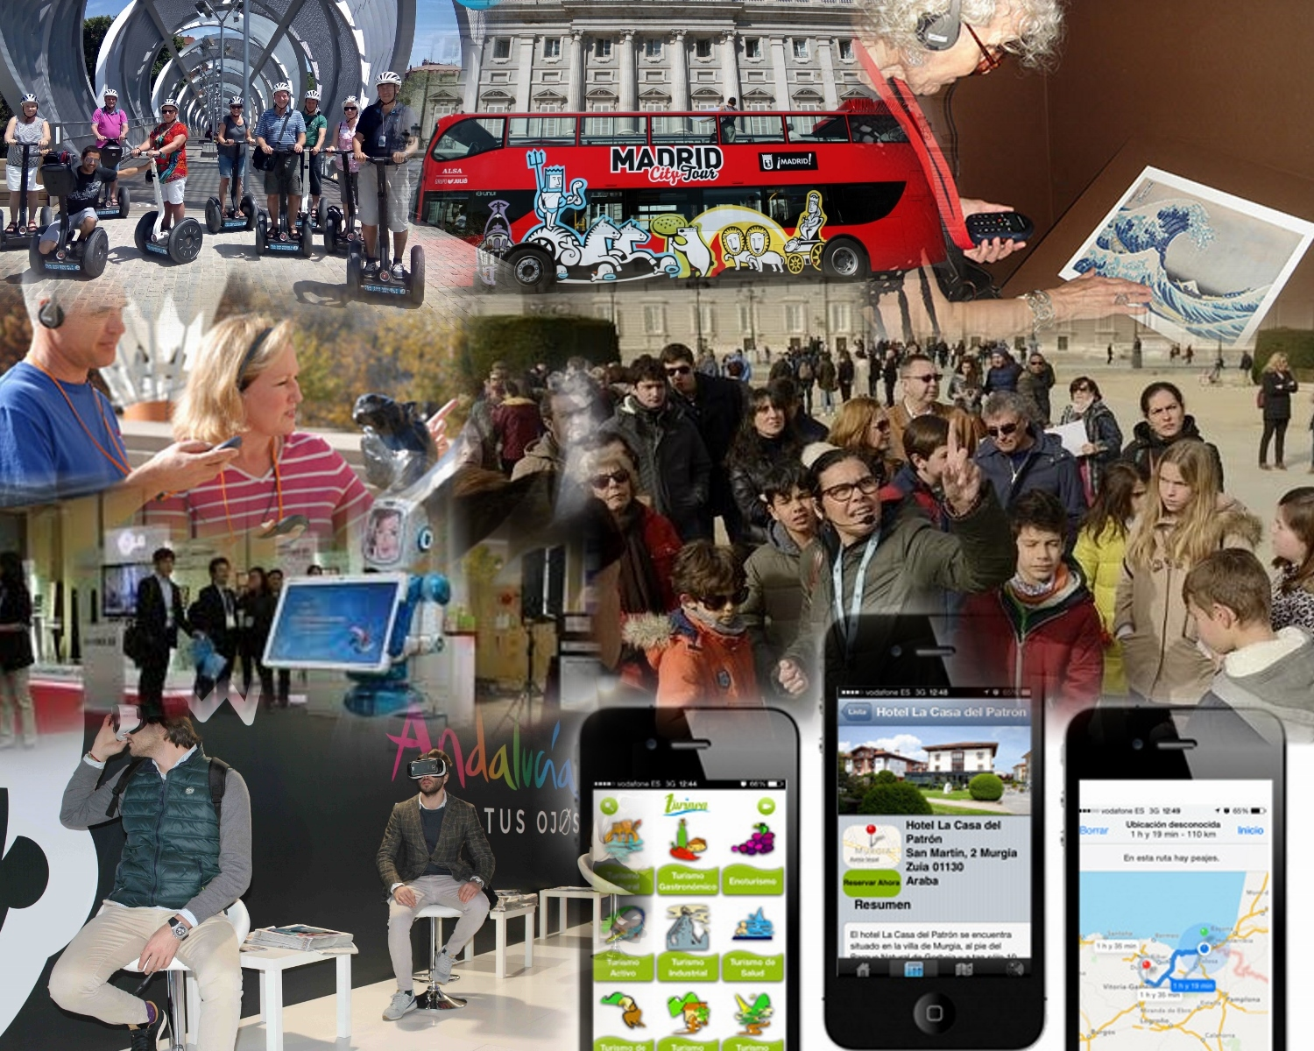
Warm up activities

Slide 17
Warm up activities
Video: World´s first robot tour guide
https://www.youtube.com/watch?v=gtA1pVl34D0&ab_channel=ABCRN

Slide 18
preview activitY
Choose 4 things you think a tour guide robot should do.

Slide 19
preview activitY
Video: Tourist information - Bad robots
https://www.youtube.com/watch?v=VuijrVChHeQ&t=104s&ab_channel=E4

Slide 20
MAIN ACTIVITY:
Mission 1: Look for 6 images about Madrid.
They have to be exclusive. So the fastest team will get their images.
Clues for students:
Open the file:
Look for images with high quality.docx

Slide 21
MAIN ACTIVITY:
Mission 1: Prepare the images for the Scratch screen size.
Clues for students:
Open the file:
Scale images up and down with GIMP.docx

Slide 22
MAIN ACTIVITY:
Mission 2: Make the collage with GIMP.
Clues for students:
Open the file:
Create a collage with GIMP.docx

Slide 23
MAIN ACTIVITY:
Mission 2: The tour should start with the collage as the main backdrop.
Clues for students: You need to programme something inside the backdrop to establish the initial conditions

Slide 24
MAIN ACTIVITY:
Mission 2: Programme inside the backdrop

Slide 25
MAIN ACTIVITY:
Mission 3: Programme the sprite to make it interact with the user. The user should be able to enter responses
Clues for students:

Slide 26
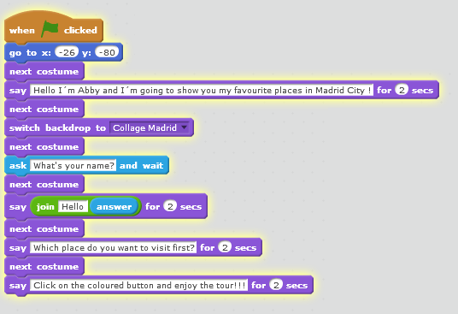
MAIN ACTIVITY:
Mission 3: Programme in the main sprite

Slide 27
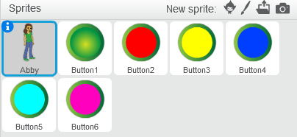
MAIN ACTIVITY:
Mission 4: The user should choose where they want to start the tour and the way to select the places.
Clues for students: You can use buttons

Slide 28
MAIN ACTIVITY:
Missions 5: When the user selects a place the picture associated with it, should become the backdrop.
Clues for students: You can send messages and you have to hide de buttons.
Option 1
Option 2

Slide 29
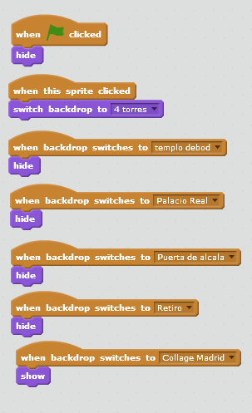
MAIN ACTIVITY:
Missions 4 and 5: Programme inside every button option 1

Slide 30
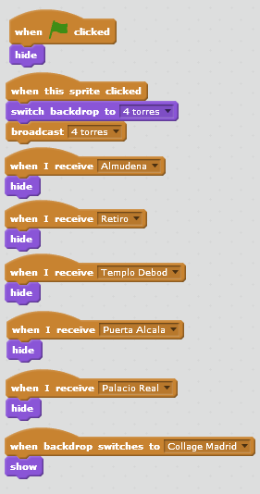
MAIN ACTIVITY:
Missions 4 and 5: Programme inside every button option 2

Slide 31
MAIN ACTIVITY:
Mission 5: When the user selects a place, the picture associated with it should become the backdrop and the sprite should present some information about the place.
Clues for students:
The programme should be inside the main sprite
(tour guide).

Slide 32
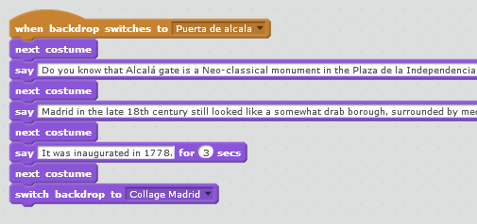
MAIN ACTIVITY:
Mission 5:Programme in the main sprite option 1

Slide 33
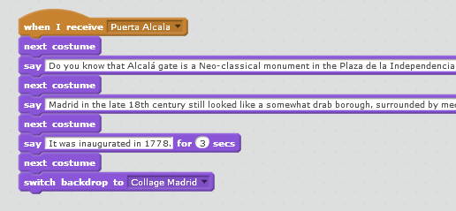
MAIN ACTIVITY:
Mission 5:Programme in the main sprite option 2

Slide 34
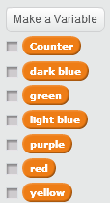
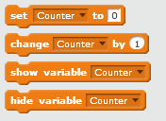
MAIN ACTIVITY:
Mission 6: Create a counter to detect when the user has finished the tour. The user can visit the places as many times as he wishes.
Clues for students: You have to use variables (the counter and one for each button, 7 in total)

Slide 35
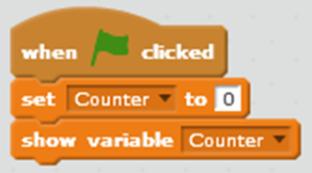
MAIN ACTIVITY:
Mission 6: Programme in the main sprite.
You have to repeat the programme on the right for all the pictures.

Slide 36
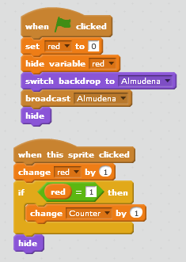
MAIN ACTIVITY:
Mission 6: Programme inside the red button (Almudena)
You have to repeat this programme for all the buttons

Slide 37
MAIN ACTIVITY:
Mission 7: When the user has finished the tour, a quiz will start. Design the quiz.
Clues for students: Check the value of the counter

Slide 38
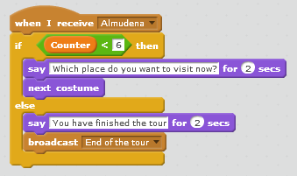
MAIN ACTIVITY:
Mission 7: Programme in the main sprite.
You have to repeat the programme for all the pictures.

Slide 39
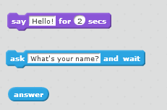
MAIN ACTIVITY:
Mission 8:Design a quiz with 6 questions, one per picture. Be creative and original
Clues for students: There are many ways of doing it. This is the simplest way to do it but the least creative and original.

Slide 40
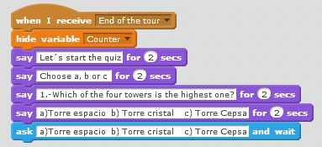
MAIN ACTIVITY:
Mission 8: Programme in the main sprite. A simple option

Slide 41
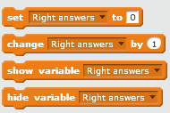
MAIN ACTIVITY:
Mission 9: The tour guide should let the user know if the answer is right or wrong.
Clues for students:

Slide 42
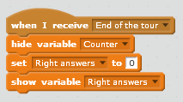
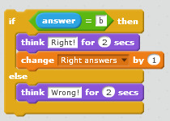
MAIN ACTIVITY:
Mission 9: Programme in the main sprite. A simple option

Slide 43
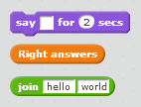
MAIN ACTIVITY:
Mission 9: The tour guide should show the quiz score
Clues for students: This is the simplest way to do it but the least creative and original.

Slide 44
MAIN ACTIVITY:
Mission 9: Programme in the main sprite at the end of the quiz

Slide 45
MAIN ACTIVITY:
Mission 10: Present your virtual tour guide to the rest of the class
Constraints when presenting to the class:
Must use at least 5 of the vocabulary terms from above.
Every group member must speak.
Presentation should take 5 minutes.

Slide 46
Check-in activities
What have we learnt from this project?
Project approach
Algorithms
Programming
Scale images up and down
Create a collage
Team work
Peer-Assessment and self-assessment
What have you learnt about Scratch?

Slide 47
Check in activities
What have you enjoyed the most?
What was the most challenging part of the project?
What will you change in the project?
What other things would you like to do with Scratch?

Slide 48
prediction activity
How will tour guides be in the future?

Slide 49
prediction activitY
Video: Back to the Future - Hover Board Chase
https://www.youtube.com/watch?v=TkyLnWm1iCs&ab_channel=Movieclips

