Slide 1
Gruffalo and his Friends in the forest
Miguel Ángel Lemus Regaña
Laura Martín Agustín
Virginia Ruíz Alarcón
Amina Sous Díez
María Useros Bueno
Natalie Vogel

Slide 2
This Digital Project has been devised as a final activity for the course “Professional Development course: CLIL for the Primary Class”. This course has been carried out at the University of Chichester as part of the “Plan de Formación de lenguas extranjeras”organized by the Consejería de Educación of Comunidad de Madrid
This Project is divided into 5 block of activities, acording to the diferent learning objetives that we are going to work with.
BLOCK 1: THE GRUFFALO
BLOCK 2: ANIMALS
BLOCK 3: INTERVIEW WITH THE GRUFFALO
BLOCK 4: DRAWING DICTATION
BLOCK 5: ART AND CRAFTS

Slide 3
BLOCK 1: THE GRUFFALO
ACTIVITY 1: BACK TO THE BOARD
ACTIVITY 2: Video -> THE GRUFFALO
ACTIVITY 3: TPS Star
ACTIVITY 4: TIMELINE

Slide 4
BLOCK 2: ANIMALS
ACTIVITY 1: ANIMAL RIDDLE
ACTIVITY 2: CLASSIFY ANIMALS
ACTIVITY 3: DESCRIBE A GRUFFALO
ACTIVITY 4: CREATE YOUR OWN FANTASTIC ANIMAL

Slide 5
BLOCK 4: DRAWING DICTATION
ACTIVITY 1: DRAWING DICTATION
ACTIVITY 2: TPS QUESTIONS

Slide 6
BLOCK 5: ART AND CRAFTS
ACTIVITY 1: CREATE YOUR FOREST

Slide 7
BLOCK 3: INTERVIEW WITH THE GRUFFALO
ACTIVITY 1: INTERVIEW MODELING
ACTIVITY 2: JIGSAW READING
ACTIVITY 3: WATCH THE INTERVIEW
ACTIVITY 4: COMPREHENSION QUESTIONS

Slide 8
Gruffalo and his friends in the forest
Subject: Natural Science.
Grade: 3rd grade.
The unit is divided into 5 blocks that will be developed in 7 sessions.

Slide 9
Learning Objectives
To clasify and describe animals
To learn about animals
To understand a story: The Gruffalo.
To express ideas related to the environment.
To create a forest using a shoe box.

Slide 10
Learning evaluable standards :
Clasify animals
Describe animals
Express ideas related to the environment.
Create a forest using a shoe box.

Slide 11
 | 4 | 3 | 2 | 1
Block 1 (1 session) | The student can understand all the story and its main parts. | The student identifies the different parts. | The student is able to understand the general idea of the story. | The student is able to follow the story.
Block 2 (2 session) | The student can describe all the animals, their parts and main characteristics. | The student can describe most of the animals and some characteristics. | The student can describe some animals and some characteristics. | The student can describe few animals.
Block 3 (1 session) | The student understands, orders and fills specifics information from the interview. | The student understands the general idea, orders and is able to fill general information from the interview. | The student is able to understand the general idea and orders the story | The student can follow the interview.
Block 4 (1 session) | The student can describe correctly a picture, can understand the instructions and use the vocabulary necessary to compare and think about the situation. | The student can describe picture, follow instructions and identifies the differences between the pictures. | The student is able to follow instructions and directions. | The student is able to draw following some instructions.
Block 5 (2 sessions) | The student is able to assess himself/herself. The student is able to create a landscape using a box in a creative way within the elements he has already learnt. | The student is able to assess himself / herself. The student is able to create a landscape using the elements he has already learnt. | The student is able to assess himself / herself with some help. The student is able to create a landscape. | The student needs improvements in order to assess himself/ herself. The student is able to create a landscape with some help.

Slide 12
BLOCK 1: STORY: The Gruffalo

Slide 13
BACK TO THE BOARD
Back to the board with some Key vocabulary words.
FOREST
FOX
MOUSE
STREAM
SNAKE
They have to guess the Word with the definitions that their classmates have to tell.

Slide 14
Story
https://www.youtube.com/watch?v=eccL5BiDtww&t=13s

Slide 15
TPS
Who are the main characters in this story?
Why does the mouse tell about the Gruffalo to the others?
What are mouse’s favourite food?
How does The Gruffalo look like?
Where did the Little Brown mouse meet the snake?

Slide 16
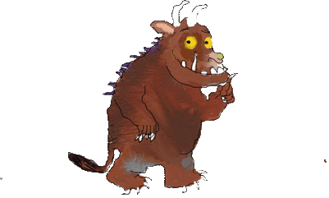
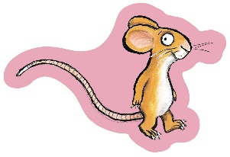
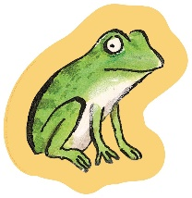
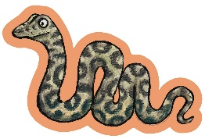
WHEN DID I MEET MY FRIENDS?
4th
2nd
1st
3rd
Notes:
Timeline graphic with pictures
(Intermediate)
To reproduce the picture effects on this slide, do the following:
On the Home tab, in the Slides group, click Layout, and then click Blank.
On the Insert tab, in the Images group, click Picture.
In the Insert Picture dialog box, select a picture and then click Insert.
Select the picture. Under Picture Tools, on the Format tab, in the Size group, click the Size and Position dialog box launcher.
In the Format Picture dialog box, in the Crop tab, in the Crop position section, crop the picture to the following values:
Width: 9”
Height: 2.65”
Left: .5”
Top: .5”
Adjust the values in the Picture position section to properly position the picture within the cropped image.
Under Picture Tools, in the Format tab, in the Size group, click Crop, click Crop to Shape, and then under Rectangles click Round Same Side Corner Rectangle (eighth option from the left).
Drag the top yellow diamond adjustment handle slightly to the right to decrease the amount of rounding on the corners.
Under Picture Tools, in the Format tab, in the Picture Styles group, click Picture Effects, point to Shadow, and then under Inner click Inside Center (second row, second option from the left).
To reproduce the timeline effects on this slide, do the following:
On the Home tab, in the Drawing group, click Rectangle. On the slide, drag to draw a rectangle.
In the bottom right corner of the Drawing group, click the Format Shape dialog box launcher.
In the Format Shape dialog box, do the following:
In the Size tab, set the Width of the rectangle to 9”, and then set the Height to .73”
In the Line Color tab, select No line.
In the Fill tab, select Solid fill, and then set the following values:
Color: Black, Text 1, Lighter 35%
Transparency: 20%
In the Shadow tab, click the button next to Presets, and then under Inner click Inside Center (second row, second option from the left).
Drag the rectangle onto the bottom of the picture.
Press and hold SHIFT and select the rectangle and the picture.
Under Drawing Tools, on the Format tab, in the Arrange group, and then do the following:
Click Align and then click Align Selected Objects.
Click Align and then click Align Center.
Click Align and then click Align Bottom.
Click Align and then click Align to Slide.
Click Align and then click Align Center.
To reproduce the month labels for the timeline, do the following:
On the Insert tab, in the Text group, click Text Box, and then on the slide, drag to draw the text box.
Type the text you want to appear in the text box (this example uses months of the year, so you might type “JAN”), and then select the text. Format the text in the textbox using the following steps:
On the Home tab, in the Font group, choose the Gill Sans MT Condensed font and a font size of 18.
Click the arrow next to Font Color, and then under Theme Colors click White, Background 1, Darker 35% (fifth row, first option from the left).
In the Paragraph group, click Center.
Select the text box. On the Home tab, in the Clipboard group, click the arrow under Copy, and then click Duplicate. Repeat the process until there is a total of six text boxes.
On the slide, drag the text boxes onto the rectangle to form a row.
Press and hold CTRL and select all six text boxes and the rectangle.
Under Drawing Tools, on the Format tab, in the Arrange group, do the following:
Click Align, and then click Align Selected Objects.
Click Align, and then click Align Middle.
Press and hold CTRL and cancel the selection of the rectangle, keeping the text boxes selected. Under Drawing Tools, on the Format tab, in the Arrange group, do the following:
Click Align, and then click Align to Slide.
Click Align, and then click Distribute Horizontally.
To change the text in the duplicate text boxes, click in each text box and edit the text (this example uses months of the year).
To change the color of a text box, select the text in the text box, and then on the Home tab, in the Font group, click the arrow next to Font Color, and then under Theme Colors click White, Background 1 (first row, first option from the left).
To reproduce the vertical line with text effects on this slide, do the following:
On the Home tab, in the Drawing group, click Line, and then, in the slide, draw a line.
On the Home tab, in the drawing group, click the Format Shape dialog box launcher.
In the Format Shape dialog box, in the Size tab, under Size and rotate, set the following values:
Height: 1.2”
Width: 0”
Rotation: 0˚
Also in the Format Shape dialog box, in the Line Style tab, set the Width to .75 pt and then, under Arrow settings, set the following values:
Begin type: Oval Arrow (second row, third option from the left).
Begin size: Arrow L Size 1 (first row, first option from the left).
End type: Oval Arrow (second row, third option from the left).
End size: Arrow R Size 1 (first row, first option from the left).
Also in the Format Shape dialog box, in the Line Color tab, select Solid line, and then set the Color option to White, Background 1, Darker 25% (fourth row, first option from the left).
Close the Format Shape dialog box.
On the Home tab, in the Clipboard group, click the arrow under Copy, and then click Duplicate.
Select the duplicate line. Under Drawing Tools, on the Format tab, in the Size group, in the Shape Height box, enter 2.6”.
Press and hold SHIFT and select both lines. On the Format tab, in the Arrange group, do the following:
Click Align, and then click Align Selected Objects.
Click Align, and then click Align Center.
Click Align, and then click Align Top.
Drag both lines together on the slide to position them under one of the timeline month labels.
Press and hold SHIFT and select both lines and the text box they are under. On the Format tab, in the Arrange group, do the following:
Click Align, and then click Align Selected Objects.
Click Align, and then click Align Center.
Create the subtext boxes:
On the Insert tab, in the Text group, click Text Box, and then on the slide, drag to draw the text box.
Type the text you want to appear in the text box, and then select the text. Format the text in the textbox using the following steps:
On the Home tab, in the Font group, choose the Gill Sans MT font and a font size of 20.
Click the arrow next to Font Color, and then under Theme Colors click White, Background 1 (first row, first option from the left).
In the Paragraph group, click Align Text Left.
On the Home tab, in the Paragraph group, click Align Text Left to align the text left in the text box.
On the slide, drag the text box to position it to the right of the vertical line.
To reproduce the background on this slide, do the following:
Right-click the slide background area, and then click Format Background. In the Format Background dialog box, click Fill in the left pane, select Gradient fill in the Fill pane, and then set the following values:
Type: Linear
Direction: Linear Down (first row, second option from the left).
Angle: 90˚
Under Gradient stops, click Add or Remove until two stops appear on the slider.
Also under Gradient stops, customize the gradient stops that you added as follows:
Select the first stop, and then set the following values:
Position: 50%
Color: Black, Text 1 (first row, second option from the left).
Select the second stop, and then set the following values:
Position: 99%.
Color: Black, Text 1, Lighter 35% (third row, second option from the left).

Slide 17
WHEN DID I MEET MY FRIENDS?
4th
2nd
1st
3rd
Notes:
Timeline graphic with pictures
(Intermediate)
To reproduce the picture effects on this slide, do the following:
On the Home tab, in the Slides group, click Layout, and then click Blank.
On the Insert tab, in the Images group, click Picture.
In the Insert Picture dialog box, select a picture and then click Insert.
Select the picture. Under Picture Tools, on the Format tab, in the Size group, click the Size and Position dialog box launcher.
In the Format Picture dialog box, in the Crop tab, in the Crop position section, crop the picture to the following values:
Width: 9”
Height: 2.65”
Left: .5”
Top: .5”
Adjust the values in the Picture position section to properly position the picture within the cropped image.
Under Picture Tools, in the Format tab, in the Size group, click Crop, click Crop to Shape, and then under Rectangles click Round Same Side Corner Rectangle (eighth option from the left).
Drag the top yellow diamond adjustment handle slightly to the right to decrease the amount of rounding on the corners.
Under Picture Tools, in the Format tab, in the Picture Styles group, click Picture Effects, point to Shadow, and then under Inner click Inside Center (second row, second option from the left).
To reproduce the timeline effects on this slide, do the following:
On the Home tab, in the Drawing group, click Rectangle. On the slide, drag to draw a rectangle.
In the bottom right corner of the Drawing group, click the Format Shape dialog box launcher.
In the Format Shape dialog box, do the following:
In the Size tab, set the Width of the rectangle to 9”, and then set the Height to .73”
In the Line Color tab, select No line.
In the Fill tab, select Solid fill, and then set the following values:
Color: Black, Text 1, Lighter 35%
Transparency: 20%
In the Shadow tab, click the button next to Presets, and then under Inner click Inside Center (second row, second option from the left).
Drag the rectangle onto the bottom of the picture.
Press and hold SHIFT and select the rectangle and the picture.
Under Drawing Tools, on the Format tab, in the Arrange group, and then do the following:
Click Align and then click Align Selected Objects.
Click Align and then click Align Center.
Click Align and then click Align Bottom.
Click Align and then click Align to Slide.
Click Align and then click Align Center.
To reproduce the month labels for the timeline, do the following:
On the Insert tab, in the Text group, click Text Box, and then on the slide, drag to draw the text box.
Type the text you want to appear in the text box (this example uses months of the year, so you might type “JAN”), and then select the text. Format the text in the textbox using the following steps:
On the Home tab, in the Font group, choose the Gill Sans MT Condensed font and a font size of 18.
Click the arrow next to Font Color, and then under Theme Colors click White, Background 1, Darker 35% (fifth row, first option from the left).
In the Paragraph group, click Center.
Select the text box. On the Home tab, in the Clipboard group, click the arrow under Copy, and then click Duplicate. Repeat the process until there is a total of six text boxes.
On the slide, drag the text boxes onto the rectangle to form a row.
Press and hold CTRL and select all six text boxes and the rectangle.
Under Drawing Tools, on the Format tab, in the Arrange group, do the following:
Click Align, and then click Align Selected Objects.
Click Align, and then click Align Middle.
Press and hold CTRL and cancel the selection of the rectangle, keeping the text boxes selected. Under Drawing Tools, on the Format tab, in the Arrange group, do the following:
Click Align, and then click Align to Slide.
Click Align, and then click Distribute Horizontally.
To change the text in the duplicate text boxes, click in each text box and edit the text (this example uses months of the year).
To change the color of a text box, select the text in the text box, and then on the Home tab, in the Font group, click the arrow next to Font Color, and then under Theme Colors click White, Background 1 (first row, first option from the left).
To reproduce the vertical line with text effects on this slide, do the following:
On the Home tab, in the Drawing group, click Line, and then, in the slide, draw a line.
On the Home tab, in the drawing group, click the Format Shape dialog box launcher.
In the Format Shape dialog box, in the Size tab, under Size and rotate, set the following values:
Height: 1.2”
Width: 0”
Rotation: 0˚
Also in the Format Shape dialog box, in the Line Style tab, set the Width to .75 pt and then, under Arrow settings, set the following values:
Begin type: Oval Arrow (second row, third option from the left).
Begin size: Arrow L Size 1 (first row, first option from the left).
End type: Oval Arrow (second row, third option from the left).
End size: Arrow R Size 1 (first row, first option from the left).
Also in the Format Shape dialog box, in the Line Color tab, select Solid line, and then set the Color option to White, Background 1, Darker 25% (fourth row, first option from the left).
Close the Format Shape dialog box.
On the Home tab, in the Clipboard group, click the arrow under Copy, and then click Duplicate.
Select the duplicate line. Under Drawing Tools, on the Format tab, in the Size group, in the Shape Height box, enter 2.6”.
Press and hold SHIFT and select both lines. On the Format tab, in the Arrange group, do the following:
Click Align, and then click Align Selected Objects.
Click Align, and then click Align Center.
Click Align, and then click Align Top.
Drag both lines together on the slide to position them under one of the timeline month labels.
Press and hold SHIFT and select both lines and the text box they are under. On the Format tab, in the Arrange group, do the following:
Click Align, and then click Align Selected Objects.
Click Align, and then click Align Center.
Create the subtext boxes:
On the Insert tab, in the Text group, click Text Box, and then on the slide, drag to draw the text box.
Type the text you want to appear in the text box, and then select the text. Format the text in the textbox using the following steps:
On the Home tab, in the Font group, choose the Gill Sans MT font and a font size of 20.
Click the arrow next to Font Color, and then under Theme Colors click White, Background 1 (first row, first option from the left).
In the Paragraph group, click Align Text Left.
On the Home tab, in the Paragraph group, click Align Text Left to align the text left in the text box.
On the slide, drag the text box to position it to the right of the vertical line.
To reproduce the background on this slide, do the following:
Right-click the slide background area, and then click Format Background. In the Format Background dialog box, click Fill in the left pane, select Gradient fill in the Fill pane, and then set the following values:
Type: Linear
Direction: Linear Down (first row, second option from the left).
Angle: 90˚
Under Gradient stops, click Add or Remove until two stops appear on the slider.
Also under Gradient stops, customize the gradient stops that you added as follows:
Select the first stop, and then set the following values:
Position: 50%
Color: Black, Text 1 (first row, second option from the left).
Select the second stop, and then set the following values:
Position: 99%.
Color: Black, Text 1, Lighter 35% (third row, second option from the left).

Slide 18
WHEN DID I MEET MY FRIENDS?
4th
2nd
1st
3rd
Notes:
Timeline graphic with pictures
(Intermediate)
To reproduce the picture effects on this slide, do the following:
On the Home tab, in the Slides group, click Layout, and then click Blank.
On the Insert tab, in the Images group, click Picture.
In the Insert Picture dialog box, select a picture and then click Insert.
Select the picture. Under Picture Tools, on the Format tab, in the Size group, click the Size and Position dialog box launcher.
In the Format Picture dialog box, in the Crop tab, in the Crop position section, crop the picture to the following values:
Width: 9”
Height: 2.65”
Left: .5”
Top: .5”
Adjust the values in the Picture position section to properly position the picture within the cropped image.
Under Picture Tools, in the Format tab, in the Size group, click Crop, click Crop to Shape, and then under Rectangles click Round Same Side Corner Rectangle (eighth option from the left).
Drag the top yellow diamond adjustment handle slightly to the right to decrease the amount of rounding on the corners.
Under Picture Tools, in the Format tab, in the Picture Styles group, click Picture Effects, point to Shadow, and then under Inner click Inside Center (second row, second option from the left).
To reproduce the timeline effects on this slide, do the following:
On the Home tab, in the Drawing group, click Rectangle. On the slide, drag to draw a rectangle.
In the bottom right corner of the Drawing group, click the Format Shape dialog box launcher.
In the Format Shape dialog box, do the following:
In the Size tab, set the Width of the rectangle to 9”, and then set the Height to .73”
In the Line Color tab, select No line.
In the Fill tab, select Solid fill, and then set the following values:
Color: Black, Text 1, Lighter 35%
Transparency: 20%
In the Shadow tab, click the button next to Presets, and then under Inner click Inside Center (second row, second option from the left).
Drag the rectangle onto the bottom of the picture.
Press and hold SHIFT and select the rectangle and the picture.
Under Drawing Tools, on the Format tab, in the Arrange group, and then do the following:
Click Align and then click Align Selected Objects.
Click Align and then click Align Center.
Click Align and then click Align Bottom.
Click Align and then click Align to Slide.
Click Align and then click Align Center.
To reproduce the month labels for the timeline, do the following:
On the Insert tab, in the Text group, click Text Box, and then on the slide, drag to draw the text box.
Type the text you want to appear in the text box (this example uses months of the year, so you might type “JAN”), and then select the text. Format the text in the textbox using the following steps:
On the Home tab, in the Font group, choose the Gill Sans MT Condensed font and a font size of 18.
Click the arrow next to Font Color, and then under Theme Colors click White, Background 1, Darker 35% (fifth row, first option from the left).
In the Paragraph group, click Center.
Select the text box. On the Home tab, in the Clipboard group, click the arrow under Copy, and then click Duplicate. Repeat the process until there is a total of six text boxes.
On the slide, drag the text boxes onto the rectangle to form a row.
Press and hold CTRL and select all six text boxes and the rectangle.
Under Drawing Tools, on the Format tab, in the Arrange group, do the following:
Click Align, and then click Align Selected Objects.
Click Align, and then click Align Middle.
Press and hold CTRL and cancel the selection of the rectangle, keeping the text boxes selected. Under Drawing Tools, on the Format tab, in the Arrange group, do the following:
Click Align, and then click Align to Slide.
Click Align, and then click Distribute Horizontally.
To change the text in the duplicate text boxes, click in each text box and edit the text (this example uses months of the year).
To change the color of a text box, select the text in the text box, and then on the Home tab, in the Font group, click the arrow next to Font Color, and then under Theme Colors click White, Background 1 (first row, first option from the left).
To reproduce the vertical line with text effects on this slide, do the following:
On the Home tab, in the Drawing group, click Line, and then, in the slide, draw a line.
On the Home tab, in the drawing group, click the Format Shape dialog box launcher.
In the Format Shape dialog box, in the Size tab, under Size and rotate, set the following values:
Height: 1.2”
Width: 0”
Rotation: 0˚
Also in the Format Shape dialog box, in the Line Style tab, set the Width to .75 pt and then, under Arrow settings, set the following values:
Begin type: Oval Arrow (second row, third option from the left).
Begin size: Arrow L Size 1 (first row, first option from the left).
End type: Oval Arrow (second row, third option from the left).
End size: Arrow R Size 1 (first row, first option from the left).
Also in the Format Shape dialog box, in the Line Color tab, select Solid line, and then set the Color option to White, Background 1, Darker 25% (fourth row, first option from the left).
Close the Format Shape dialog box.
On the Home tab, in the Clipboard group, click the arrow under Copy, and then click Duplicate.
Select the duplicate line. Under Drawing Tools, on the Format tab, in the Size group, in the Shape Height box, enter 2.6”.
Press and hold SHIFT and select both lines. On the Format tab, in the Arrange group, do the following:
Click Align, and then click Align Selected Objects.
Click Align, and then click Align Center.
Click Align, and then click Align Top.
Drag both lines together on the slide to position them under one of the timeline month labels.
Press and hold SHIFT and select both lines and the text box they are under. On the Format tab, in the Arrange group, do the following:
Click Align, and then click Align Selected Objects.
Click Align, and then click Align Center.
Create the subtext boxes:
On the Insert tab, in the Text group, click Text Box, and then on the slide, drag to draw the text box.
Type the text you want to appear in the text box, and then select the text. Format the text in the textbox using the following steps:
On the Home tab, in the Font group, choose the Gill Sans MT font and a font size of 20.
Click the arrow next to Font Color, and then under Theme Colors click White, Background 1 (first row, first option from the left).
In the Paragraph group, click Align Text Left.
On the Home tab, in the Paragraph group, click Align Text Left to align the text left in the text box.
On the slide, drag the text box to position it to the right of the vertical line.
To reproduce the background on this slide, do the following:
Right-click the slide background area, and then click Format Background. In the Format Background dialog box, click Fill in the left pane, select Gradient fill in the Fill pane, and then set the following values:
Type: Linear
Direction: Linear Down (first row, second option from the left).
Angle: 90˚
Under Gradient stops, click Add or Remove until two stops appear on the slider.
Also under Gradient stops, customize the gradient stops that you added as follows:
Select the first stop, and then set the following values:
Position: 50%
Color: Black, Text 1 (first row, second option from the left).
Select the second stop, and then set the following values:
Position: 99%.
Color: Black, Text 1, Lighter 35% (third row, second option from the left).

Slide 19
Block 2: Animals
(2 sessions)

Slide 20
Animals

Slide 21
1.Animal riddles
Listen and read the descriptions.
Guess the animal.
Write the name of the animal in your team’s paper.
Let’s see how many you can guess.

Slide 22
1.
I live in a river or the sea.
My body is covered with scales.
I’m an oviparous animal.
I have a tail.
I also have fins and big eyes.
I can swim.

Slide 23
2.
I am the most popular pet in the world.
I sleep as much as 20 hours a day.
I have got whiskers.
I like licking my fur to be clean.
I can see very good at night and have an excellent hearing.
My babies are called kittens.
I am a carnivore.

Slide 24
3.
I have got a tiny body
I am good at jumping, climbing and swimming.
I am a herbivore.
I am a mammal.
Cats like hunting me.
When I am in a group we are called mice.

Slide 25
4.
I have feathers.
I have huge eyes.
I have wings.
I am oviparous.
I like hunting small animals at night.
I can see very good at night.
During the day I rest on a tree branch.

Slide 26
5.
I have long teeth.
My body is covered by scales.
I have a long body.
I have no legs.
I have a long tongue.
I shed my skin once a year.

Slide 27
6.
I am an omnivore
I live in the north pole
My fur is white.
My babies are called cubs.
I hibernate during the winter.

Slide 28
7.
I attack and sting the enemy.
I have wings
I have 5 eyes.
My body is black and yellow.
I produce honey.
I have 6 legs and 2 antennae.

Slide 29
8.
I am a wild animal.
I look like a dog but I behave like a cat.
My fur is red.
My tail is long, thick and bushy.
I like hunting small animals.
I am a very curious animal.
I live in an underground burrow in a forest.
I can climb up and down the trunks of trees.

Slide 30
9.
I am born in water.
When I am a baby my name is tadpole.
I can live in water and on land
I swim on ponds and leap on land.
I breath out of the water.
I like eating insects and worms. I’m a carnivore.
I am an amphibian
I am oviparous.

Slide 31
10.
I am a combination of giraffe and zebra.
I eats leaves and fruits.
I have horns like a giraffe.
I’m shorter than a giraffe.
I’m very shy.
I live in the African forests.

Slide 32
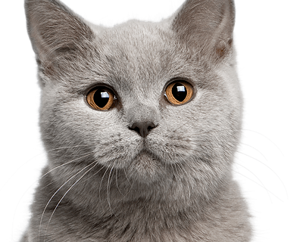
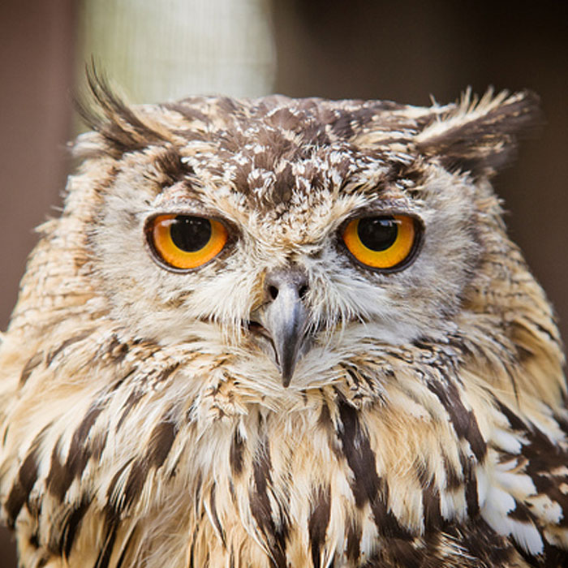
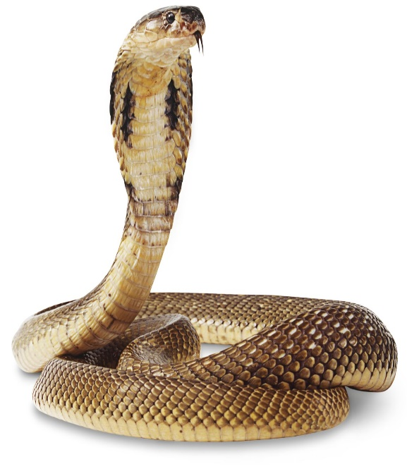
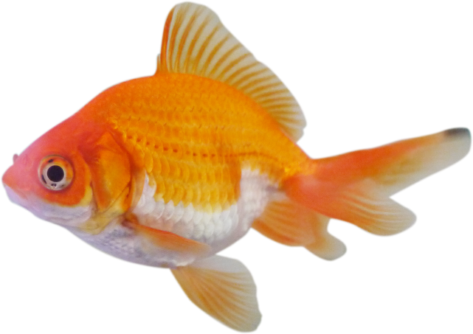
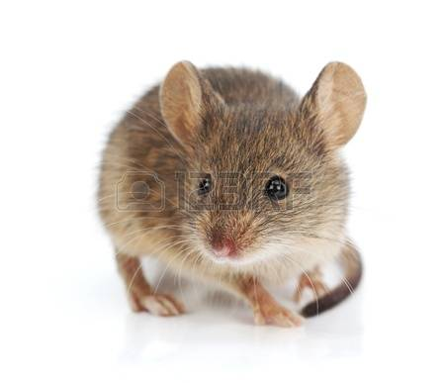
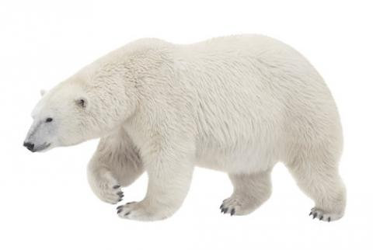
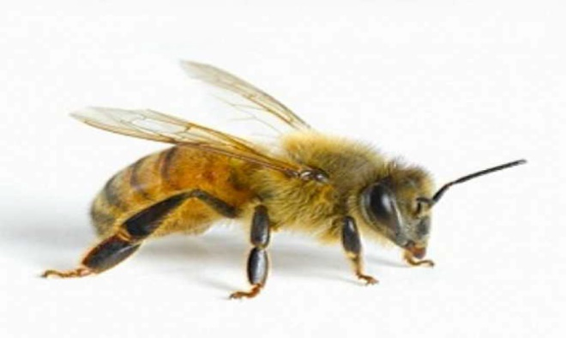
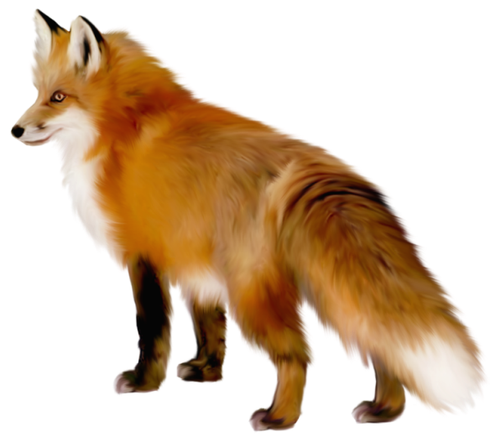
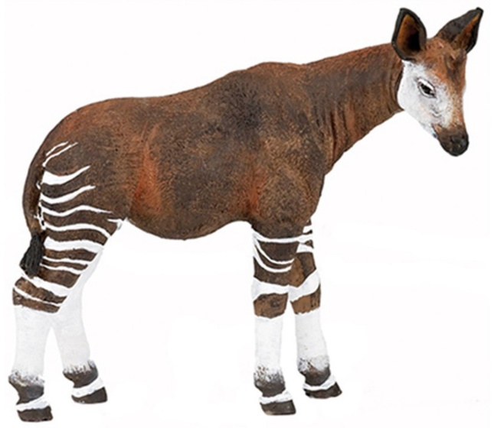
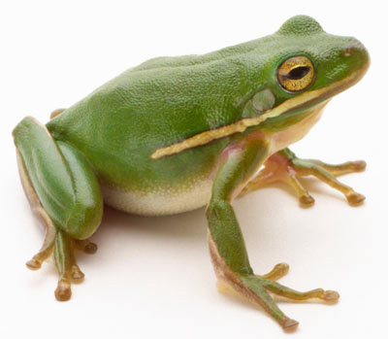
answers
1 | 2 | 3 | 4 | 5
6 | 7 | 8 | 9 | 10

Slide 33
2.Classify the animals
MAMMALS | BIRDS | FISH | REPTILES | AMPHIBIANS | INSECTS

Slide 34
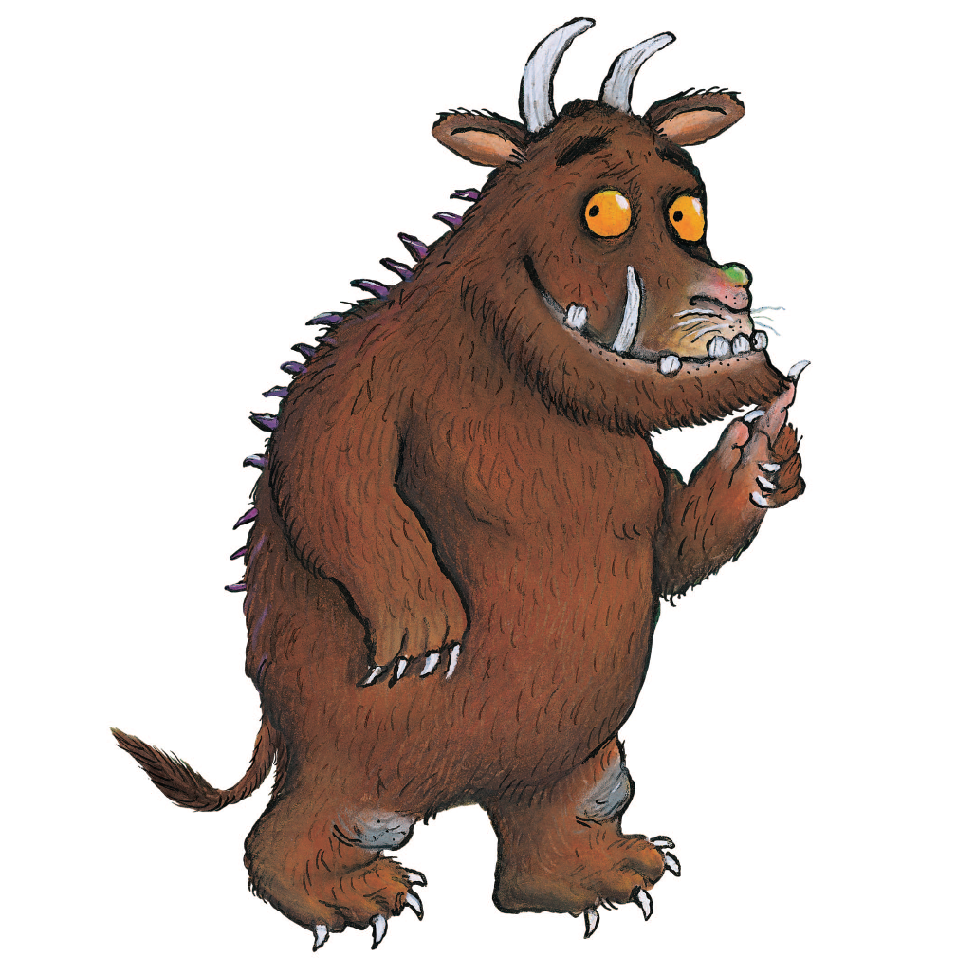
3. What’s this animal? Describe it!
What can he do?
What does the Gruffalo eat?
Where does he live?
What are the characteristics of its body?
Can you classify it?

Slide 35
4. Create your own fantastic animal
My animal is called a Lionfly.
It has a lion body covered with soft brown fur and peacock feathers on its head.
I has butterfly wings and big ears.
It eats meat so it’s a carnivore.
It is a mammal.
It lives in the African Savannah.
It can run very fast and fly.

Slide 36
Block 3: Interview

Slide 37
What is an interview?
Model an interview

Slide 38
Gruffalo Interview
I: Today I am interviewing the Gruffalo about his life in the forest.
Good morning Mr Gruffalo. It is an honour to visit you in the forest.
G: Thank you, very much.
I: Let me ask you some questions about your life in the forest.
G: My pleasure!
I: I hear that you live in a forest, can you explain what is a forest?
G: A forest is where there are lots of trees and they are all over the world.
I: Do you know any other type of forest apart from the one that you live in?
G: Yes, I do! They are not all the same. In cold places, you can find temperature forests and in hot places the tropical ones.
I: Is it that the reason why sometimes there are orange leaves and some other times brown leaves?
G: No, the reason is that there are different type of trees, deciduous trees and evergreen trees.
I: What animals live in the forest?
G: My best friends are, a mouse, a snake, a fox and an owl. But, there are many other animals such us rabbits, deer and badgers.
I: How do you think people use forest?
G: Some human beings don’t take care of the forest. They cut down trees and they throw litter. The factories and cars pollute the air and the water.
I: Thank you very much Mr Gruffalo, that is all for now.

Slide 39
Interview
https://www.youtube.com/watch?v=BisB-KlgkzQ&t=66s

Slide 40
¿? | ANSWER | NAME | CHECK
What’s a forest?
Name two type of forest?
What different type of trees you know? | There are______trees and _______ trees.
What are Gruffalo ‘s best friends?
What other animals live in the forest?
How don’t take care of the forest and why?

Slide 41
BLOCK 4: Drawing Dictation

Slide 42
Pair work Student A
Student B

Slide 46
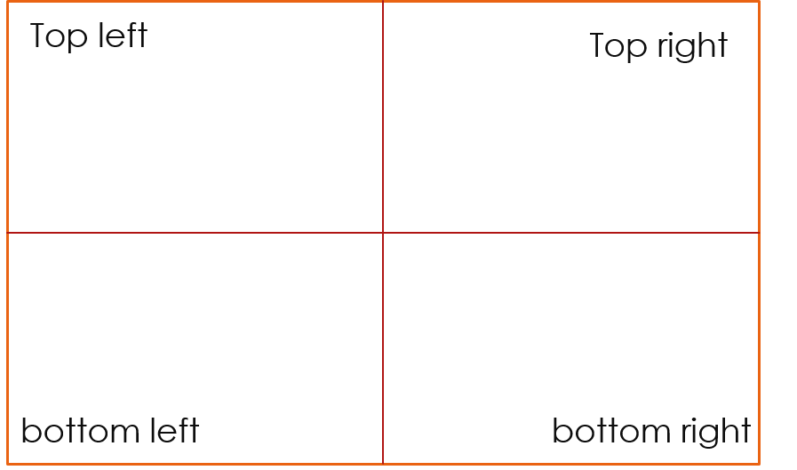
Student B draws what Student A describes.

Slide 47
Checking

Slide 48
Pass your drawing to another pair.

Slide 49
STS. ANALYSE THE PICTURES (TPS) What is going on in the pictures ? Why do you think has this happened?

Slide 50
BLOCK 5: Arts and Crafts

Slide 51
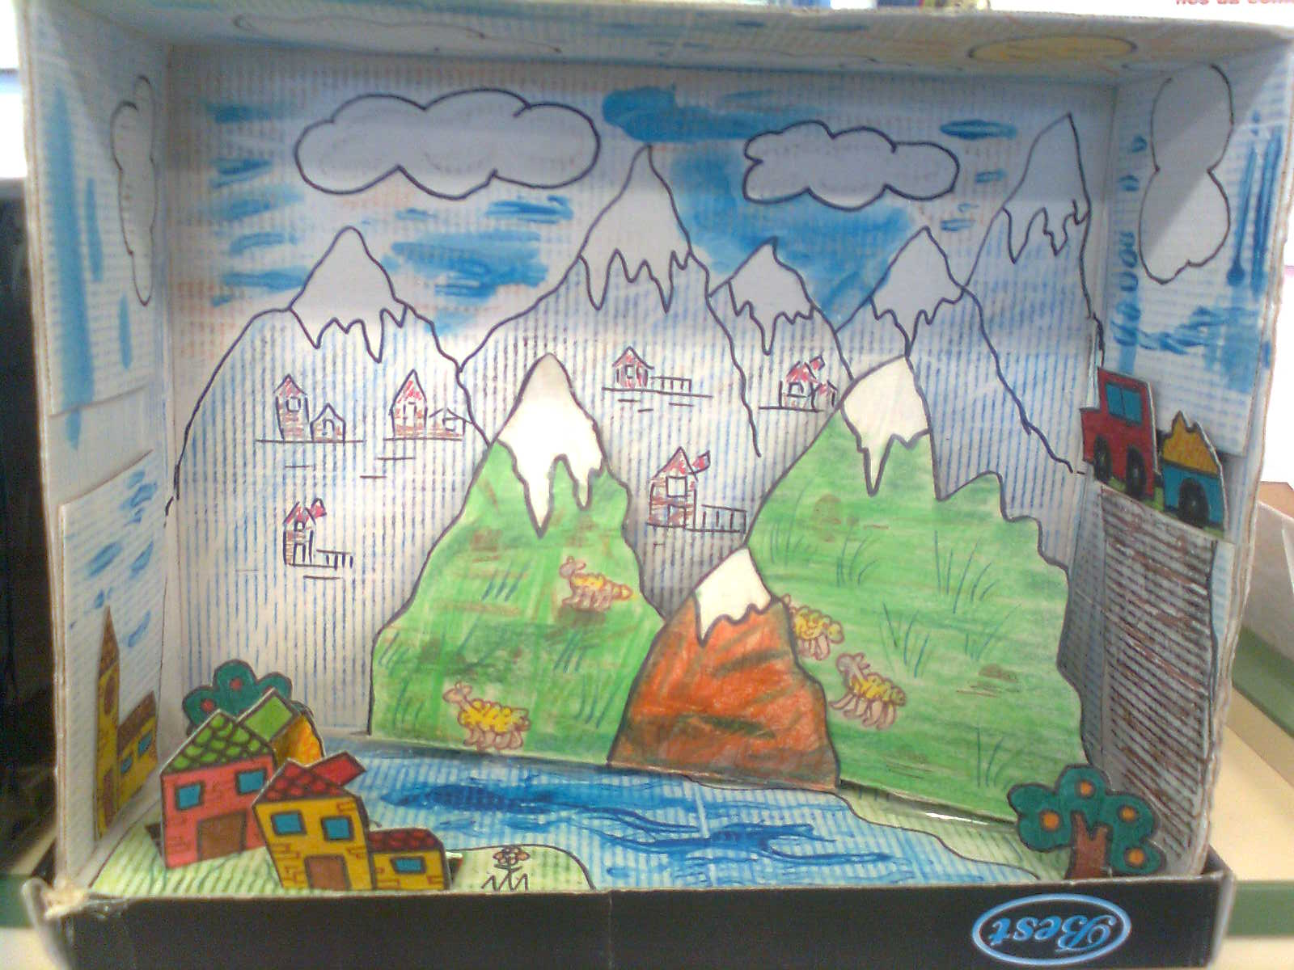
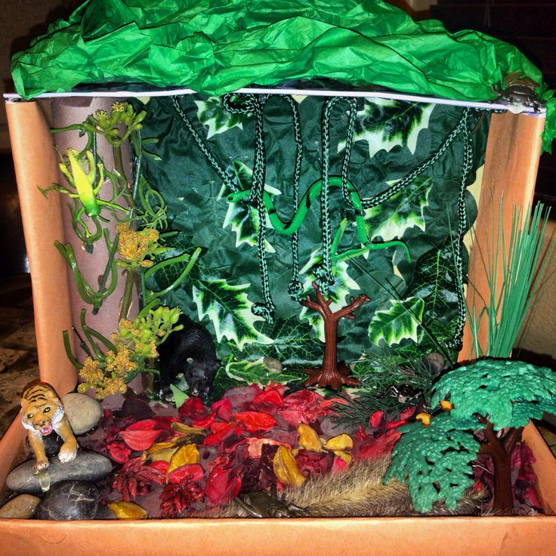
To create their own forest where they would like to live.
To be able to identify the parts of the forest.
To be able to evaluate themselves.

Slide 52
EVALUATION
PLICKERS

Slide 53
Resource bank
https://drive.google.com/drive/folders/0B05INNHn63YvOWI3VXlEZnE4a3M?usp=sharing

Slide 54
Este obra está bajo una licencia de Creative Commons Reconocimiento 4.0 Internacional.

