Slide 1
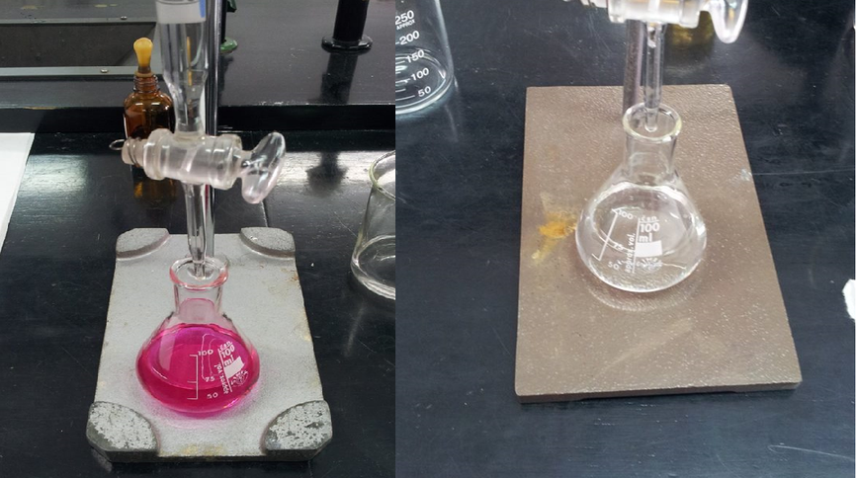
ACID-BASE TITRATIONS
Mario Calleja Álvarez
Final Project:
IN-35 “Inquiry – based learning for science teachers”.

Slide 2
Subject Area: Chemistry
Educational Stage: Bachillerato
Target Grade: 2nd course

Slide 3
Draw this graph in your notebook.
Group A

Slide 4
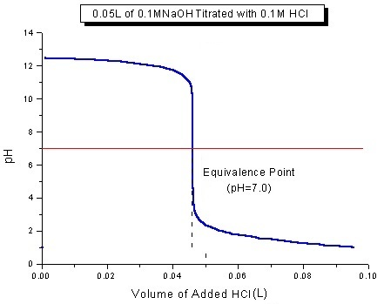
Draw this graph in your notebook.
Group B

Slide 5
Search for the definitions:
Titration:
pH:
Equivalence point:
Acid-base indicator:

Slide 6
Guess how the graph was obtained and explain the increase/decrease in pH upon the addition of different amounts of acid/base solutions.
Compare your deductions with someone from the other group.

Slide 7
Previous calculations:
Group A
500 ml of HCl 0,5 M:
Search for the label at the bottle of HCl in the lab and note it’s purity.
Calculate the weigh/volume of HCl needed.
Group B
500 ml of NaOH 0,5 M:
Search for the label at the recipient of NaOH in the lab and note it’s purity.
Calculate the weigh/volume of NaOH needed.

Slide 8
In the lab:
Collect the lab material.
Prepare the solutions.
Pick 100 ml from the dissolution and add some water (note the amount but do not tell the other group) this will be the “problem solution”. Calculate its concentration.
Pick 100 ml from the problem solution and pass it to the other group.
Now you have to guess the concentration of the solution you’ve just received.

Slide 9
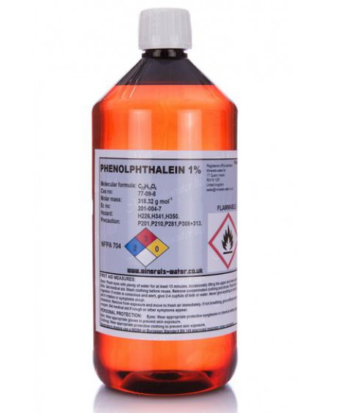
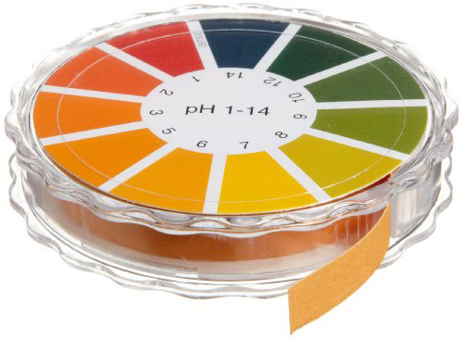
How to measure pH?
You have these materials available in order to measure pH at the beggining, equivalence point and end point of the titration. Guess it’s names and how would you use them for your purpose.

Slide 10
Once you’ve finished your titrations, calculate the concentration of the problem solution.
Ask the other group for the concentration of the problem solution that they calculated and compare the results with the ones obtained from your titrations.

Slide 11
Create and fill a table like this:
 | pH measuring method | pH | Volume of acid/base spent (ml) | Concentration by titration (M) | Concentration calculated (M)
Beginning
Equivalence point
End point

Slide 12
Do the values of the concentration obtained through titration and the one calculated by the members of the other group differ?
If so, try to explain why, name possible causes of mistakes.

Slide 13
Now find an explanation for differences in the graphs obtained in these other titrations.

Slide 15
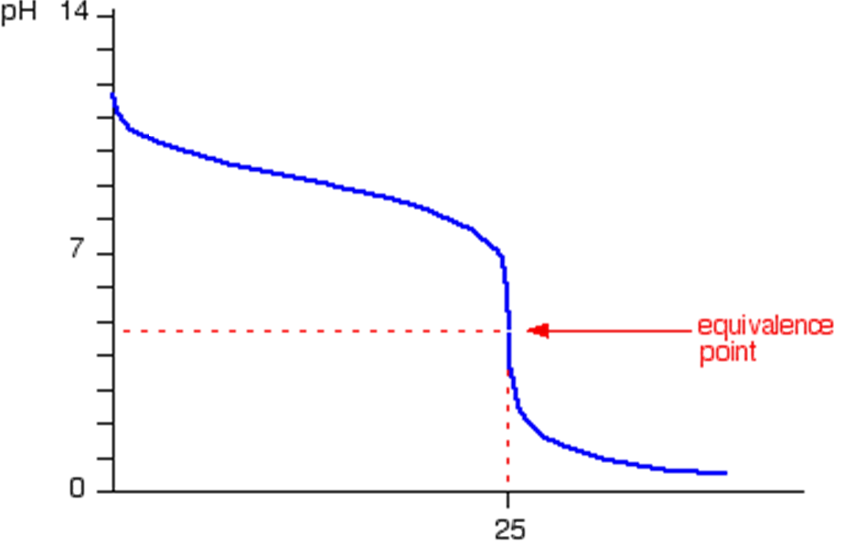

Slide 18
This practice does not include:
Safety information.
Essential instructor background information.
Directions for preparing solutions.
Important tips for successfully doing these labs.

