Slide 1
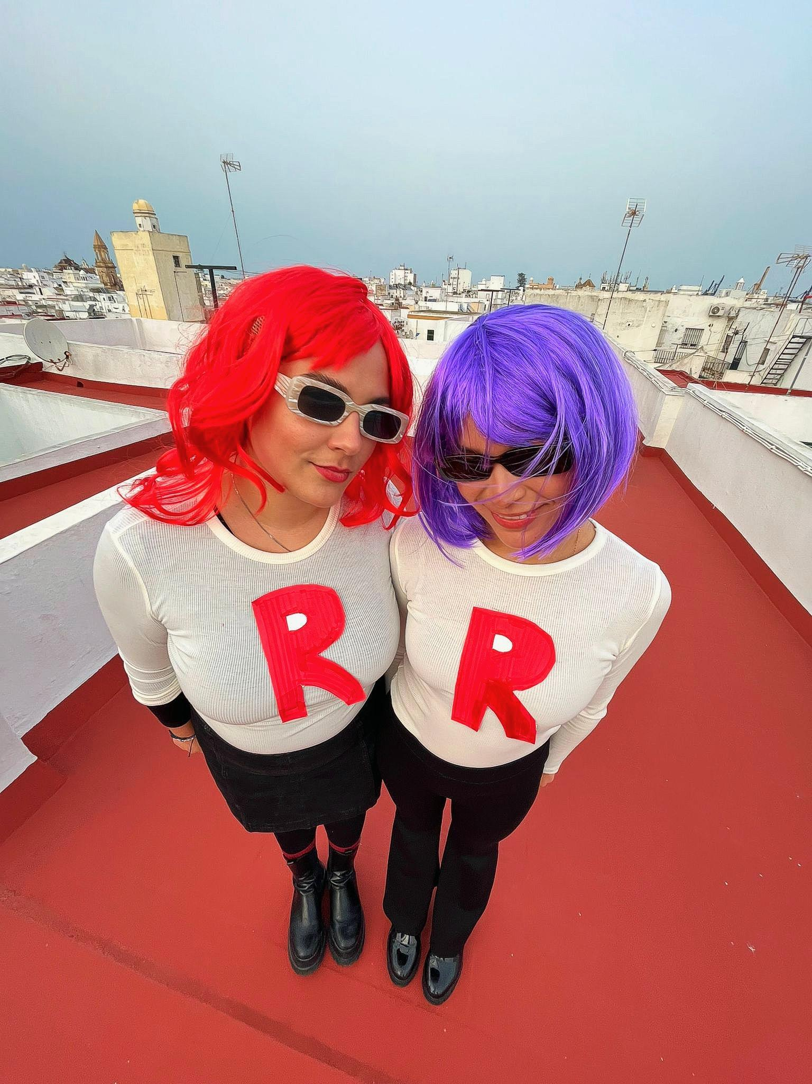
About Me: Diana
Personal Information:
I'm 25 years old.
I was born in Miami, Florida.
My birthday is on April 22nd.

Slide 2
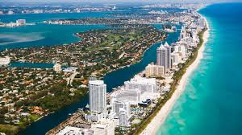
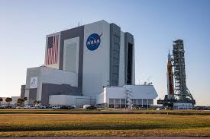
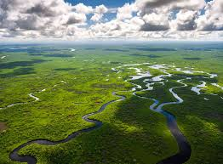
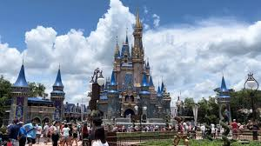
Florida, my home state

Slide 3
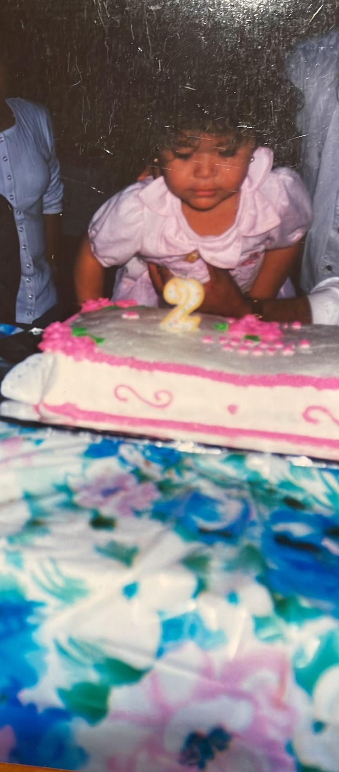
Family
I have 7 siblings.
I have 6 brothers and 1 sister.
I'm the youngest.
I also have a cat named Toby.

Slide 4
Interests and Hobbies
I enjoy:
Reading
Listening to music
Some of my favorite books are: Pedro Paramo, Pride and Prejudice and the Twilight series
I like listening to different genres. Right now, I listen to a lot of indie and pop music.
Trying new foods
Traveling
I enjoy learning about new cultures and exploring new places. I’ve been to 12 countries.

Slide 5
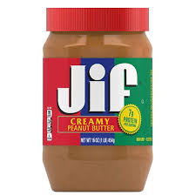
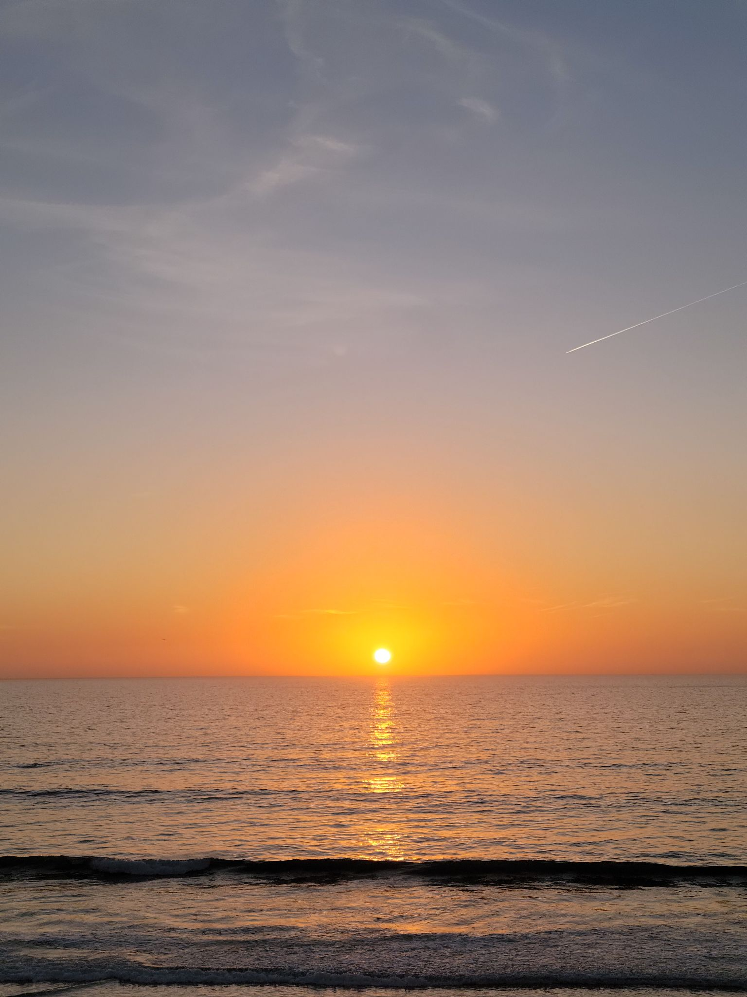
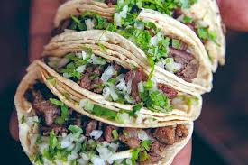
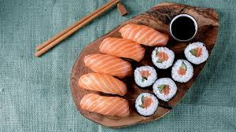
Some of my favorite things

Slide 6
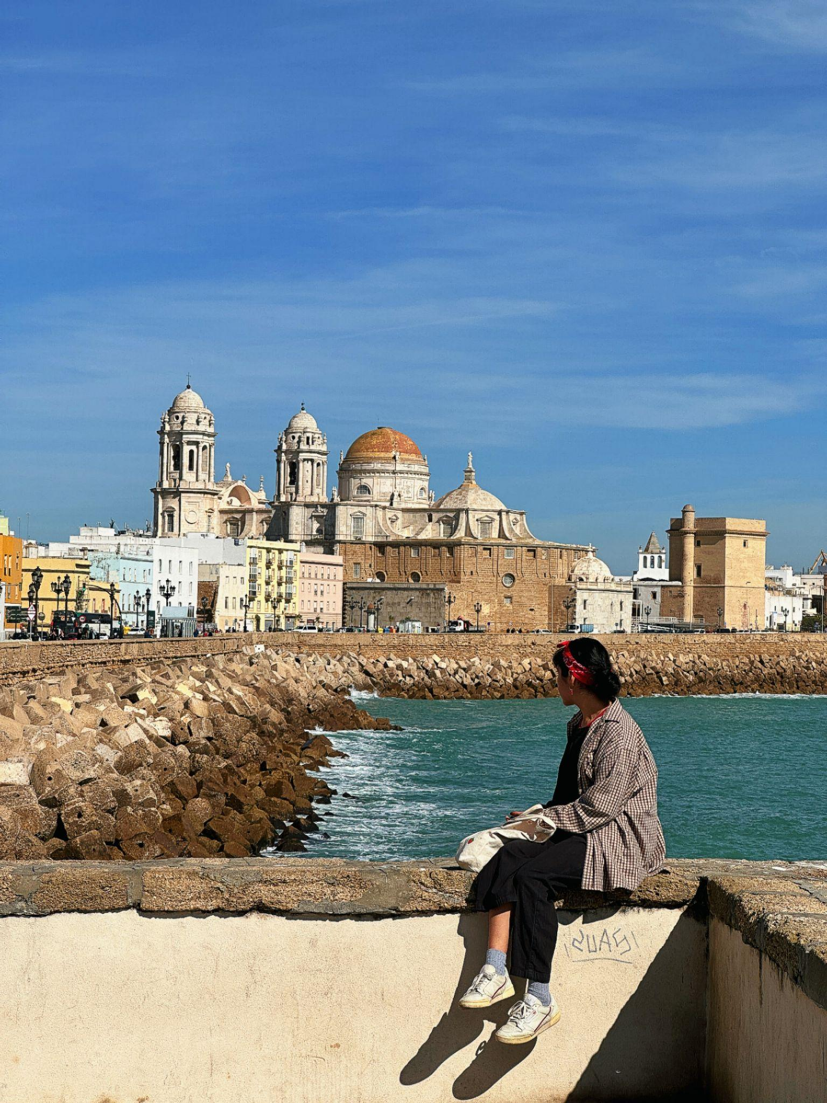
Education and International Experience
•I studied International Studies and World Languages/Culture at The University of South Florida in Tampa, FL.
•I was an English assistant in Germany, and last year I worked and lived in Cadiz.

Slide 7
Move to Madrid
•This year, I decided I wanted a city with more to offer, so I chose Madrid.
I expect to to learn more about different cultural aspects of Spanish culture, help you all with English and hope you can help me with Spanish as well.

Slide 8
Questions
•If you have any questions, feel free to ask.

Slide 9
Let me get to know you
Describe yourself in 5 words or less.
Do you think you could leave your home country to work/study?
What’s the name of the most recent song you’ve had on repeat?
What’s something you like or dislike about living in Spain?

Slide 10
Two truths & a lie
We will go around the room. Each person will say their name and 3 things about themselves. One of those things is a lie.
The rest of the class has to figure out which one is a lie.

Slide 11
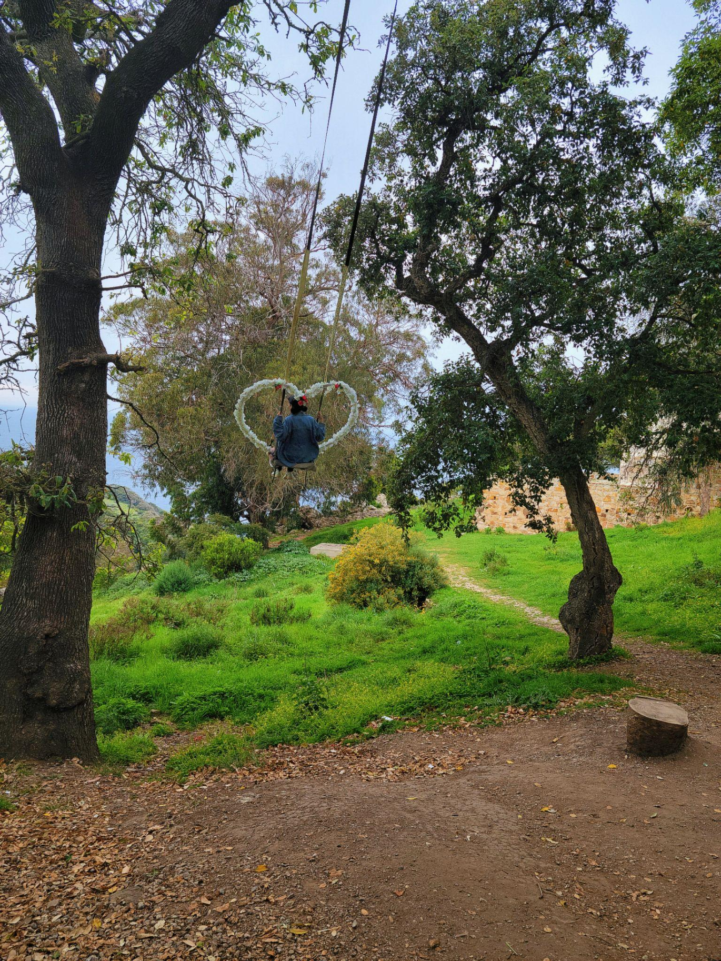
Thanks!

