Slide 1
PAST SIMPLE

Slide 2
TO BE IN THE PAST

Slide 5
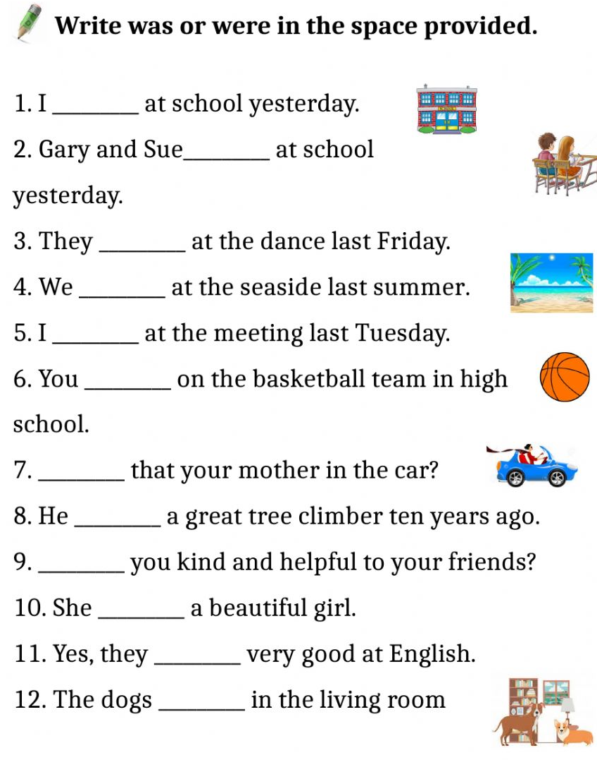
WAS
WERE
WERE
WERE
WAS
WERE
WAS
WAS
WERE
WAS
WERE
WERE

Slide 6
were
was
was
was
Wasn’t
was
Were
Weren’t
were
were
Wasn’t
were
was
were
was
was
was
were
https://www.englishexercises.org/makeagame/viewgame.asp?id=8366

Slide 8
PLAYED
ARRIVED
WATCHED
REVISED
EXPLAINED
DIDN’T PLAY
WORKED
INVITED
LISTENED
LOOKED
TRIED
RAINED
SURFED

Slide 9
Didn’t watch
Didn’t appear
Didn’t look
Didn’t close
Didn’t follow
Didn’t disappear
Didn’t wait
Didn’t recognise
Didn’t identify
Didn’t apologise
Didn’t like
Didn’t admit

Slide 10
DID THE GIRL BLUSH
DID CAROLINE LIKE
DID YOU EXPLAIN
DID MUM COOK
DID THE PUPIL ASK
DID THE GIRL ENJOY
DID YOU VISIT
DID CHARLES ARRIVE
DID THE SECRETARY CANCEL
DID MRS. CLARK
DID THE CAT SCRATCH
DID YOUR SISTER TYPE

