Slide 1
BILINGUALISM IN PHYSICAL EDUCATION (2017)
JOSÉ MARÍA RANGEL BRAVO

Slide 2
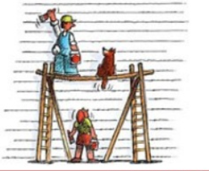
TEACHING AND LEARNING P.E. IN A BILINGUAL CONTEXT
This presentation will focus on some resourses that can be used in order to support P.E. teachers throughout scaffolding learning language techniques while teaching.
In education, scaffolding refers to a variety of instructional techniques used to move students progressively toward stronger understanding and, ultimately, greater independence in the learning process.
In the “building” industry a “scaffol” is a temporary platform.
“Scaffolding” means “to provide support”. Scaffolds gets people to a
Higher level that the may not reach without support.

Slide 3
LERNING ESTRATEGIES
EVERY STRATEGY PRESENTED IS GOING TO BE ILLUSTRATED WITH EXAMPLES DIRECTLY RELATED TO PHYSICAL EDUCATION.

Slide 4
ILUSTRATING MEANING
USING FLASHCARDS AND VIDEOS BEFORE, DURING AND AFTER THE EXPLANATIONS.
ASKING OUR STUDENTS TO MAKE SIMPLER DEFINITIONS OF THE TERMS TO LEARN.
ASK OUR STUDENTS TO GIVE EXAMPLES.

Slide 5
“DRIBBLING”
Dribbling is maneuvering of a ball by a single player while moving in a given direction, avoiding defenders' attempts to intercept the ball.
Such control may be exercised with the legs(i.e., association football), hands (basketball and handball), stick (bandy, field hockey, and ice hockey) or swimming strokes (water polo). A successful dribble will bring the ball past defenders legally and create opportunities to score.
MAKE IT EASIER
Dribbling involves changes of direction to avoid defenders with slight touches of the feet, or the stick or by bouncing a ball.

Slide 6
GUESSING FROM CONTEXT
THE STUDENTS ARE ABLE TO UNDERSTAND THE MEANING OF AN UNKNOWN WORD BECAUSE THEY UNDERSTAND THE WHOLE MEANING OF A SENTENCE. THEREFORE, IT WOULD BE UTTERLY RECOMMENDED TO INTRODUCE NEW VOCABULARY OR NEW WORDS WITHIN A FAMILIAR CONTEXT.

Slide 7
HOW TO PERFORMANCE A SOMMERSAULT
A basic somersault, also known as a forward roll, is a beginner gymnastics skill. Though the somersault is fairly straightforward, it can be used to simulate more challenging skills, such as the front flip, also known as a front somersault. If you want to know how to do a somersault, go to Step 1 to get started. (…)

Slide 8
MEMORISING
SOMETIMES IT IS EXTREMELY HARD FOR OUR STUDENTS TO LEARN BY HEART. THEREFORE, IT WOULD BE MUCH BETTER TO DEVELOP MEANINGFUL LEARNINGS CONECTING THE PREVIOUS EXPERIENCES WITH THE NEW LEARNINGS:
SHOWING IMAGES
ASKING THEM QUESTIONS
GIVING EXAMPLES AND FEEDBACK

Slide 9
HIGHTLIGHTING PRONUNCIATION FEATURES
NEW WORDS WILL BE INTRODUCED WITH AN IMAGE, THE SPELLING AND PHONETIC SIMBOLS TO LEARN THEIR PRONUNTIATION. AFTER, WE WILL ASK OUR STUDENTS TO MAKE SOME SENTENCES WITH THIS WORDS TO MAKE SURE THAT THEY HAVE UNDERSTOOD THEIR MEANING.

Slide 10
“H” HOUSE
/haʊs/

Slide 11
FOCUSING ON COLLOCATIONS, PHRASAL VERBS AND IDIOMS
EVERY DIDACTIC UNIT WE CAN TRY TO FAMILIARIZE OUR STUDENT WITH THE LEARNING OF NEW LANGUAGE TERMS, SUCH AS COLLOCATION, PHRASAL VERBS AND IDIOMS.
DURING THE SESSIONS WE COULD INTRODUCE THEM TO OUR PUPILS AND PROPOSSE CHALLENGES SO THEY CAN SHOW THEIR KNOWLEDGE (MAKING SENTENCES WITH THEM, MATCHING THE TERMS WITH THEIR DEFINITION…).
ADRENALINE JUNKIE
PEACE OF CAKE
BALL IS ON YOUR COURT

Slide 12
STRATEGIES FOR MOTIVATING LEARNERS
1.- ASK LEARNERS ABOUT THEIR OWN PREFERENCES.
It is a great way to ENGAGE them in their own learning process.
PREFERENCES FOR THE WARM UP.
(THROUGHT GAMES, WARMING ROUTINES, FREELY).
SPORTS THAT STUDENTS WOULD LIKE TO TRY. REACH AN AGREEMENT. GIVE THEM A LIMITED RANGE OF POSSIBILITIES.
(INVASION GAMES: BASKETBALL, HOCKEY, HANDBALL, RUGBY, ULTIMATE FRISBEE).

Slide 13
STRATEGIES FOR MOTIVATING LEARNERS
2.- BUILD UP LEARNERS’ CONFIDENCE.
GIVING ONLY POSITIVE FEEDBACK ON LANGUAGE USED IN AN ACTIVITY.
. That’s correct, well done!
. Yes, that’s much better!
. Fantastic! . Great! . Super!
. Really good!
. God job!

Slide 14
STRATEGIES FOR MOTIVATING LEARNERS
ENCOURAGING PUPILS TO KEEP ON TRYING WHEN HAVING DIFFICULTIES IN PERFORMING THE TASK.
. Good try!
. The only thing that really matters is to try your best!
. Wow! You are getting better.
. Never give up!
. Keep on Trying!

Slide 15
STRATEGIES FOR MOTIVATING LEARNERS
3.- MAKE SURE THAT LEARNERS UNDERSTAND INSTRUCTION. CHEKING UNDERSTANDING.
ASKING QUESTIONS:
. Are you goin to work in pairs or in groups?
. How many steps you can take?
. With how many hands do you have to catch the ball?
. Can you throw the same ball twice in a row?
. What do you have to do when you get hit?
. What do you think it is the best strategy to succeed in the game?

Slide 16
STRATEGIES FOR MOTIVATING LEARNERS
ASKING FOR EXPLANATIONS OF THE GAMES USING THEIR OWN WORDS:
. Please, could anybody explain us how to play “the sectret agent”?
. Please, I need a volunteer who reminds us of the main rules of “dodgeball”
ASKING FOR DEMOSTRATIONS:
. Please, could anybody make us a demostration of a “dynamic possition of balance”?

Slide 17
STRATEGIES FOR MOTIVATING LEARNERS
4.- GIVE LEARNERS A REASON FOR COMMUNICATING WITH ONE ANOTHER.
PROMOTE COMMUNICATION DURING THE GAMES BY INTRODUCING SPECIFIC TIMES TO DO IT:
A chasing game in which pupils have to sit down when they get tagged and are not allowed to move. They only can be saved while answering properly a question made by any of their classmates. This question could be related to the contents that the students are working in other subjects: i.e. SCIENCES.
. Could you tell me three different joints of our body?
. Would you be able to name the different types of nutrients that provide us energy?

Slide 18
INTRODUCTORY ACTIVITIES
Activities that we can use when starting a class or introducing a new language.
The teacher’s actions could be...

Slide 19
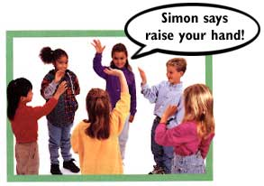
1. DOING A WARM - UP:
The teacher does a short game with students to give them energy.
SIMONS SAYS…
Teacher gives an instraction and everybody must do it (related with actions). Besides, in this moment we can also use the TPR (Total Physical Response). That is to say, giving the class a series of instructions they must follow.

Slide 20
2. SETTING THE SCENE:
It consists on showing pictures about one topic before listening to a recording about typical things there.
P.e: Show Madrid’s map and explain where it is in order to explain then the traditional games of Madrid

Slide 21
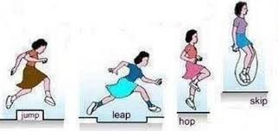
3. MIMING:
The teacher does an action with his body in order to show the meaning of a new word.
P.E: If we are explaning jumpings, we could show them the difference between hopping, jumping and leaping.

Slide 22
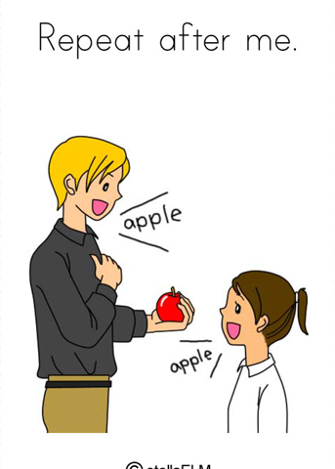
4. DRILLS:
To reinforce the new vocabulary or grammar structure, the teacher can use the choral repetition.
Moreover, it’s a perfect moment if you want them to pay attention in the correct pronunciation
TEACHER: WE ARE PRACTISING HOP. Repeat after me please: HOP, HOP (we can show the phonics cards)
And now we are going to LEAP . REPEAT, please: LEAP, LEAP.

Slide 23
5. ELICITING LANGUAGE:
It consists on asking them, for instance, different types of semantic words and write them in the board.
i.e: Can you tell me the name of sports with divided court?
Could you write them on the board, please?

Slide 24
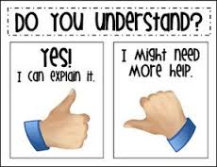
6. ASKING CONCEPT QUESTIONS:
IF YOU WANT TO CHECK IF STUDENTS HAVE UNDERSTOOD WHEN A NEW LANGUAGE HAS BEEN USED.
- Is it clear what I want you to do? .-
-Tell me how it works using your own words.

Slide 25
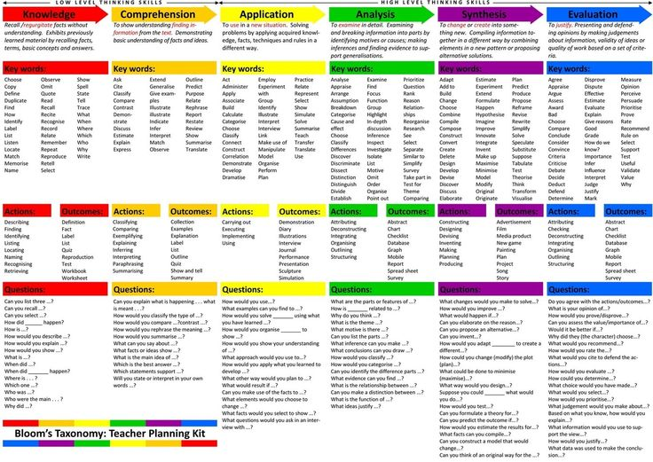
BLOOM’S REVISED TAXONOMY.
It is a strategy in which the TALK is used as a TOOL for THINKING.
THROUGHOUT the P.E. sessions we
can design specific times to talk and give
the pupils the opportunity of DEVELOPING
their COMUNICATION and thinking skils.
Thus, they will be able to show their
knowledge, comprehension, application,
Analysis, synthesis or evaluation
In relation to the P.E. contents.

Slide 26
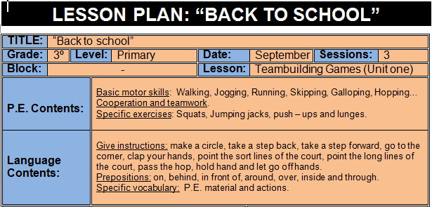
SAMPLE OF A P.E. CLIL SESSION USING BLOOM’S REVISED TAXONOMY QUESTION STEM.

Slide 27
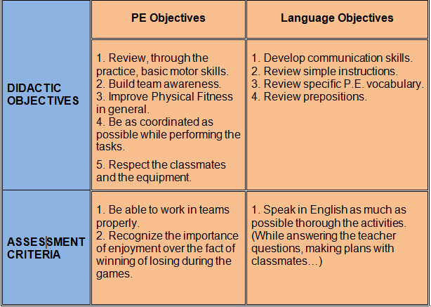

Slide 28
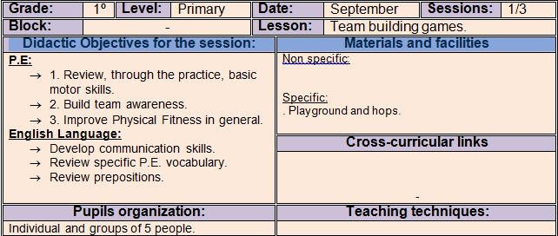
SESSION 1:

Slide 29
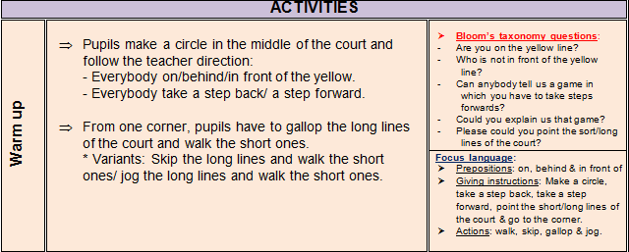
WARM UP:

Slide 30
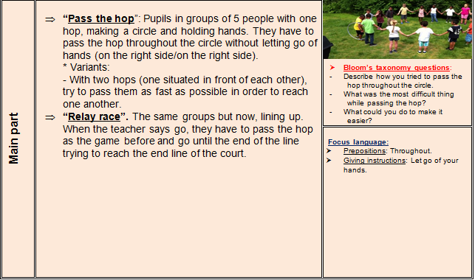
MAIN PART:

Slide 32
COOL DOWN:

