Slide 1
PEN NAMES
of Famous Female Authors

Slide 2
Here’s a brief timeline of some important female authors who have used male pen names or initials to overcome sexist readers and publishers.

Slide 3
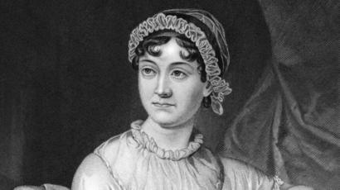
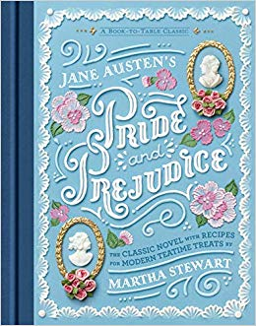
1811 - jane austen
PEN NAME: A lady
FAMOUS WORKS:
‘Emma’
‘Pride and Prejudice’
‘Sense and Sensibility’

Slide 4
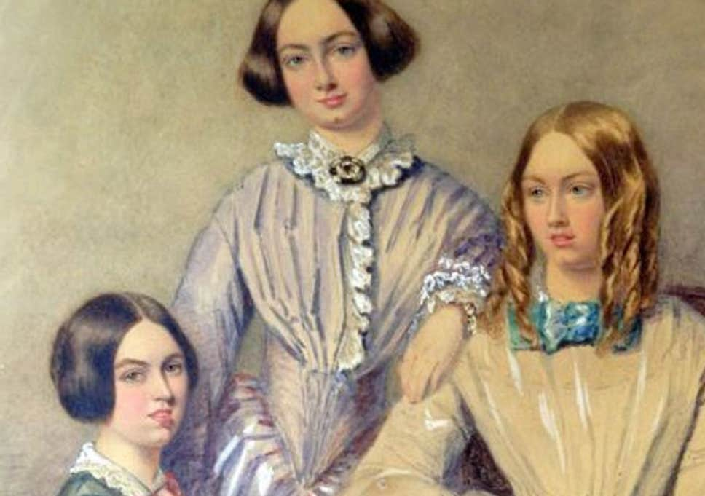
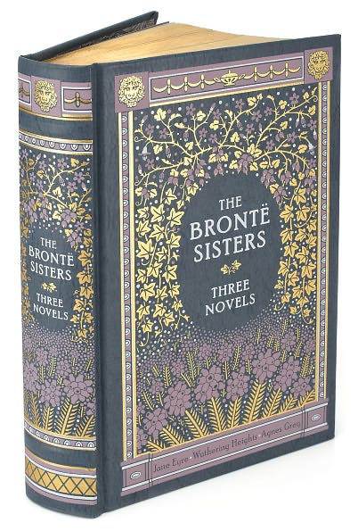
1846 – the bronte sisters
PEN NAMES:
- CHARLOTTE: Currer Bell
- EMILY: Ellis Bell
- ANNE: Acton Bell
FAMOUS WORKS (in order):
‘Jane Eyre’
‘Wuthering Heights’
‘The Tenant of Wildfell Hall’

Slide 5
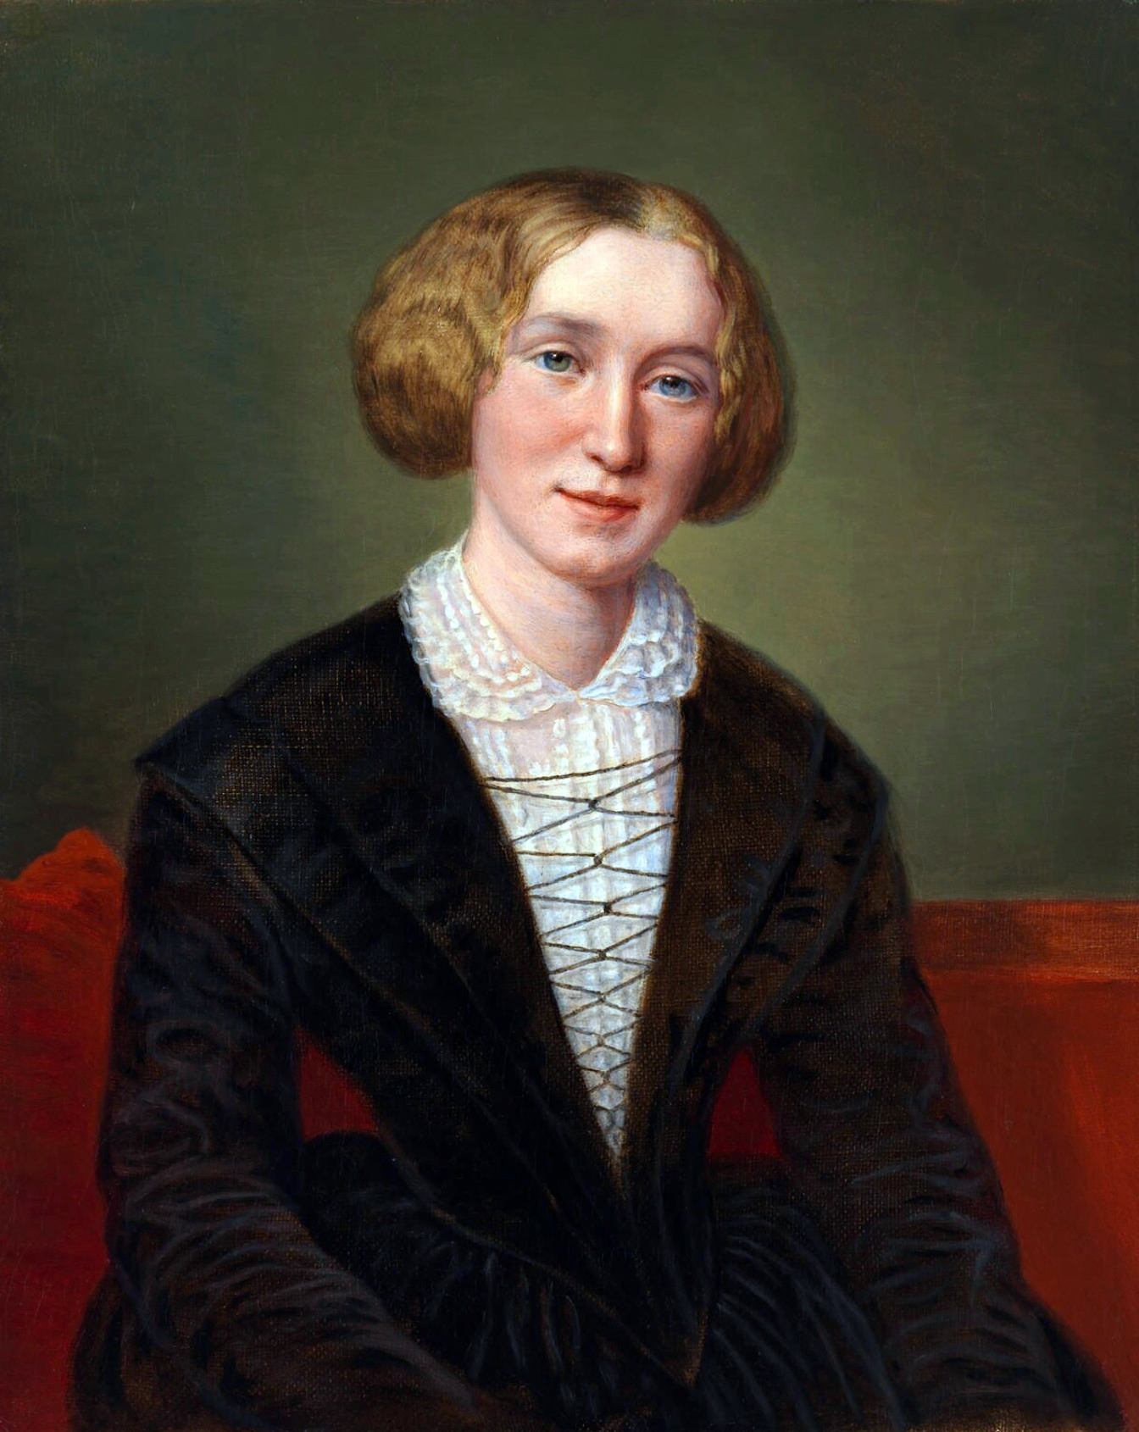
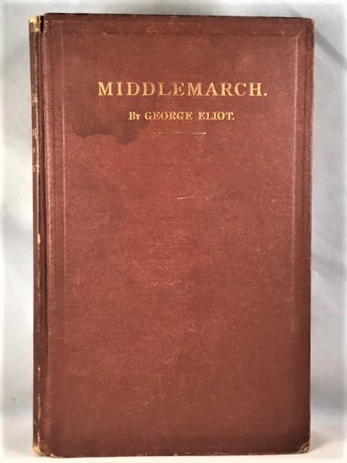
1856 – Mary ann evans
PEN NAME: George Eliot
FAMOUS WORK:
‘’MiddleMarch’

Slide 6
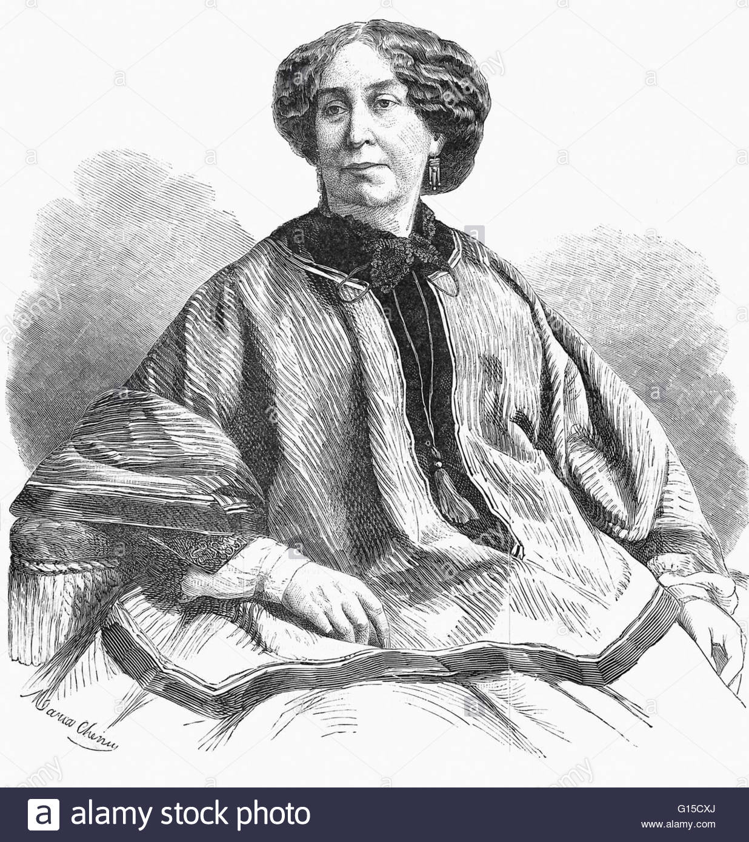
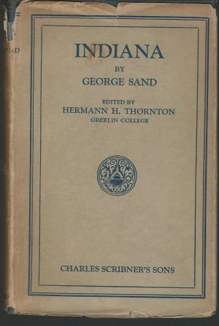
1832 – amantine-lucile-aurore dudevant
PEN NAME: George Sand
FAMOUS WORKS:
‘Valentine’
‘Indiana’

Slide 7
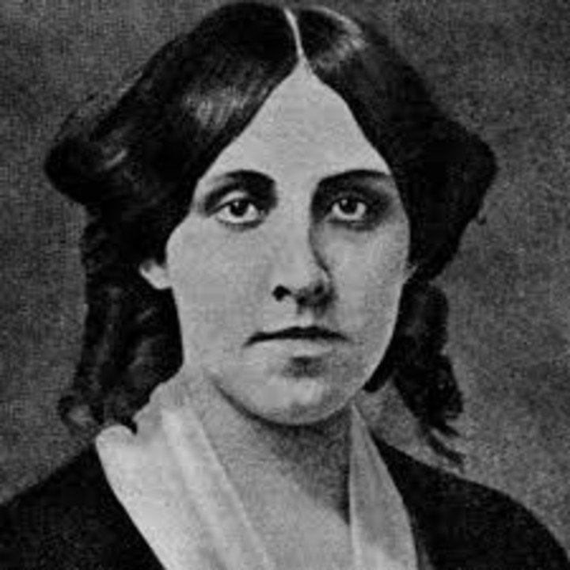
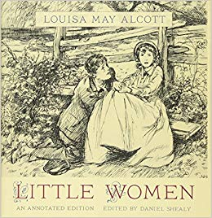
1865 – louisa may alcott
PEN NAME: A. M. Barnard
FAMOUS WORK:
‘Little Women’

Slide 8
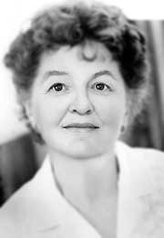
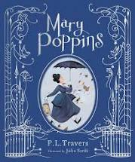
1934 – Pamela lyndon travers
PEN NAME: P.L. Travers
FAMOUS WORK:
‘Mary Poppins’

Slide 9
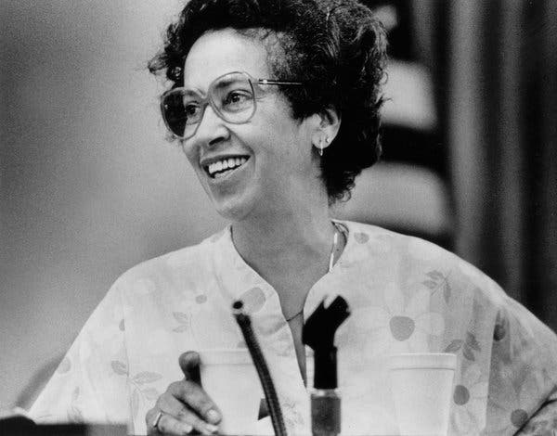
1984 – Joan Cooper
PEN NAME: J. California Cooper
FAMOUS WORKS:
‘A piece of mine’
‘Family’

Slide 10
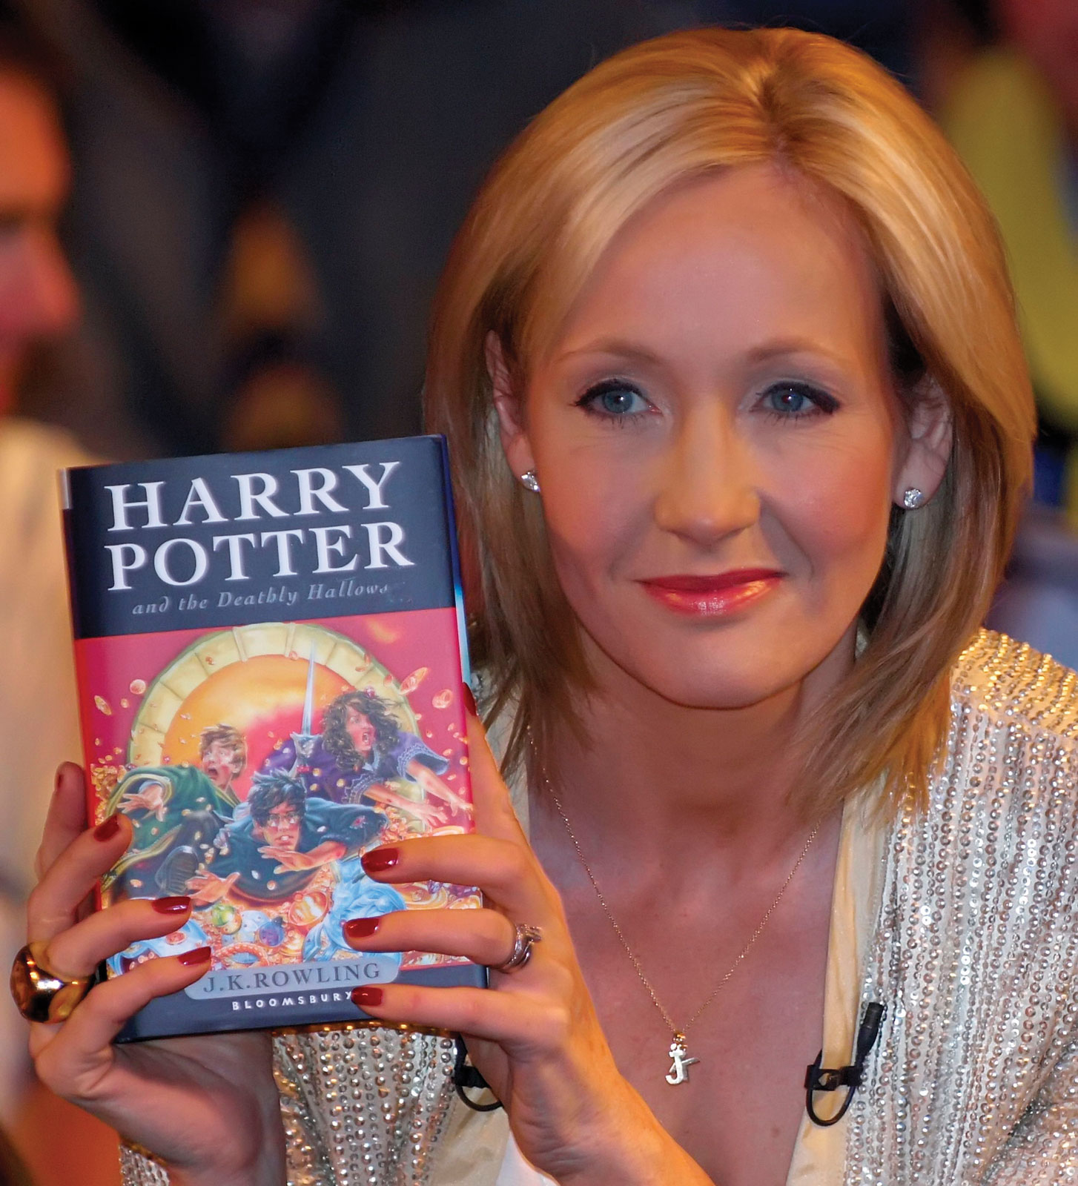
1997 – Joane Rowling
PEN NAME: J.K. Rowling, Robert Galbraith
FAMOUS WORKS:
‘Harry Potter’ as J.K Rowling
‘The Cuckoo’s Calling’ as Galbraith

