Slide 1
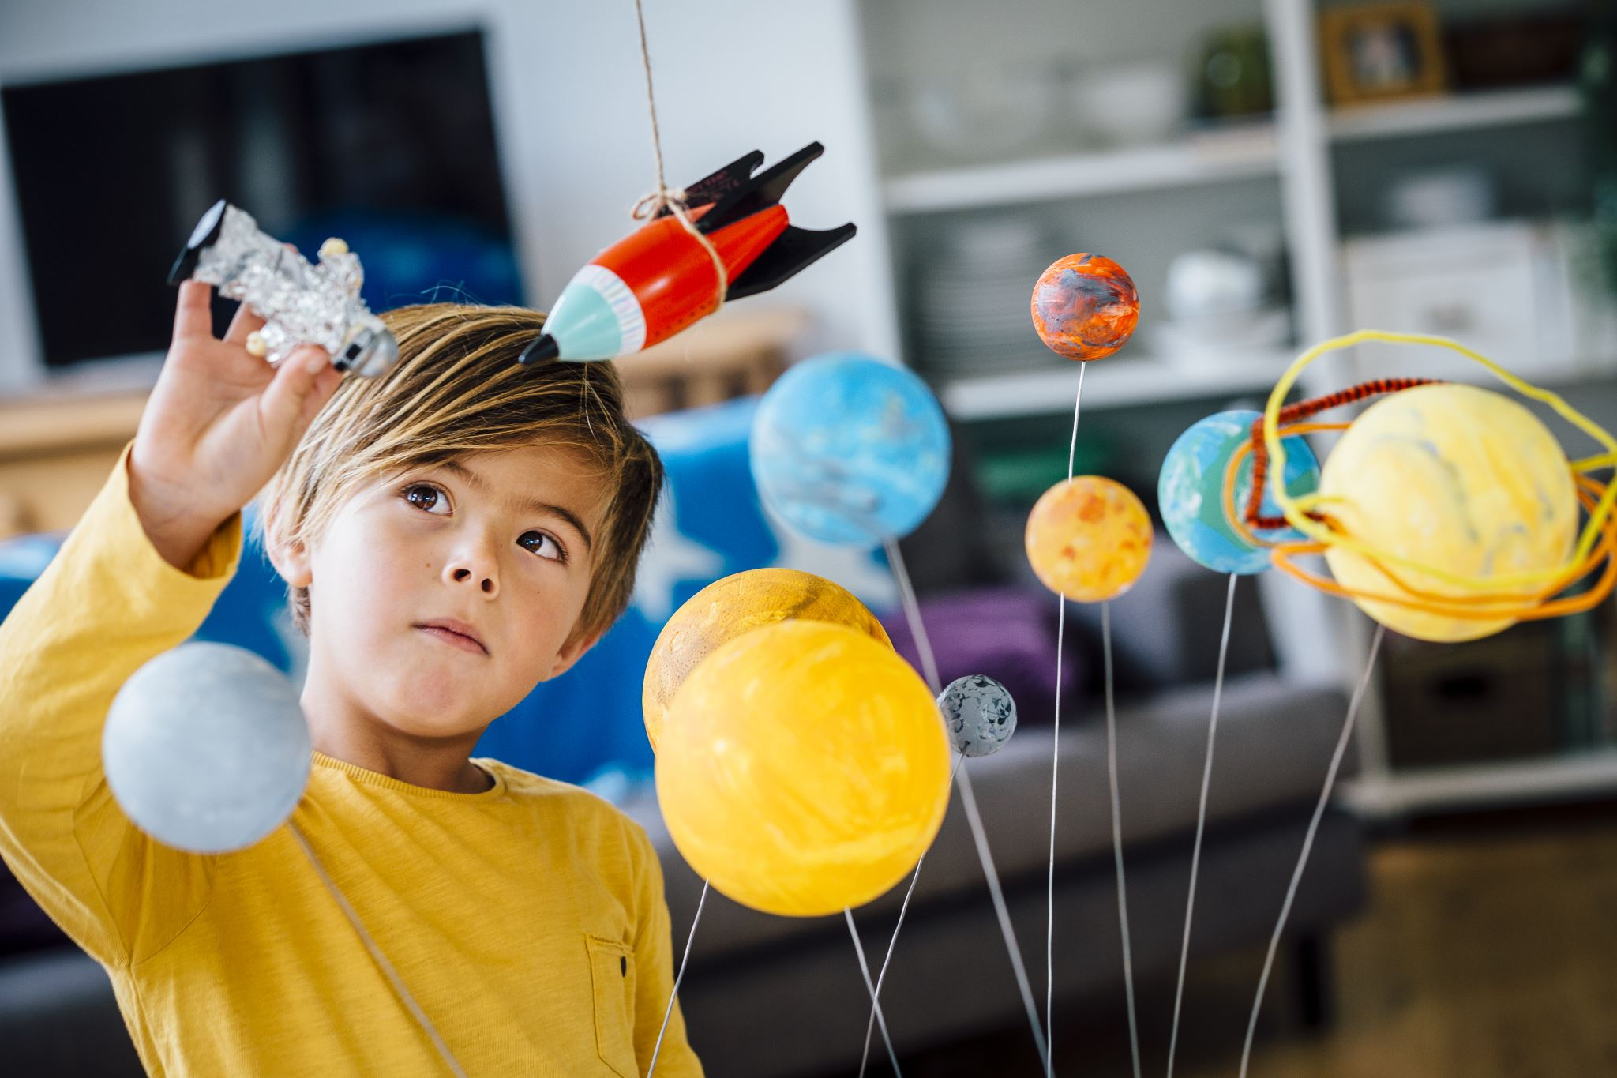
INSTRUCCIONES PARA REALIZAR TU ESPACIO DE ACTIVIDADES CON RITMOS DISTINTOS DE APRENDIZAJE
Read carefully what you have to do in each activity.
Follow the numbers.
While watching the video, stop it and write down in your notebook the most important facts.
It is compulsory to do up to activity 3.
If you can not do more activities, go to fuel and listen to the video before you finish.
Enjoy the activities.

