Slide 1
SEPTIEMBRE 2017
 |  |  |  | 1 | 2 | 3
4 | 5 | 6 | 7 | 8 | 9 | 10
11 | 12 | 13 | 14 | 15 | 16 | 17
18 | 19 | 20 | 2 | 22 | 23 | 24
25 | 26 | 27 | 28 | 29 | 30 | 1 OCTUBRE
EVELYN
DAVID
LUCÍA A.
OTOÑO

Slide 2
OCTUBRE 2017
2 | 3 | 4 | 5 | 6 | 7 | 8
9 | 10 | 11 | 12 | 13 | 14 | 15
16 | 17 | 18 | 19 | 20 | 21 | 22
23 | 2 | 25 | 26 | 27 | 28 | 29
30 | 31
HALLOWEEN

Slide 3
NOVIEMBRE 2017
 |  | 1 | 2 | 3 | 4 | 5
6 | 7 | 8 | 9 | 10 | 11 | 12
13 | 14 | 15 | 16 | 17 | 18 | 19
20 | 21 | 22 | 23 | 24 | 25 | 26
27 | 28 | 29 | 30
CARLOS

Slide 4
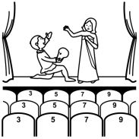
DICIEMBRE 2017
 |  |  |  | 1 | 2 | 3
4 | 5 | 6 | 7 | 8 | 9 | 10
11 | 12 | 13 | 14 | 15 | 16 | 17
18 | 19 | 20 | 21 | 22 | 23 | 24
25 | 26 | 27 | 28 | 29 | 30 | 31
INVIERNO
FESTIVAL
DE
NAVIDAD
Ensayo general
NOCHEBUENA
DÍA DE NAVIDAD
SANTOS INOCENTES
NOCHEVIEJA

Slide 5
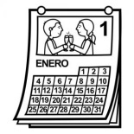
ENERO 2018
1 | 2 | 3 | 4 | 5 | 6 | 7
8 | 9 | 10 | 11 | 12 | 13 | 14
15 | 16 | 17 | 18 | 19 | 20 | 21
22 | 23 | 24 | 25 | 26 | 27 | 28
29 | 30 | 31
AÑO NUEVO
MONTSE

Slide 6
FEBRERO 2018
 |  |  | 1 | 2 | 3 | 4
5 | 6 | 7 | 8 | 9 | 10 | 11
12 | 13 | 14 | 15 | 16 | 17 | 18
19 | 20 | 21 | 22 | 23 | 24 | 25
26 | 27 | 28
ARIANA
NEIS

Slide 7
MARZO 2018
 |  |  | 1 | 2 | 3 | 4
5 | 6 | 7 | 8 | 9 | 10 | 11
12 | 13 | 14 | 15 | 16 | 17 | 18
19 | 20 | 21 | 22 | 23 | 24 | 25
26 | 27 | 28 | 29 | 30 | 31 | 1 ABRIL
PRIMAVERA
DÍA DEL
PADRE
EVA
HÉCTOR

Slide 8
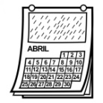
ABRIL 2018
2 | 3 | 4 | 5 | 6 | 7 | 8
9 | 10 | 11 | 12 | 13 | 14 | 15
16 | 17 | 18 | 19 | 20 | 21 | 22
23 | 24 | 25 | 26 | 27 | 28 | 29
30
LUCÍA P.

Slide 9
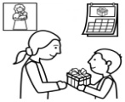
MAYO 2018
 | 1 | 2 | 3 | 4 | 5 | 6
7 | 8 | 9 | 10 | 11 | 12 | 13
14 | 15 | 16 | 17 | 18 | 19 | 20
21 | 22 | 23 | 24 | 25 | 26 | 27
28 | 29 | 30 | 31
DÍA DE
LA MADRE
RUBÉN

Slide 10
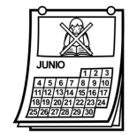
JUNIO 2018
 |  |  |  | 1 | 2 | 3
4 | 5 | 6 | 7 | 8 | 9 | 10
11 | 12 | 13 | 14 | 15 | 16 | 17
18 | 19 | 20 | 21 | 22 | 23 | 24
25 | 26 | 27 | 28 | 29 | 30
VERANO

