Slide 1
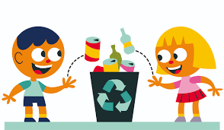
How can I change my school?
RECYCLING
2nd grade of Primary Education

Slide 2
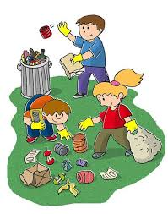
Objectives
Learning Objectives
To understand the importance of recycling.
To carry out an observation task in the playground.
To use a data table to organize information.
To take care of the environment around us.
To research about school cleaning and how to improve it.
Literacy
To use recycling vocabulary such as plastic, glass, cardboard,...
Make predictions and suggestions: I think that..../ I can....

Slide 3
Learning Activities
To carry out an observation task of a dirty playground to write down on table what they have found.
Using this information to group and classify these elements into the correct container in order to recycle.
To compare the data results using graphs.
To make advertisements for the rest of the school, to use as less containers as possible for breakfast. In order not to make rubbish in the playground.

Slide 4
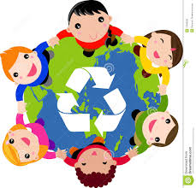
Success Criteria
I can identify a dirty or clean playground.
I recognize the vocabulary.
I can classify recyling objects in the correct container.
I can make predictions about our investigations
I can compare the graph information and make suggestions

Slide 5
Lesson Organization
Grouping | Students | Teacher | Material/App
Whole class | Students watch a video about recycling | Teacher explains that children in class are going to help the school to maintain the environment clean. We will make the presentation with this video. | https://www.youtube.com/watch?v=OasbYWF4_S8
Groups | Students compare two pictures of a playground. | Teacher shows a picture of a dirty playground and a clean playground Students talk together to explain the differences between them and decide which one they prefer. The teacher aks the groups why they make this choice. | Picture 1.
Groups | Students go to the playground after the break to observe what they can find there. | Teacher gives students a table in which they have to complete with their observations. This activity will be done it again one week later, after the research | Table 1.

Slide 6
Whole class | What can we do to change the rubbish in the playground? | The students suggest what we could do to find less rubbish in the playground | To elaborate an advertisement for the rest of the classes
Groups | Students go back to the class and make a graph with the data the have taken and the help of the teacher. Students takes pictures of the playground using a scholl tablet every day during the lenght of the experiment. | Teacher ask the students group by group (4 groups) the results, for example group one the result of organic, and so on with the rest of the data and elaborate on the blackboard a graph using an app. In this activity our students will make graphs to obtain information. To analyse the results of the reseach | https://nces.ed.gov/nceskids/createagraph/ Our result
Whole class | Students organize the ítems into the correct containers. | Teacher gives students a table in which they have to cot out and put the items in the correct containers. | Table 2.
Whole class | Students fill autoevaluation sheet. | Teacher gives a sheet. | Table 3.
Whole class | Students play a game about recycling. | Teacher explain the game and students play. | http://www.bbc.co.uk/schools/barnabybear/games/recycle.shtml

Slide 7
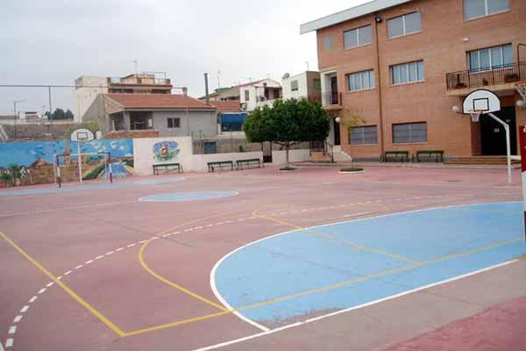

Slide 8
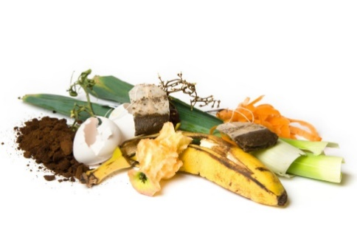
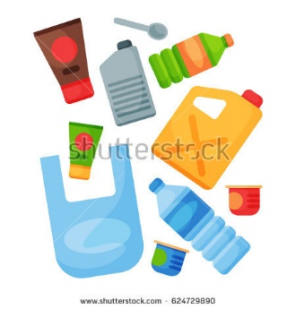
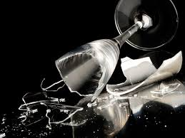
WHAT DO YOU FIND IN YOUR PLAYGROUND?
ORGANIC | PLASTIC/BRICK | PAPER | GLASS

Slide 9
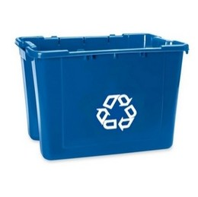
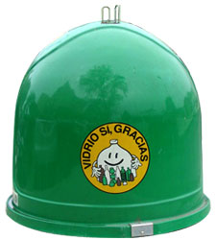
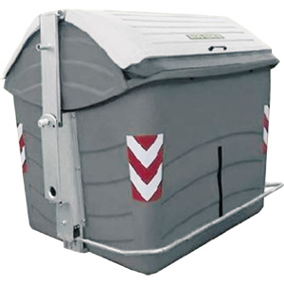
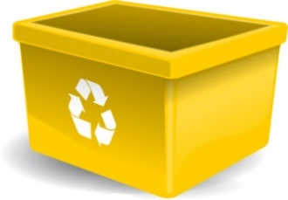
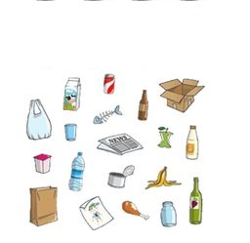
Things we can recycle

Slide 10
Self/peer assessment
Recycling in my school | Self-assessment |  |  | Peer assessment
I can….
Identify the reality of recycling in the school and in the planet
Classify the rubbish in the correct container
Use a data table to organize the information
Use a graph and compare the results
Explain my own conclusion

Slide 11
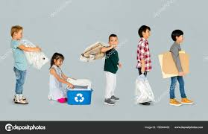
Conclusion
Group name: __________________________
Is your prediction right?
What changes can you see?
How do you feel about the changes?

